Slide 1
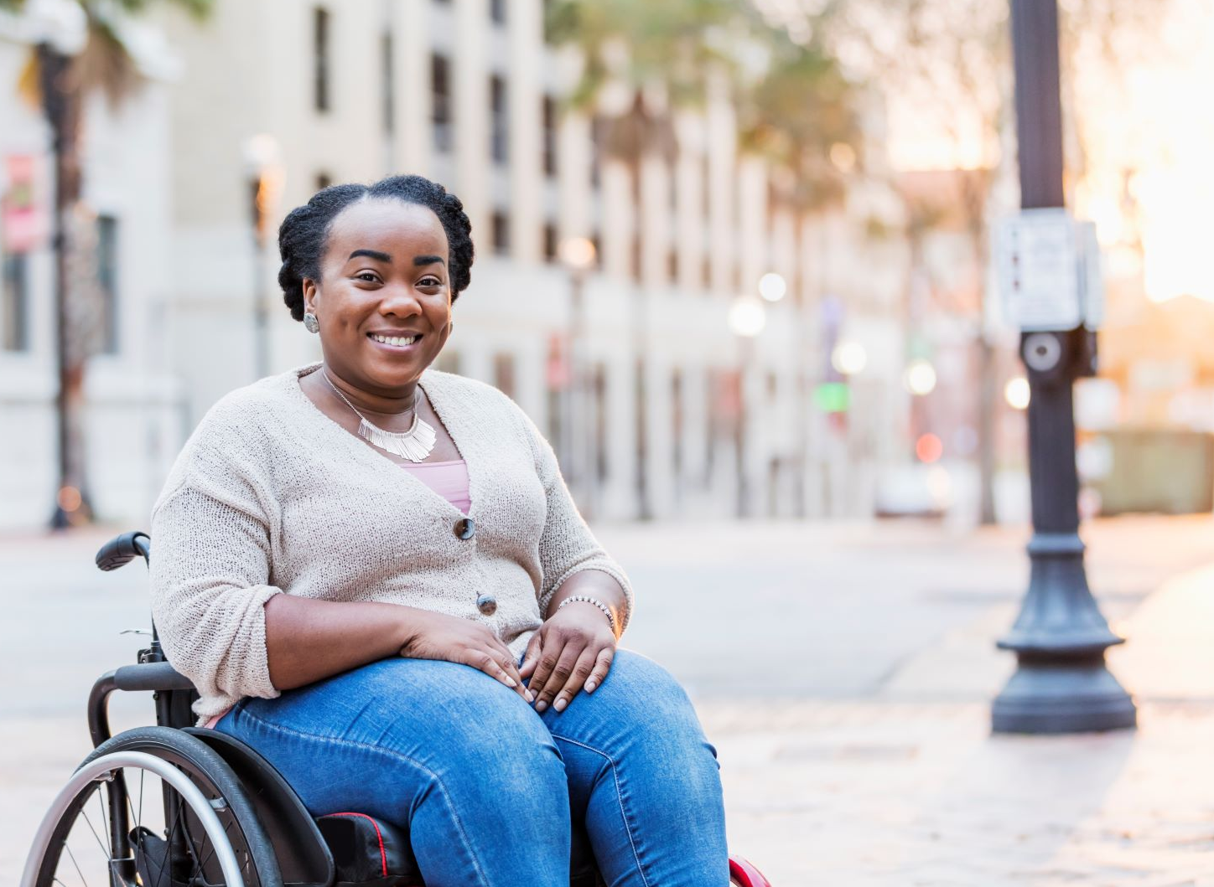
Accessible Voting 101
Shane Schoeller, Greene County Clerk, MACCEA President
Leigh Anne Haun, Missouri Developmental Disabilities Council (MODDC) Project Coordinator
Notes:
We can each provide some more information about ourselves- any bio information we want to use to introduce ourselves as well as professional background information

Slide 2
What we hope you leave here with:
GOAL: Everyone can cast a private and independent ballot
General awareness of election day procedures and those leading up
Barriers we are all facing and how to come to solutions together
How to partner with your Election Authorities in advocacy
Legislative Update
Notes:
SHANE
Why we wanted to do this presentation with everyone here today:
Demystify the process and maybe learn something/ a new perspective
Show how we can partner to improve accessibility
Our angle is from the perspective of who you support and how you can support them in the voting process. But, you are a voter too! So, please use this opportunity to understand your role in engaging in the voting process. You are a stakeholder in disability issues and a powerful voice.

Slide 3
Why the disability vote is important
Elected officials have a direct impact on healthcare, education, transportation, employment and all facets of life.
The Disability Vote is a powerful vote
38 Million citizens with disabilities eligible to vote in 2020 elections, 1/6th of the Electorate (Source: Rutgers Fact Sheet)
Notes:
LEIGH ANNE
The importance of voting
Policymakers are key in the services and supports needed

Slide 4
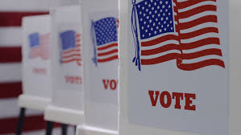
What are some common barriers self-advocates encounter at the polls?
Notes:
LEIGH ANNE
We can hopefully get some crowd engagement to shout out/offer some common barriers they or those they serve have faced in the voting process
Common questions?
Specific examples of barriers
I still don’t understand…

Slide 5
Common Barriers to the Voting Process
Can I vote Absentee? Permanent Absentee? What is the difference?
Curbside voting sign and information not visible to voters
Can someone assist me in voting? If so, who?
Voting Equipment not available and, if it is, no one knows how to use it.
Photo ID
Constantly Changing Voting Precinct/Transportation
Notes:
LEIGH ANNE
These are some of the common barriers we hear about from self advocates and advocates- so we are going to touch on each of these. We are going to offer how self advocates experience this and also how election officials experience/navigate these situations.
This presentation is by no means a comprehensive list, but wanted to hit some that we hear most often.
We will hopefully cover them- but if we hear some things that we don’t already have in our slides- we will try to weave it in towards the end or follow up individually

Slide 6
Absentee Voting
What’s the rule?
Registering for Permanent Absentee
Permanent, physical disability
Will receive a notice prior to every election that they are eligible
Automatically receive an absentee ballot in the mail prior to each election
How?
Mail-in
Notary (if you are ill or sick, does not require a notary, reason #2)
Voting absentee at a single election
Absence on Election Day where you are registered, Religious belief or practice, incapacity or confinement due to illness or physical disability, employment as an election authority, or incarceration
Notes:
LEIGH ANNE
Things to keep in mind from a clerk perspective on this- understanding both sides of a potential barrier
If someone is filling out registration form through the phonebook, so make sure to bring your ID
This is to protect YOU (may point to Shane during this part)
Birth certificate, other proof of united states citizenship, drivers licesne

Slide 7
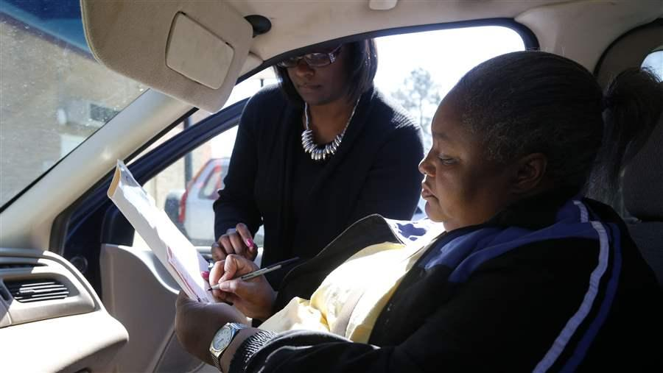
Curbside Voting
The Rule
Voters with limited mobility can vote “curbside” or outside polling place
Ask someone to go in and ask poll workers to bring ballot to you
What Happens Sometimes
Voters don’t know they can request this
Phone Number to call for curbside is not visible
How you can advocate
Notes:
SHANE
What can voters do if the signs aren’t visible for curbside voting? Call EA?
Share EA perspective: you instructed them to put out signs, and they don’t, Or they put them on tinted windows, etc.

Slide 8
Voter Assistance
What’s the rule?
If you cannot read, write or are blind or have another physical disability, you can bring in a person to help you vote.
Assistant does not have to be over the age of 18 or be a registered voter
A bipartisan team of poll workers could assist upon request
Guardianship and Voting
Notes:
SHANE
Go ahead and cast ballot if they are unsure. If they want to have their voting rights restored, contact MO P&A

Slide 9
Voter Assistance: Avoiding Coercion
Notes:
SHANE
Will set up/explain this video and we will play- working with comms person and added subtitles
Explain that this is intended for training for election workers. But, it sets up how to assist voters if that is what you are doing.

Slide 10
Guardianship Question?
Missouri Protection and Advocacy:
Phone: 800-392-8667
Relay MO (TDD): 800-735-2966
Fax: 573-659-0677
Email: app.unit@mo-pa.org
Notes:
LEIGH ANNE
Go ahead and cast ballot if they are unsure. If they want to have their voting rights restored, contact MO P&A

Slide 11
Voting Equipment
What’s the rule?
State and Local Elections do NOT require accessible voting machine
Greene County Example: use in every election
All federal elections require an accessible voting machine
May not be at every precinct, but officials need to let you know where they are going to be
If they aren’t there, typically because of funding
What happens sometimes
Notes:
SHANE
Federal law requires a voting machine- is this at one location?
State and local elections are not required to have voting machines, but most do-
Lack of comfort on BOTH sides with using the equipment

Slide 12
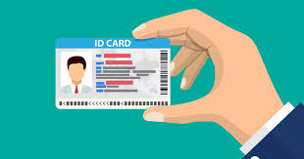
Photo ID
What’s the rule?
Currently you can bring:
ID issued by the state or US Government
ID issued by local election authority
ID from university, college, vocational or technical school
Current utility bill, bank statement, paycheck, government check or other government document that contains the name and address of the voter
What if I forget my ID?
Notes:
LEIGH ANNE
How can y
you request a new voter ID card if you misplaced it? How do you get updated voter IDs card?
Request one from local election authority
Ask for “proper form of identification” vs “valid driver’s license”

Slide 13
Changing Precinct/Transportation
Voting Precincts 101:
May request accessible polling place assignment if your precinct is not accessible
The Challenge with voting locations
How to work together to find the right precinct
Notes:
SHANE
How can people know this? Saw on your website, but is this universal for all clerks?
It will be on the voter ID card that you have- if it changes, you will be given notice
Press release to tell voters if it has been changed
How to find your voting precinct
Challenges EA encounters when securing voting precincts:
Businesses closing or changing ownership
COVID
Schools not being “friendly”

Slide 14
So what can we do?
Be Informed
Build Relationships
Advocate
Notes:
LEIGH ANNE
What CAN we do? How do we come together to increase access and knowledge?

Slide 15
Be Informed: Support Star
Charting the LifeCourse has the Support Star Tool
Fill this out to make a plan to vote
Coming Soon: Support Star sample for voting
Notes:
LEIGH ANNE
Share CtLC resource Voting Star

Slide 16
Build Relationships: How to Partner with Your EA
Build Relationships!
Look up your election authority
Just stop by/arrange a visit
Set up a phone/zoom call
Ask for demonstration of voting machines for yourself or for your group
Volunteer for Elections
Voice your concerns and offer solutions
Notes:
SHANE
We are all partners in this advocacy- we need to approach voting as a group effort/partnership
What you can do if you really are hitting a wall/feel like you aren’t getting the support needed, or, worst case scenario- a law isn’t being followed

Slide 17
Election Protection Hotline
Notes:
Leigh Anne
If you or those you support truly are not getting the support they need and you fear that a law isn’t being followed, you can call this number.
Frame positively
Shane: want to know sooner rather than later– if this is the quickest way

Slide 18
Legislative Update: HB 1878
Removal of problematic language- MACCEA
No Outside funding/private funding to EAs
Strict Photo ID
Can cast provisional ballot
No Excuse Absentee Voting
Only in person
Voting Machines
Removes direct recording touch screens
Direct Recording Electronic Voting Machine vs Ballot Marking Device
Notes:
Headed to the Governor’s desk to sign, passed last week.
Some key points in the bill the disability advocates have talked about:
Shane- highlight MACCEAs advocacy on removing “only disabled person” from the voting machine language
-LAH- no outside funding to EAs, strict photo ID, no excuse absentee voting (in person only), restricting paid registration to vote
Shane- talk about accessible voting machine concerns and maybe ease some tension on this one- it is only DREs and not BMDs
IF these provisions stand and are signed by governor, they would not go into effect until August 28th

Slide 19
Legislative Update: HB 1878
If you want to express your thoughts on this bill, you can contact the Governor’s office at:
Phone: 573-751-3222
Fax: 573-751-1495
Submit an email on their website
Subject: HB 1878
Notes:
Headed to the Governor’s desk to sign, passed last week.
Some key points in the bill the disability advocates have talked about:
Shane- highlight MACCEAs advocacy on removing “only disabled person” from the voting machine language
-LAH- no outside funding to EAs, strict photo ID, no excuse absentee voting (in person only), restricting paid registration to vote
Shane- talk about accessible voting machine concerns and maybe ease some tension on this one- it is only DREs and not BMDs
IF these provisions stand and are signed by governor, they would not go into effect until August 28th

Slide 20
Leadership and Advocacy Opportunities
Missouri Voter Protection Coalition
Local Leadership Opportunities
Share your stories with policymakers
Look up your state and federal policymakers
Meet with LOCAL policymakers
Notes:
Leigh Anne
Informed leaders make change happen

Slide 21
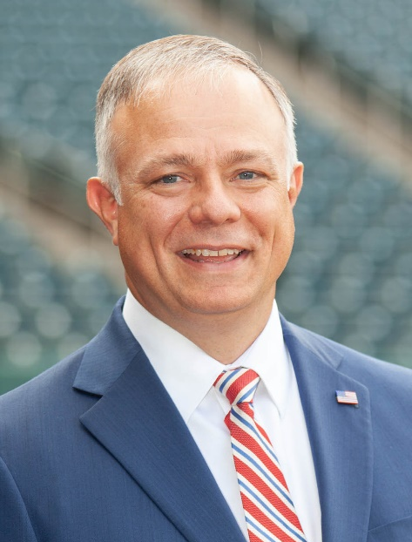
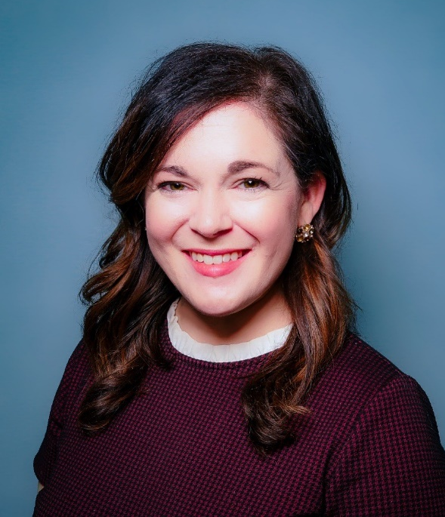
Let’s Connect!
Shane Schoeller
417-868-4060
countyclerk@greenecountymo.gov
Leigh Anne Haun
573-526-6770
lhaun@moddcouncil.org
Notes:
Shane- what information, if any do you want to include here?

