Slide 1
Volunteers
The Best Human Resource
Dr. Alex Cobb

Slide 2
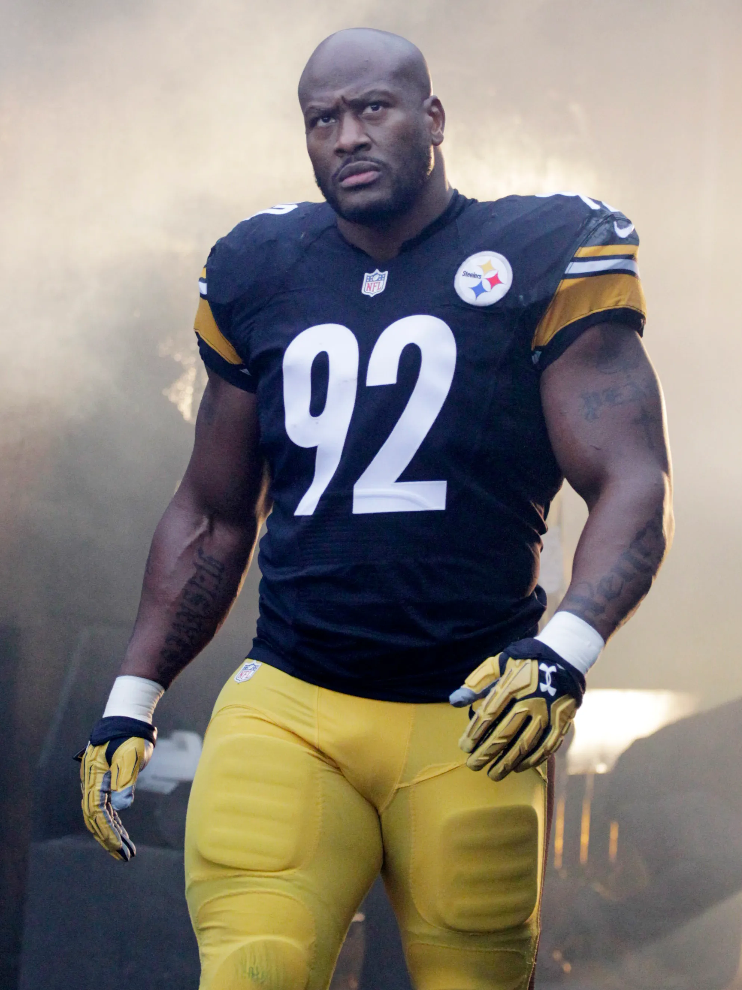
One Volunteer Story:

Slide 3
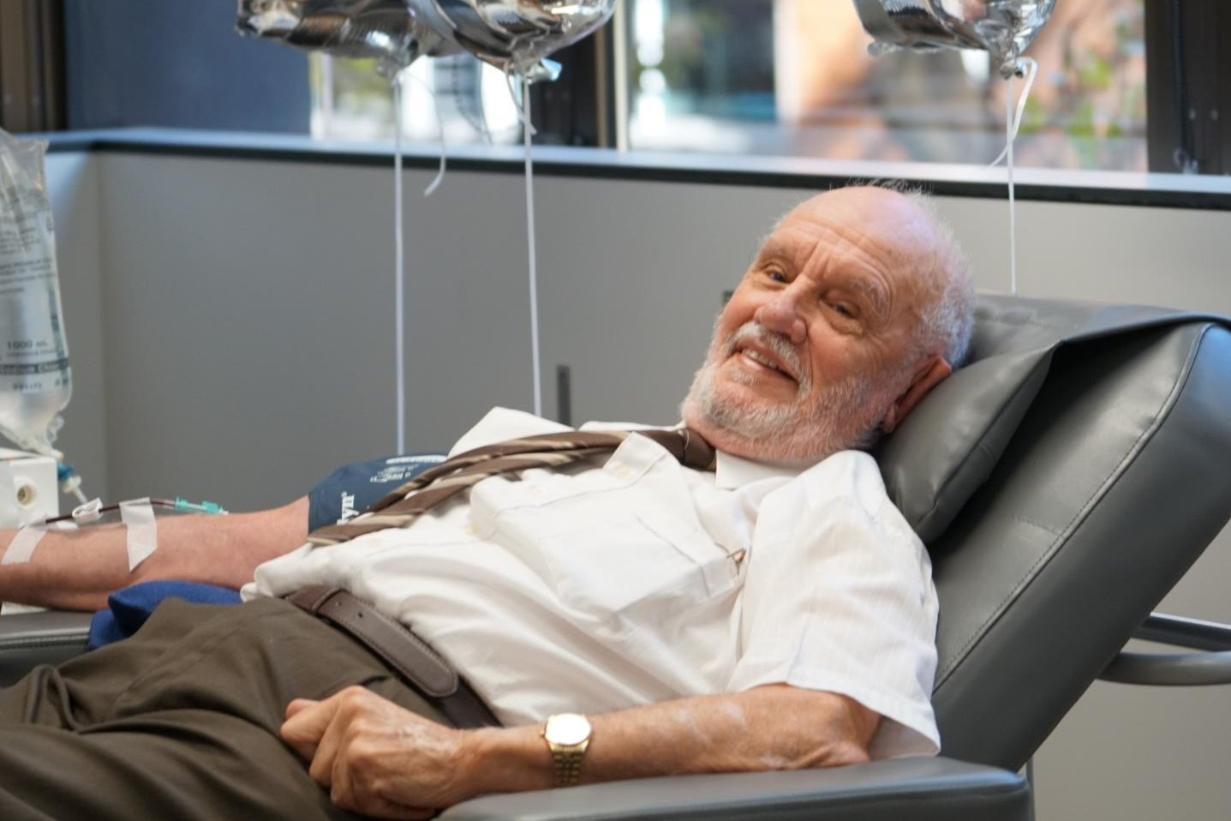
One Volunteer Story:

Slide 4
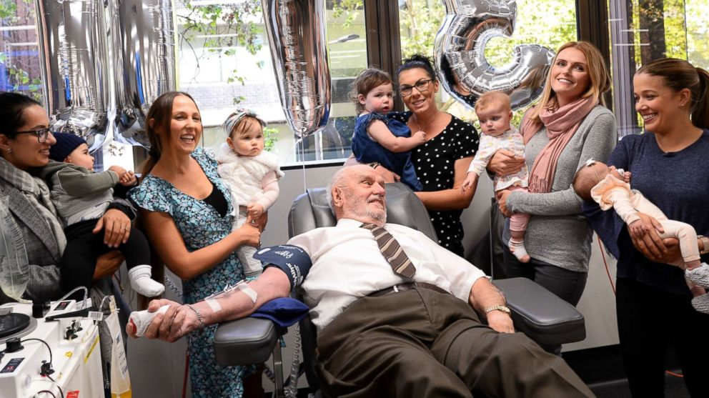
One Volunteer Story:

Slide 5
One Volunteer’s Worth:
One volunteer can make a HUGE difference!

Slide 7
Goal For Today:
Equip you to:
Gain a volunteer program
Obtain volunteers
Train volunteers
Maintain/Retain volunteers

Slide 8
Goal For Today:
Equip you to:
Gain a volunteer program
Obtain volunteers
Train volunteers
Maintain/Retain volunteers
=
Attain A Quality Volunteer Program

Slide 9
Goal For Today:
Equip you to:
Gain a volunteer program
Obtain volunteers
Train volunteers
Maintain/Retain volunteers
≠
A Migraine

Slide 10
Gain A Volunteer Program

Slide 11
Gain A Volunteer Program
A solid volunteer program begins by looking inside, not outside.

Slide 12
Gain A Volunteer Program
1. Why do we want and need volunteers?
2. Where and when will we use volunteers?
3. Who will oversee volunteers and volunteer processes?
4. What is required for volunteers? Of our organization?
5. How will you manage the entire volunteer program?

Slide 13
Gain A Volunteer Program
Volunteers are like an investment portfolio; you want to diversify.

Slide 14
Obtaining Volunteers

Slide 15
Obtaining Volunteers
Resources:
www.volunteermatch.org
www.justserve.org
www.volunteerozarks.com

Slide 16
Obtaining Volunteers
Keys To Recruitment:
Respond Immediately
Listen Intently
Communicate Clearly
Promote Continuously

Slide 18
Training Volunteers

Slide 19
Training Volunteers
What are different types of training?
What are different topics for training?

Slide 20
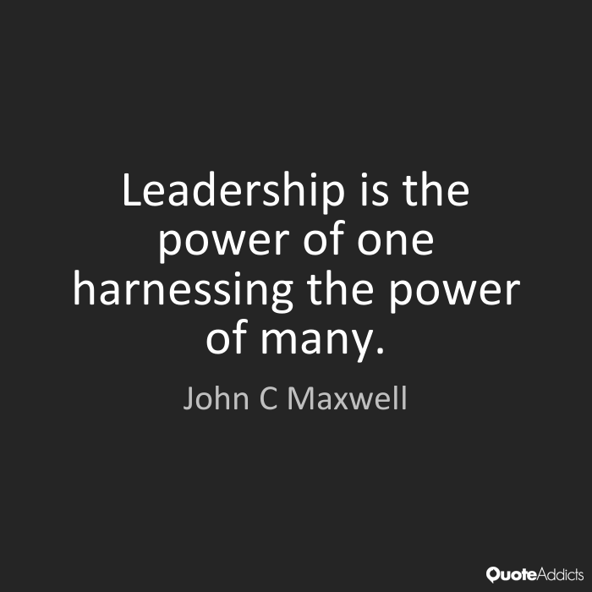

Slide 21
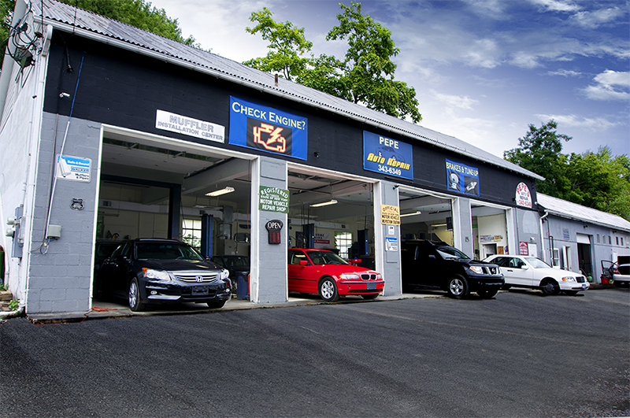
Maintaining/Retaining Volunteers

Slide 22
Maintaining/Retaining Volunteers
How to properly maintain:
Check-In with individuals
Calibrate as a group
Celebrate as an organization
Champion with everyone

Slide 23
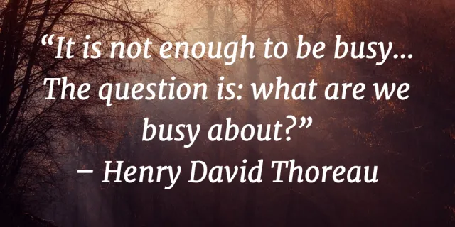

Slide 24
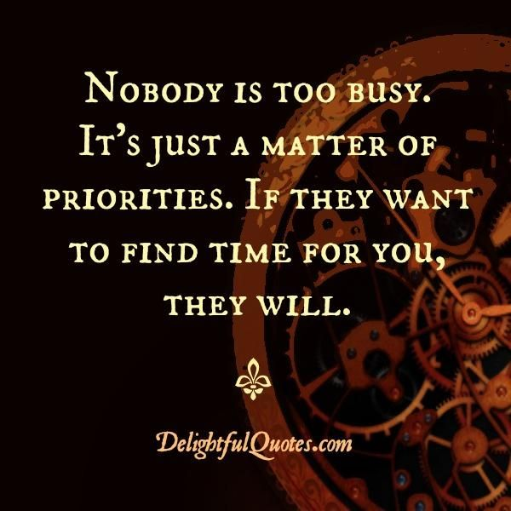

Slide 26
The best volunteers will share your:
passion.

Slide 27
Dr. Alex Cobb
Alex.Cobb@SeniorAgeMO.org
417-868-9520

