Slide 1
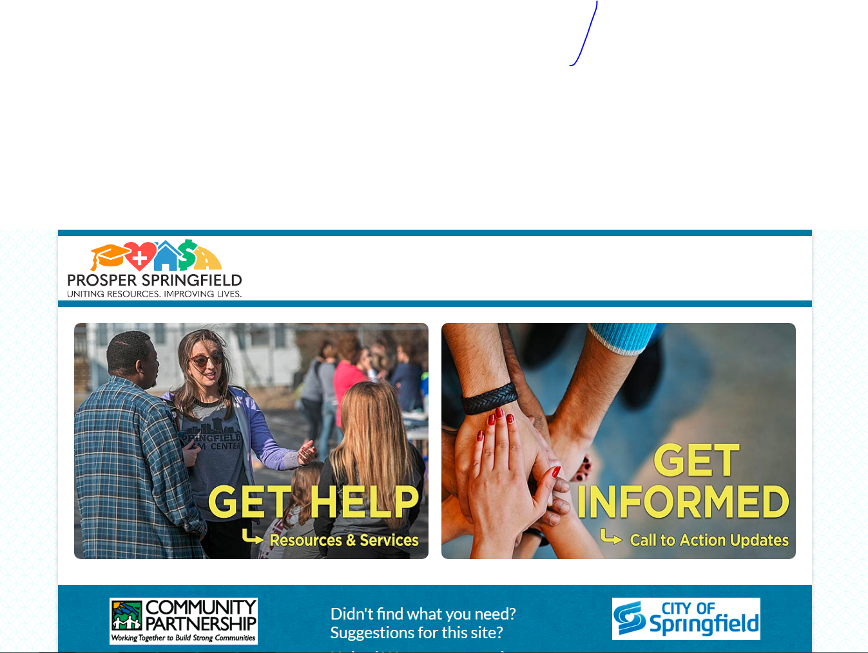
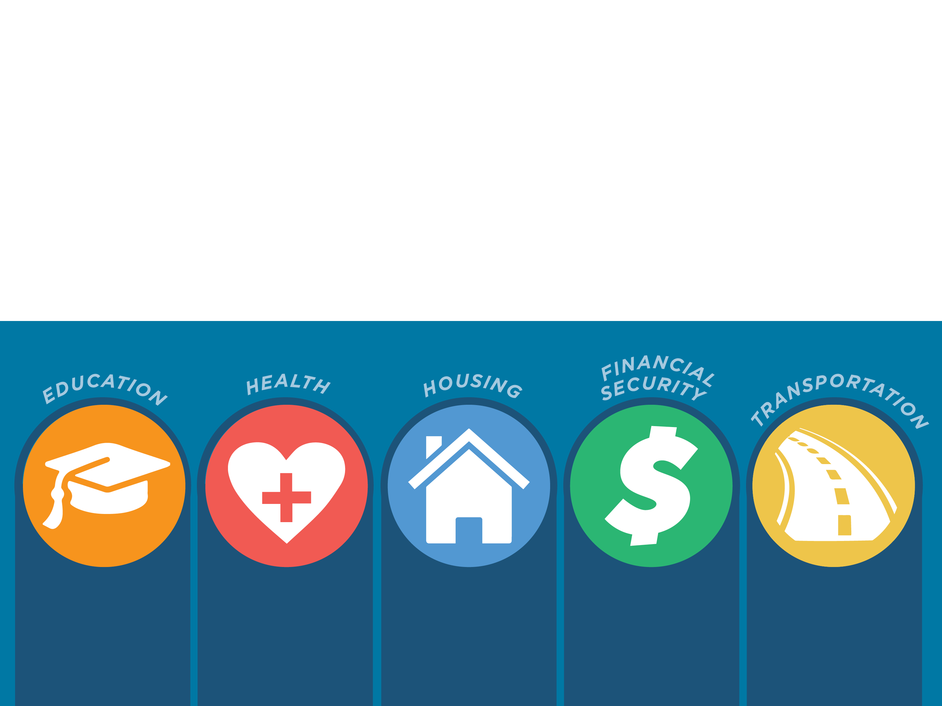

Get
“Get Inspired to Have a Seat at the Table”
May 23, 2022
Notes:
Thank you for the opportunity to speak with you today about equity and prosperity. Most of my sharing of information today is based on collaborative work as the Prosper Springfield Director in Springfield, Missouri – the other Springfield!

Slide 2

Prosper Springfield builds relationships and aligns community resources to create pathways that help move people to prosperity.
Notes:
Prosper Springfield was created from the community work of the Impacting Poverty Commission that met for 18 months starting in 2013, to learn about causes and affects of poverty. Collective impact models were created for the initiative to knit together the community’s efforts to increase prosperity for all who call Springfield home.
The initiative connected community work taking place that capitalized on the momentum of successful programs. I worked with over 300 partner organizations to create a strategic alignment of efforts to make it easier for people to improve their education, health and housing while becoming better employed and financially secure based on the community’s Call to Action Report produced by the IPC Oct 2015.
The Prosper Springfield Mission: is to build relationships with those who can help and those who need help, align resources and create systems to help move people to prosperity.
Historically, Springfield had been described by various outside entities as being program rich and system poor. The alignment focus for Prosper Springfield was to take existing programs and create systems. Many entities had already started this process.

Slide 3
Vision
To build an environment in which all members of the Springfield community are able to measurably improve their education, health, housing and employment/financial security.
Notes:
The Prosper Springfield vision is to help people increase prosperity in their lives, which will look different for everyone. A family unit earning $9000 a year, with debt and no transportation doubling their income, clearing their debt and now having working transportation will not get someone out of the federal poverty level but for them they have prospered and that is as far as they may choose to go.

Slide 4

PROSPER SPRINGFIELD BACKGROUND
Two community goals established from the Impacting Poverty Commission in the October 2015 Call to Action Report.
Notes:
Created from the Impacting Poverty Commission that was established in 2012-13 to address Springfield’s increasing poverty rate.

Slide 5
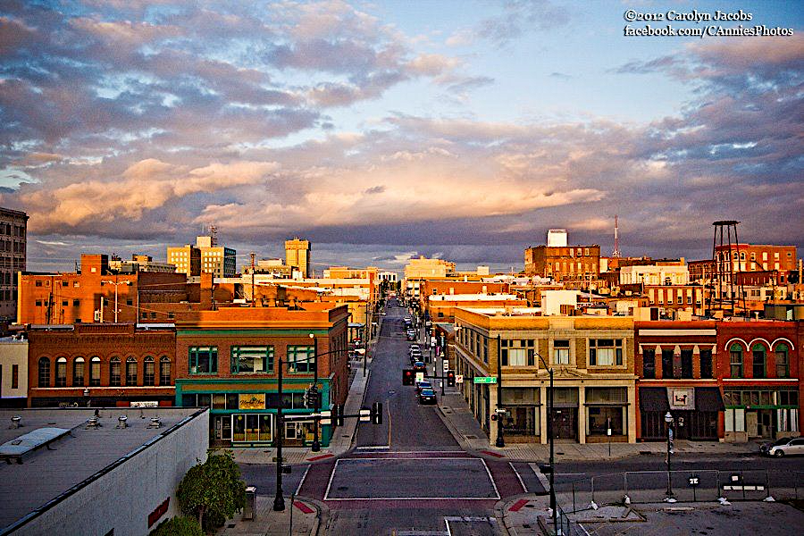
GOAL 1: Raise post-secondary attainment ​to 60%
GOAL 2: Reduce poverty rate by 5 percentage points
By 2025:
Notes:
These are the two goals, which also included creating a community portal to provide access to resources and services for individuals who may need help and the same portal for community members to stay informed about the status of the action items in the Oct 2015 Call to Action report – over 80% of the action items were completed beyond expectations from that report..

Slide 6

5-Year Poverty Reduction
25.7%
21.7%
Notes:
2018 was the first year of stabilizing poverty to 25.7% based on 2014 to 2017 U. S. Census Data
2020 poverty rate reduction to 21.79% based on 2016 to 2020 U. S. Census Data – this data includes COVID-19 impacts for 2019 and 2020. It also sets the new baseline for poverty reduction rate with the 2020 Census data that is now available. The poverty rate for Springfield has reduced by 4.0% over the past five years.
Results are from a community effort with private, public and social sectors
But what does this mean in terms of population and poverty rates?

Slide 7
POVERTY RATE – WHAT GOAL CAN WE
REALISTICALLY ACHIEVE?
Poverty Rate – 21.7%
Approximate Untouchable Numbers – 11.0%
College Students
Ages 65+
Ages 5 and Under
Ages 5 – 17
Poverty Rate to Use to Develop New Goals – 10.7%
Notes:
The percentages are hard to see. However, the color schemes tell the story! This slide represents the 169,176 people who registered as living in Springfield . Mo in the 2020 Census.
What is not included in this chart are the 12.5% of the population who identified with different types of disabilities or the 9,726 Veterans who reside in Springfield. These are populations that are considered as intersections within the population. We would not the needs of these populations just the populations of color if we did not disaggregate data.

Slide 8

Notes:
As you can see the one-year U. S. Census chart takes us through 2020 and shows a slight poverty rate increase with 2019 data because of COVID-19 impacts.
The new US Census data just became available December 2021. We are in the process of reviewing the 2020 data now to complete Prosper Springfield’s Fourth Annual Report, entitled, “This is Us”!
The 2020/2021 Prosper Springfield Report will reflect the new poverty rate of 21.7% as the new baseline from the 2020 Census Reporting.
To dive deep into this work requires leaders to respond to this question:

Slide 9
Notes:
A different look at the data that should lead to further analysis to determine cause, effect and solutions. The green square placeholder is to add the percentage rate with populations with disabilities.

Slide 10
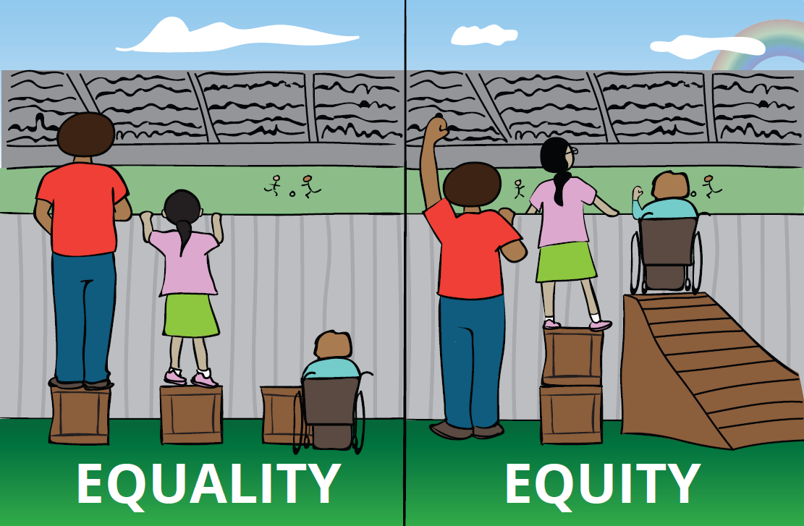
EQUALITY VS EQUITY
Notes:
As we move into this space of inclusion, we need to understand the evolution of equality and equity.
When we only focus on equality, some members of our community may still not reach the intended outcome for all. This picture reflects the intended outcome is for all three youth to be able to watch the game. Equality is giving each person the same thing whether they need it or not to reach the intended outcome
Equity focuses on providing what is needed based on the needs of each individual to meet the intended outcome.
For example, CFO provides a series of grants to rural communities. The same services and resources were made available to any community member to empower individuals for personal and family success. However, with some groups the outreach may have been in a different language, or services may have been provided after 5:00 P.M. and in their community. This approach provides access and inclusion for all.

Slide 11
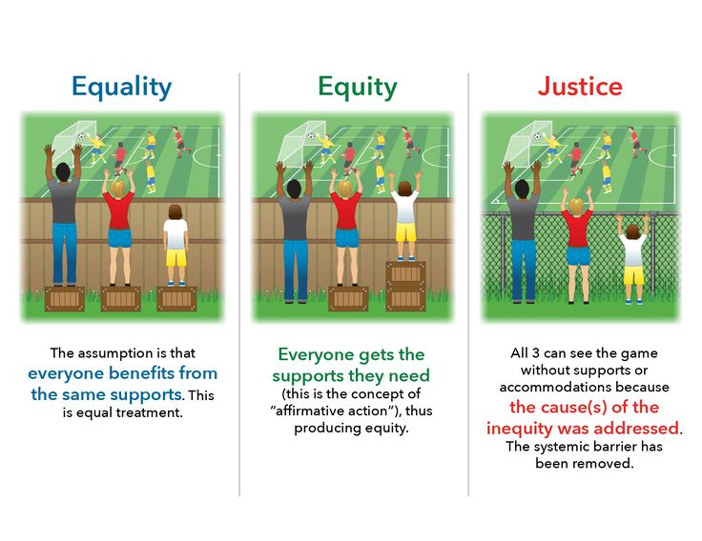
Notes:
Targeted Universalism looks at the outcome you want to achieve and what does it take for each sup group population to get there – not taking anything away from any group but looking at what caused the barrier and giving each group what they need to meet the outcome for all.
Having the right people at the table is key to ensure individuals with disabilities are included in discussions and equity work. Leaders with decision making authority are key players to ensure inclusion. A good starting place in answering this question:

Slide 12
What policies and practices cause barriers for individuals with disabilities to have the same level of access and inclusion as others?
Notes:
Whether it is racial/ethnic data or intersectional data, there is a question leaders should ask of their organizations:
For example, an employer offers tuition reimbursement to help employees complete college. However, if an employee is not in a financial situation to pay upfront tuition fees, this policy “keeps this employee out – it is a barrier. The employees who are able to take advantage of this benefit, may be able to promote to higher positions and have access to opportunities that others may not.
Another example, many students attending SPS whose parents qualified for their children to receive free or reduced lunch were not able to take dual credit classes because of the cost. So, students who had that type of access were able to attend college with earned college credit. Others had financial barriers to participation.
This practice was changed a few years ago by MSU – I will discuss how later in the presentation.
As I share information with you today, please write down polices that keep people out that come to mind.
For every PowerPoint, training guide or tutorial is it assessed for the greatest level of accessibility?
Are the opening and closing of doors to your establishment electronic?
Does your city of poles in the middle of sidewalks that could prevent someone with a wheelchair from using the sidewalk?
Does someone with a disability participate in planning events and training to provide another perspective?
These are real life issues!

Slide 13
How to Address “Real Life Issues”
Notes:
You must be intentional to be inclusive!
A starting point for Springfield is to align goals with the MO Dept. Higher Education and Workforce Development to impact poverty rates and employment options.
Use Collective Impact Models to be inclusive of those impacted.
Local government engagement.
Use disaggregated data to learn what the data really means.
I will provide some examples of the work in Springfield to be more inclusive of individuals with disabilities.

Slide 14
Missouri Department of Higher Education &
Workforce Development
“Best in the Midwest in Educational Attainment and Workforce Participation by 2030.”
Educational Attainment w/Equity Targets
Labor Force Participation w/Equity Targets
Measurable Indicators
Notes:
How about affinity groups?
How about speakers from different intersective groups for lunch and learn sessions?
Have you heard of the Inclusive Excellence Model? Or Targeted Universalism?
Example of MSU offering dual credit for any student who qualifies for free and reduce lunch – even though the data shows achievement opportunities are greatest for African American students – it was developed for all students.

Slide 15
BEST IN MIDWEST TARGETS:
60% Educational Attainment
70% Labor Force Participation
EQUITY TARGETS:
60% Educational Attainment for all Groups
70% Participation and/or Employment for all groups

Slide 16
Collective Impact Model
Notes:
Collective Impact models need to reflect diverse members and others whose efforts target disparate populations with an assessment to understand lived experiences. This Chart is from a group of Coalition members who participated in a stakeholder assessment analysis to determine any gaps in Coalition members based on lived experiences for the grant received from the MODDC – African American School to Prison Pipeline Statewide Research Project.

Slide 17
Mayor’s Initiative on Equity and Equality
Charge:
Develop guiding principles to improve equitable access to opportunities, recognizing the inherent dignity, value and worth of each individual.
Deliverable:
Guiding principles that will be applied to make Springfield more inclusive and improve equitable access to opportunities to all.
Notes:
Considering five pillars of change:
Dialogue and Understanding
Cultural Consciousness
Advocacy and Partnerships
Structural and Systemic Barriers
Personal and Organizational Accountability

Slide 18
Mayor’s Initiative on Equality and Equality
Five Pillars of Change:
Dialogue and Understanding
Cultural Consciousness
Advocacy and Partnerships
Structural and Systemic Barriers
Personal and Organizational Accountability
Notes:
The guiding principles were derived from these pillars and adopted by the City Council April18, 2022.
Next month recommendations from the Prosper Springfield Equity and Prosperity Commission will be published.
MSU brought the Inclusive Excellence Model to Springfield several years ago.

Slide 19
Clarity in Language, Goals, and Measures
Equity Mindedness
Equitable Practices and Policies
Continued Process of Learning
Pervasive System-Wide Principle
Five Principles of Inclusive Excellence

Slide 20
Access, Success and Equity
Learning and Development
Organizational Climate
Organizational Commitment
Four Main Areas of Focus for Inclusive Excellence

Slide 21
Summary
Inclusion needs to be woven in all that you do with an effort of urgency and intentionality!
Universal Design with strategies focused attention will ensure equity and prosperity for most if not all!

Slide 22


Slide 23

Francine Pratt 916-541-1675
Fpratt@cpozarks.org

