Slide 1
Notes:
https://www.razmobility.com/ios-accessibility-applications/

Slide 2
Role of AT
Assistive Technology’s goal is all about problem solving.

Slide 3
Vision

Slide 4
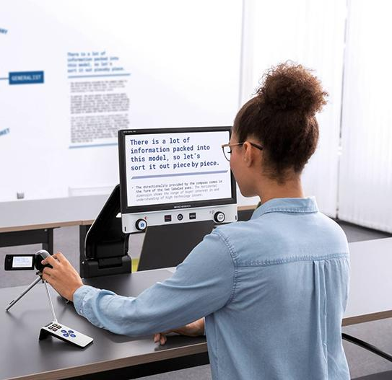
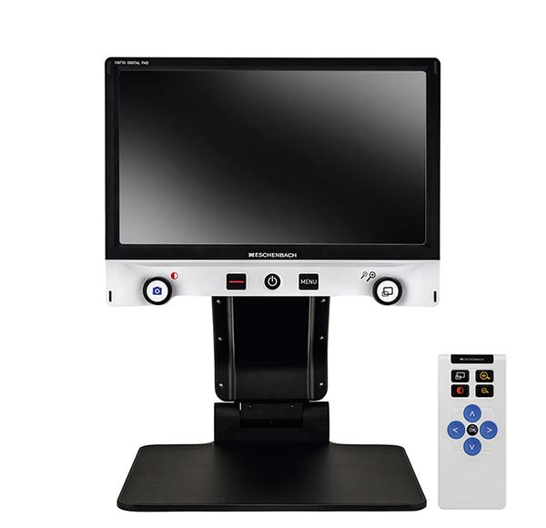
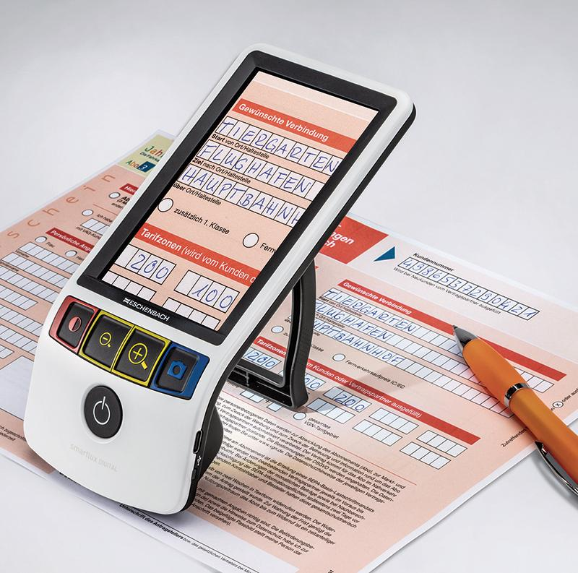
Vario Digital FHD Advanced
New Smartlux Digital

Slide 5
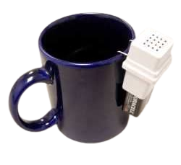
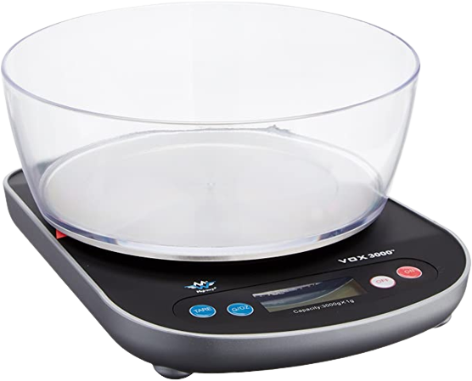
AT for the Kitchen
Hot liquid level indicator
Talking Measuring scale
Talking Measuring jug

Slide 6
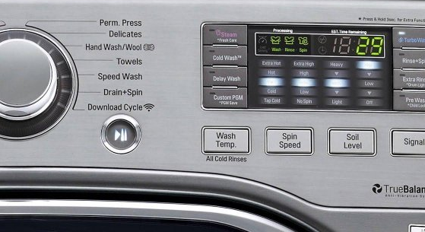
BUMP DOTS
BUMP DOTS

Slide 7
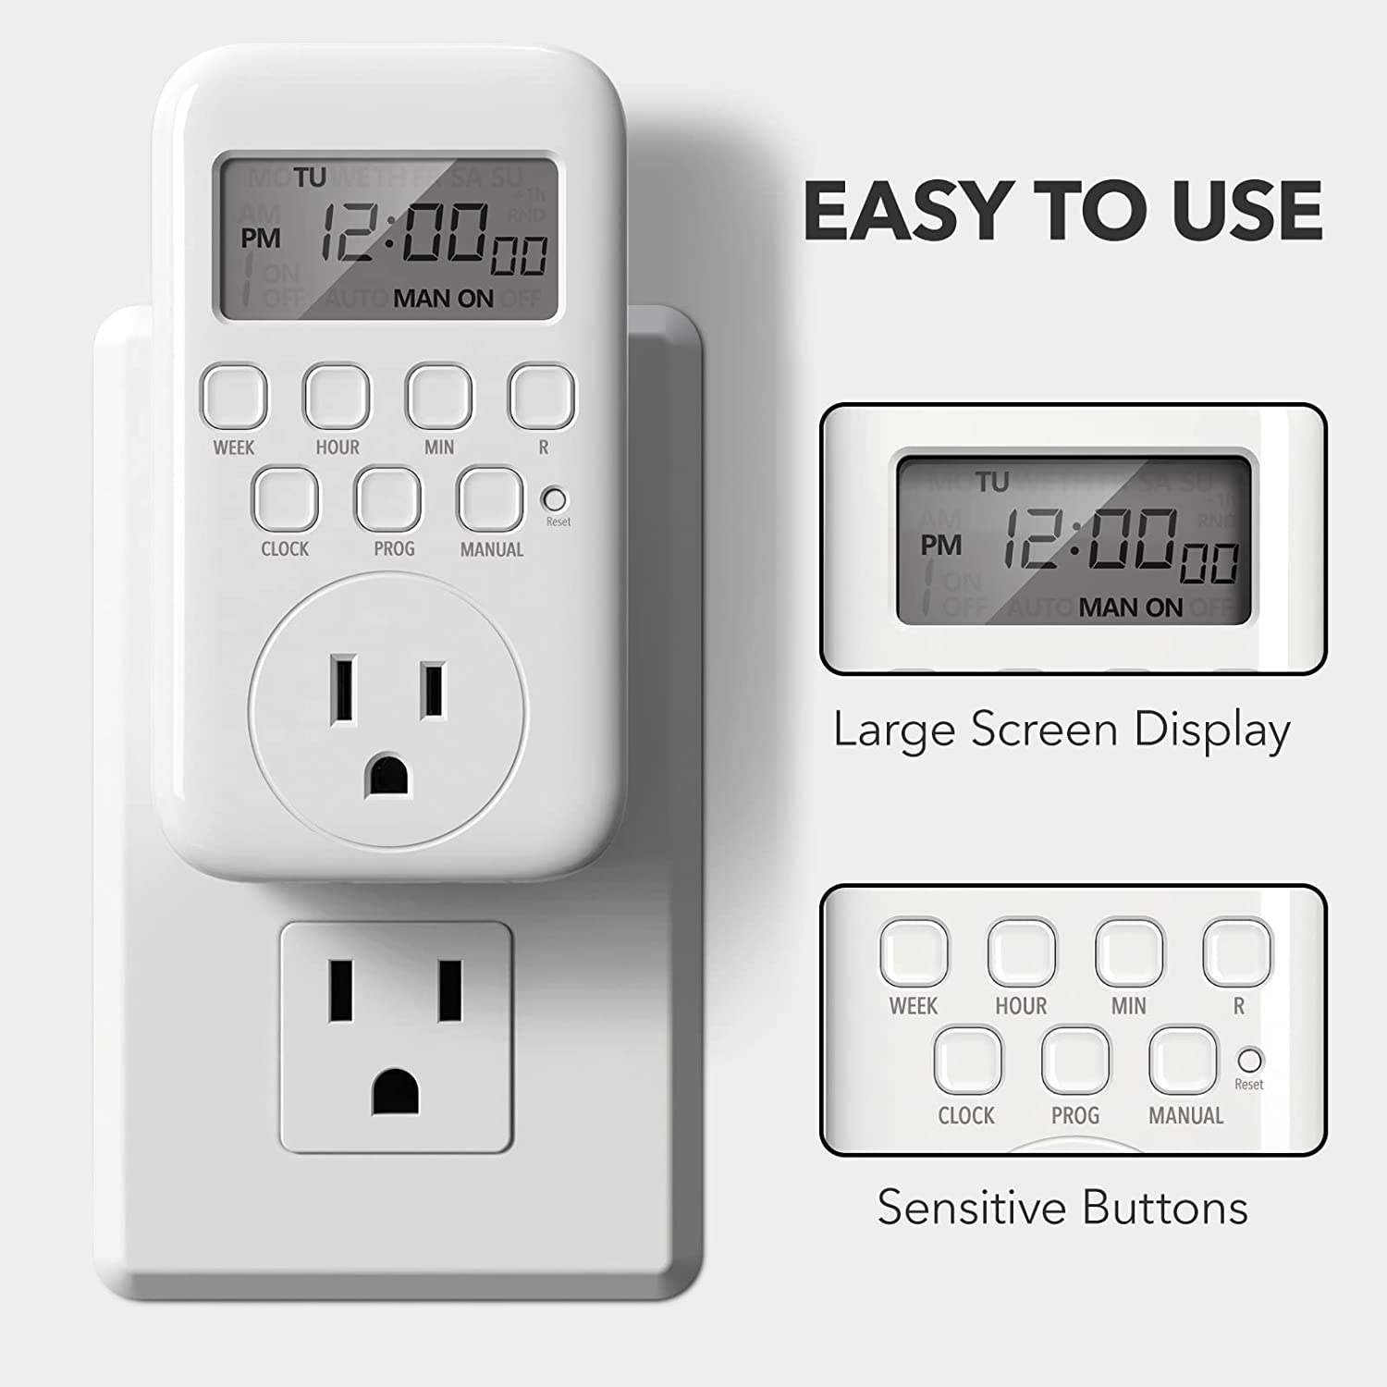
AT for the Bathroom
Outlet Timer
Talking Scale
Shower Soap and Shampoo dispenser

Slide 8
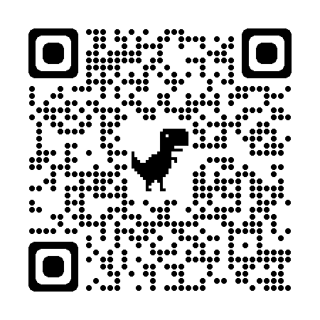
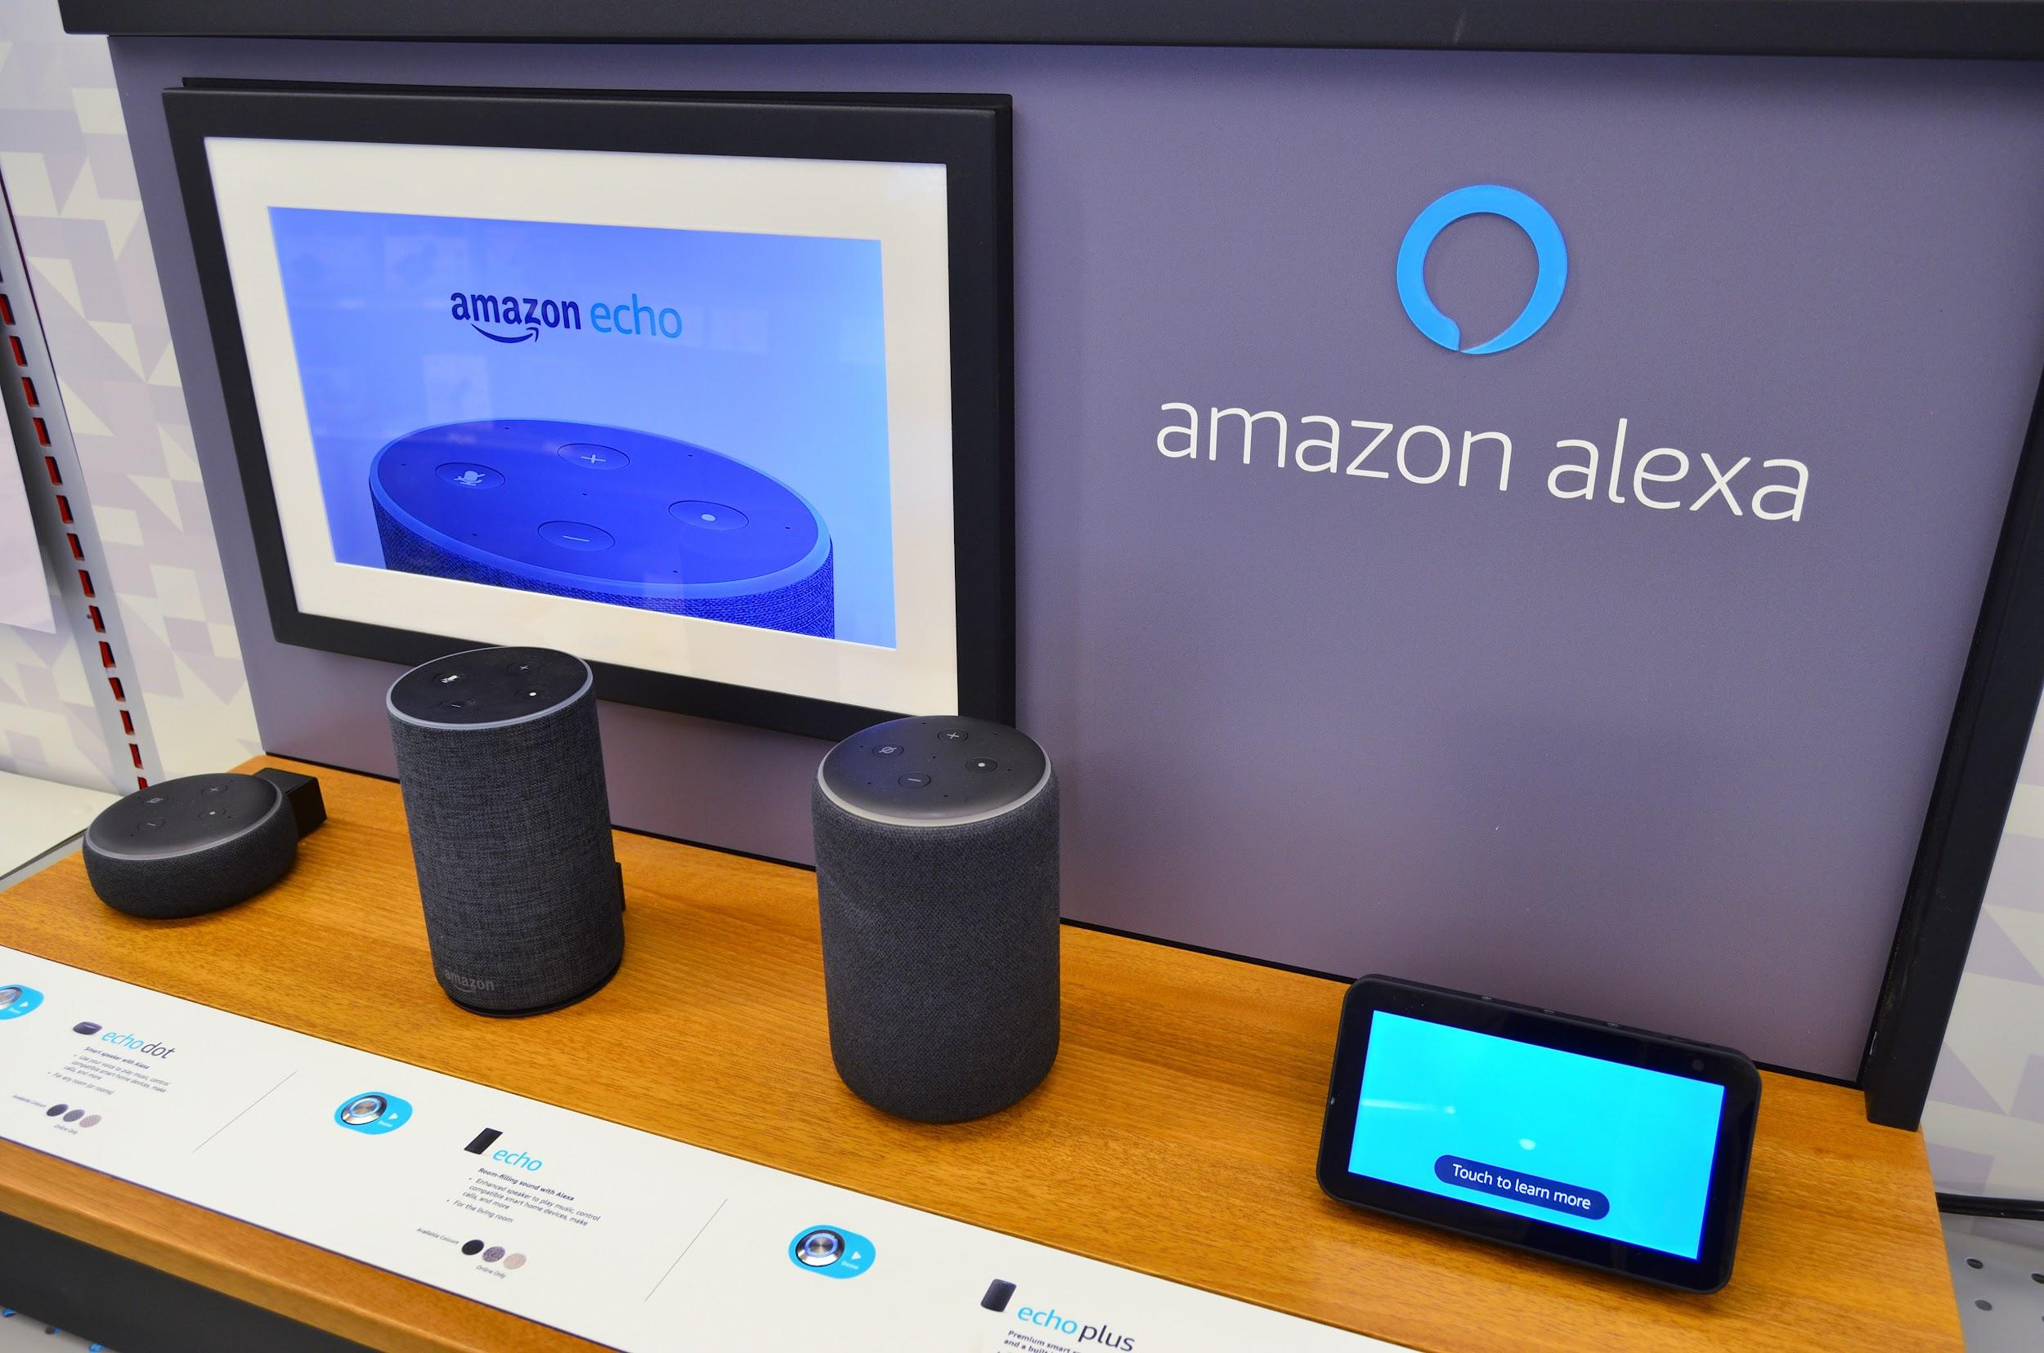
Smart Home for Vision
Alexa Accessibility Vision
Photo description: 5 different Amazon Alexa devices

Slide 10
Apple Devices

Slide 11
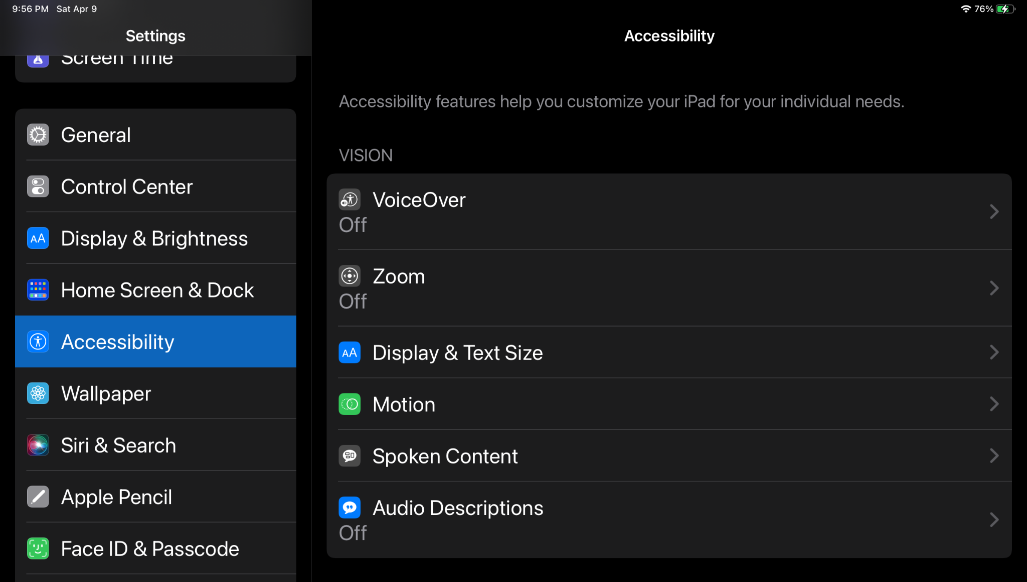
Image Description: IPAD Settings Accessibility page, VISION
Voice Over, Zoom, Display & Text Size, Motion, Spoken Content, Audio Descriptions

Slide 12
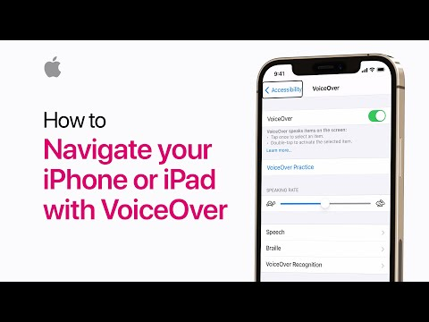

Slide 13
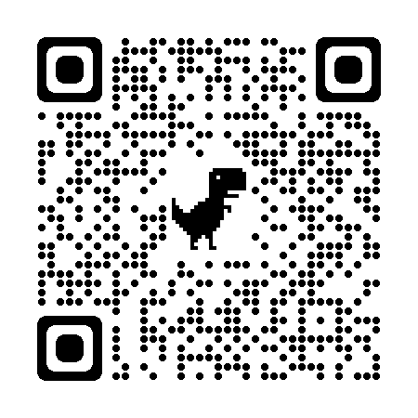
Downloadable Apps

Slide 14
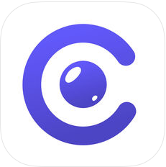
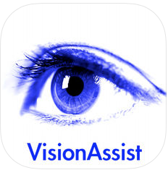
AIRA
Tap-Tap See
CamFind
Eye-D
VO Calendar
Be My Eyes
Envision AI
Vision Assist
NantMobile
Money Reader
Notes:
Aira
Aira provides personalized assistance from trained Aira agents, family members or friends. By utilizing live video, audio and data streams, these agents serve as visual interpreters helping customers understand the environment around them.
Audiobooks from Audible
Home to a library of over 180,000 audio books, podcasts and audible channels.
BARD Mobile
Access and read talking books from NLS BARD on your Android device.
Be My Eyes – Helping the blind
Bringing Sight to the Blind and Visually Impaired. Be My Eyes is an app that connects blind and visually impaired with sighted helpers from around the world via live video connection.
CamFind – Visual Search Engine
Take a picture of any object to perform search on that object.
Dragon Anywhere
Easily dictate documents of any length, edit, format and share them directly from your iPhone or iPad — whether visiting clients, a job site, or your local coffee shop. All hands-free.
Envision AI
Envision can process an image and extract the information the user is looking for. It can read texts from any surface accurately and quickly. This text can then be explored through VoiceOver and also exported.
Eye-D
Eye-D helps the blind and visually impaired be location aware, explore and navigate to nearby places of interest, evaluate surroundings with their smartphone camera and read printed text.
Eye-D Pro
Eye-D helps visually impaired be location aware, explore and navigate to nearby places of interest, evaluate surroundings with their smartphone camera and read printed text. Similar to free version of the Eye-D application but without advertisements and with some additional features.
KNFB Reader
KNFB Reader 3.0 is a rapid and efficient text recognition app. Its text-to-speech, text-to-Braille, and text highlighting tools make it valuable for blind, low-vision, dyslexic, and others with reading differences.
Use it to import or take a photo of anything containing text. Take a photo and the app reads text out loud or displays it on a connected refreshable Braille display.
Light Detector
If you are blind, Light Detector helps you to be more independent in many daily activities. At home, point your iPhone towards the ceiling to understand where the light fixtures are and whether they are switched on. In a room, move the device along the wall to check if there is a window and where it is. You can find out whether the shades are drawn by moving the device up and down.
NantMobile Money Reader
Instantly recognizes currency and speaks the denomination, enabling people experiencing visual impairments or blindness to quickly and easily identify and count bills. Twenty one currencies are supported.
Nearby Explorer
A GPS app designed for use by people who are blind. Instead of just providing directions, it describes the environment. It uses onboard maps so a data connection is not required.
Seeing AI
Seeing AI is a free app that narrates the world around you. This ongoing research project harnesses the power of AI to open up the visual world and describe nearby people, text and objects.
TapTap See
An app designed to identify objects for blind and visually impaired users.
VisionAssist
VisionAssist will provide magnification and enable you to improve the contrast to help you read or see what you want to read. If you are in a dark area, you can use the iPhone's flash as a torch to lighten up what you are reading.
VO Calendar
VO Calendar is a weekly calendar specifically designed to be used (only!) with VoiceOver. The result of this VoiceOver-only design is not only a smoother navigation through the app. It also makes it possible for the VoiceOver speech to give smart summaries depending on the context. This prevents you from having to go through each event individually.

Slide 15
Audible
Dragon
Nearby Explorer
BARD Mobile
KNFB Reader
Light Detector
Notes:
Aira
Aira provides personalized assistance from trained Aira agents, family members or friends. By utilizing live video, audio and data streams, these agents serve as visual interpreters helping customers understand the environment around them.
Audiobooks from Audible
Home to a library of over 180,000 audio books, podcasts and audible channels.
BARD Mobile
Access and read talking books from NLS BARD on your Android device.
Be My Eyes – Helping the blind
Bringing Sight to the Blind and Visually Impaired. Be My Eyes is an app that connects blind and visually impaired with sighted helpers from around the world via live video connection.
CamFind – Visual Search Engine
Take a picture of any object to perform search on that object.
Dragon Anywhere
Easily dictate documents of any length, edit, format and share them directly from your iPhone or iPad — whether visiting clients, a job site, or your local coffee shop. All hands-free.
Envision AI
Envision can process an image and extract the information the user is looking for. It can read texts from any surface accurately and quickly. This text can then be explored through VoiceOver and also exported.
Eye-D
Eye-D helps the blind and visually impaired be location aware, explore and navigate to nearby places of interest, evaluate surroundings with their smartphone camera and read printed text.
Eye-D Pro
Eye-D helps visually impaired be location aware, explore and navigate to nearby places of interest, evaluate surroundings with their smartphone camera and read printed text. Similar to free version of the Eye-D application but without advertisements and with some additional features.
KNFB Reader
KNFB Reader 3.0 is a rapid and efficient text recognition app. Its text-to-speech, text-to-Braille, and text highlighting tools make it valuable for blind, low-vision, dyslexic, and others with reading differences.
Use it to import or take a photo of anything containing text. Take a photo and the app reads text out loud or displays it on a connected refreshable Braille display.
Light Detector
If you are blind, Light Detector helps you to be more independent in many daily activities. At home, point your iPhone towards the ceiling to understand where the light fixtures are and whether they are switched on. In a room, move the device along the wall to check if there is a window and where it is. You can find out whether the shades are drawn by moving the device up and down.
NantMobile Money Reader
Instantly recognizes currency and speaks the denomination, enabling people experiencing visual impairments or blindness to quickly and easily identify and count bills. Twenty one currencies are supported.
Nearby Explorer
A GPS app designed for use by people who are blind. Instead of just providing directions, it describes the environment. It uses onboard maps so a data connection is not required.
Seeing AI
Seeing AI is a free app that narrates the world around you. This ongoing research project harnesses the power of AI to open up the visual world and describe nearby people, text and objects.
TapTap See
An app designed to identify objects for blind and visually impaired users.
VisionAssist
VisionAssist will provide magnification and enable you to improve the contrast to help you read or see what you want to read. If you are in a dark area, you can use the iPhone's flash as a torch to lighten up what you are reading.
VO Calendar
VO Calendar is a weekly calendar specifically designed to be used (only!) with VoiceOver. The result of this VoiceOver-only design is not only a smoother navigation through the app. It also makes it possible for the VoiceOver speech to give smart summaries depending on the context. This prevents you from having to go through each event individually.

Slide 16
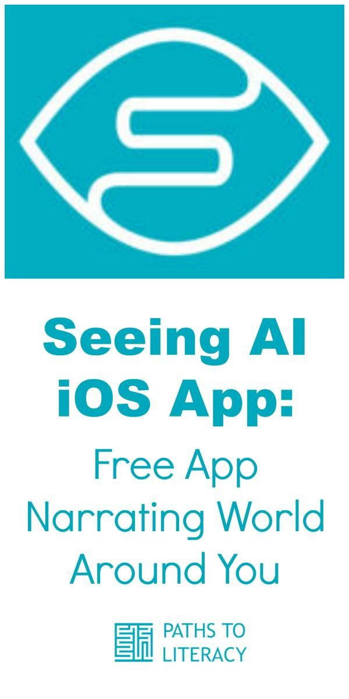
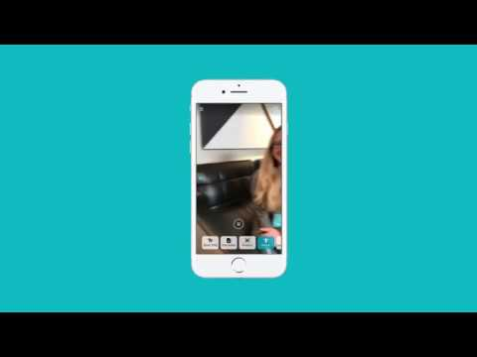
Downloadable Apps

Slide 17
Hearing Devices

Slide 18
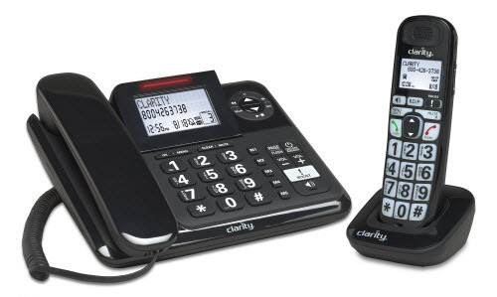
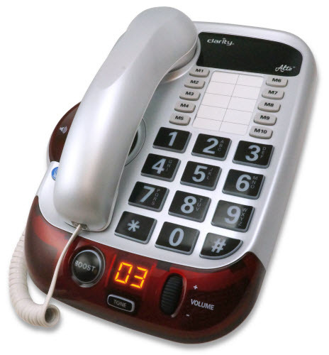
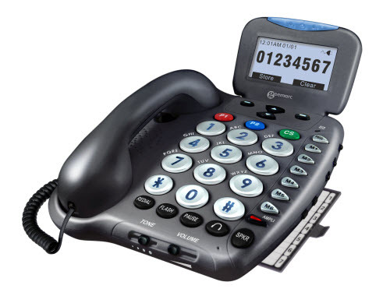
Amplified Landline phones
Photo Description: 4 styles of amplified phones, 3 corded phones, 1 cordless

Slide 19
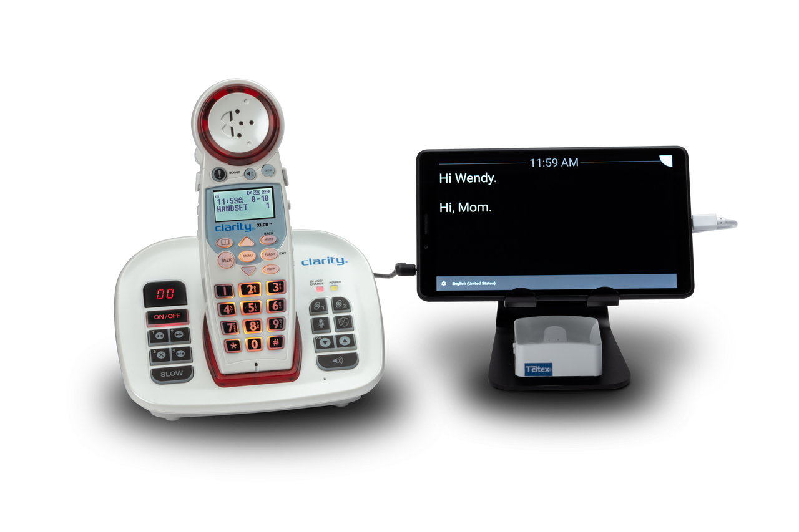
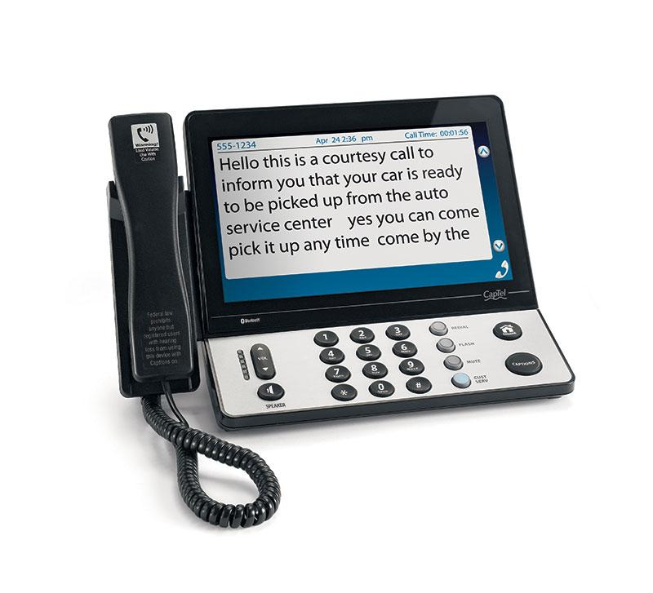
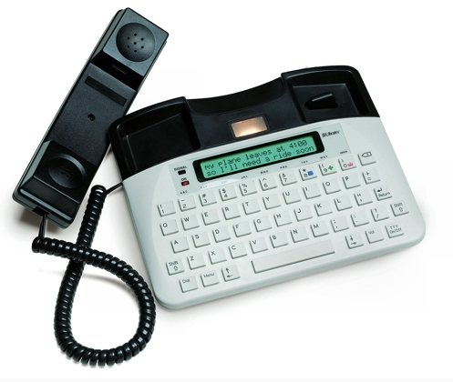
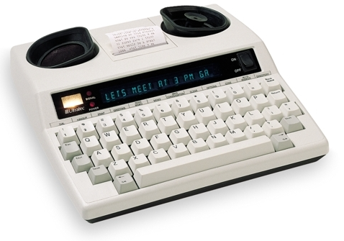
Captioned Phones & TTY

Slide 20
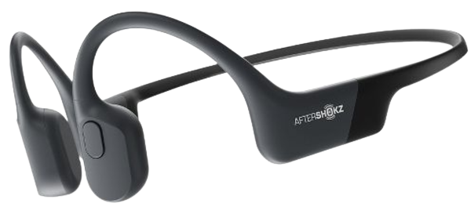
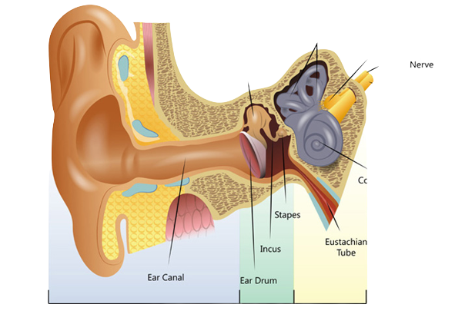
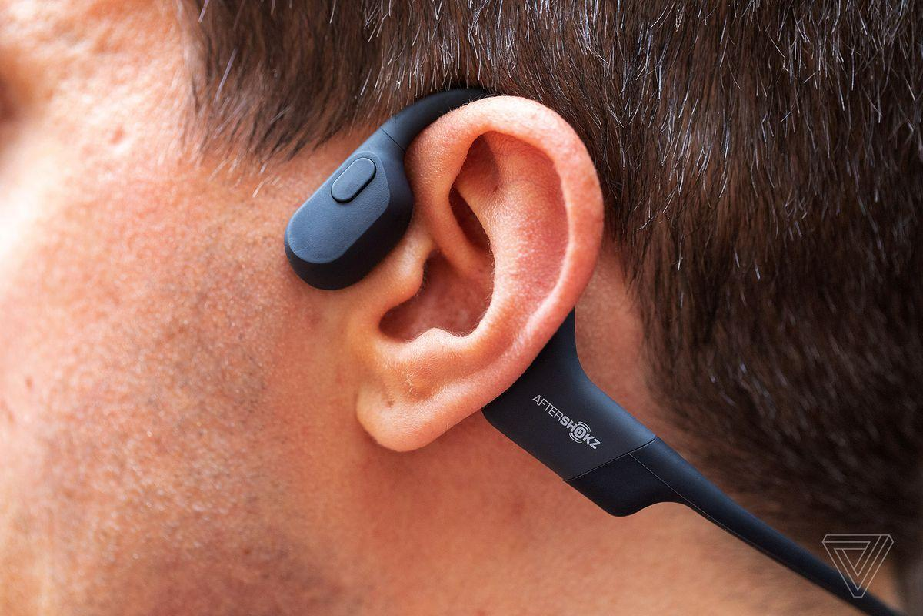
Bone Conduction headphones
Bone Conduction headphones sends sound vibrations through the bones of the skull which bypass the outer and middle ear directly to the cochlea.
Traditional headphones sit in the ear canal and depend on the middle ear to transport the sound vibrations to the cochlea

Slide 21
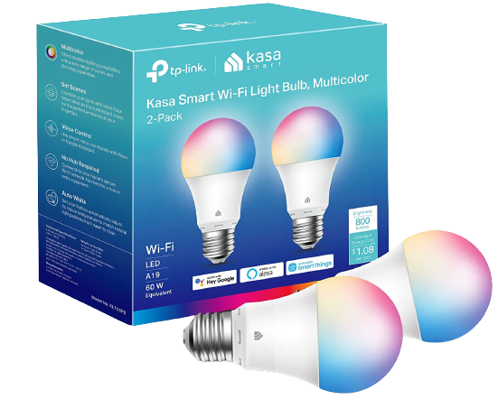
Door Bell

Slide 22
Iphone/Ipad
SonicCloud
Closed Captioning
Type to Siri
FaceTime
Sound Recognition
Headphone Accommodations

Slide 23
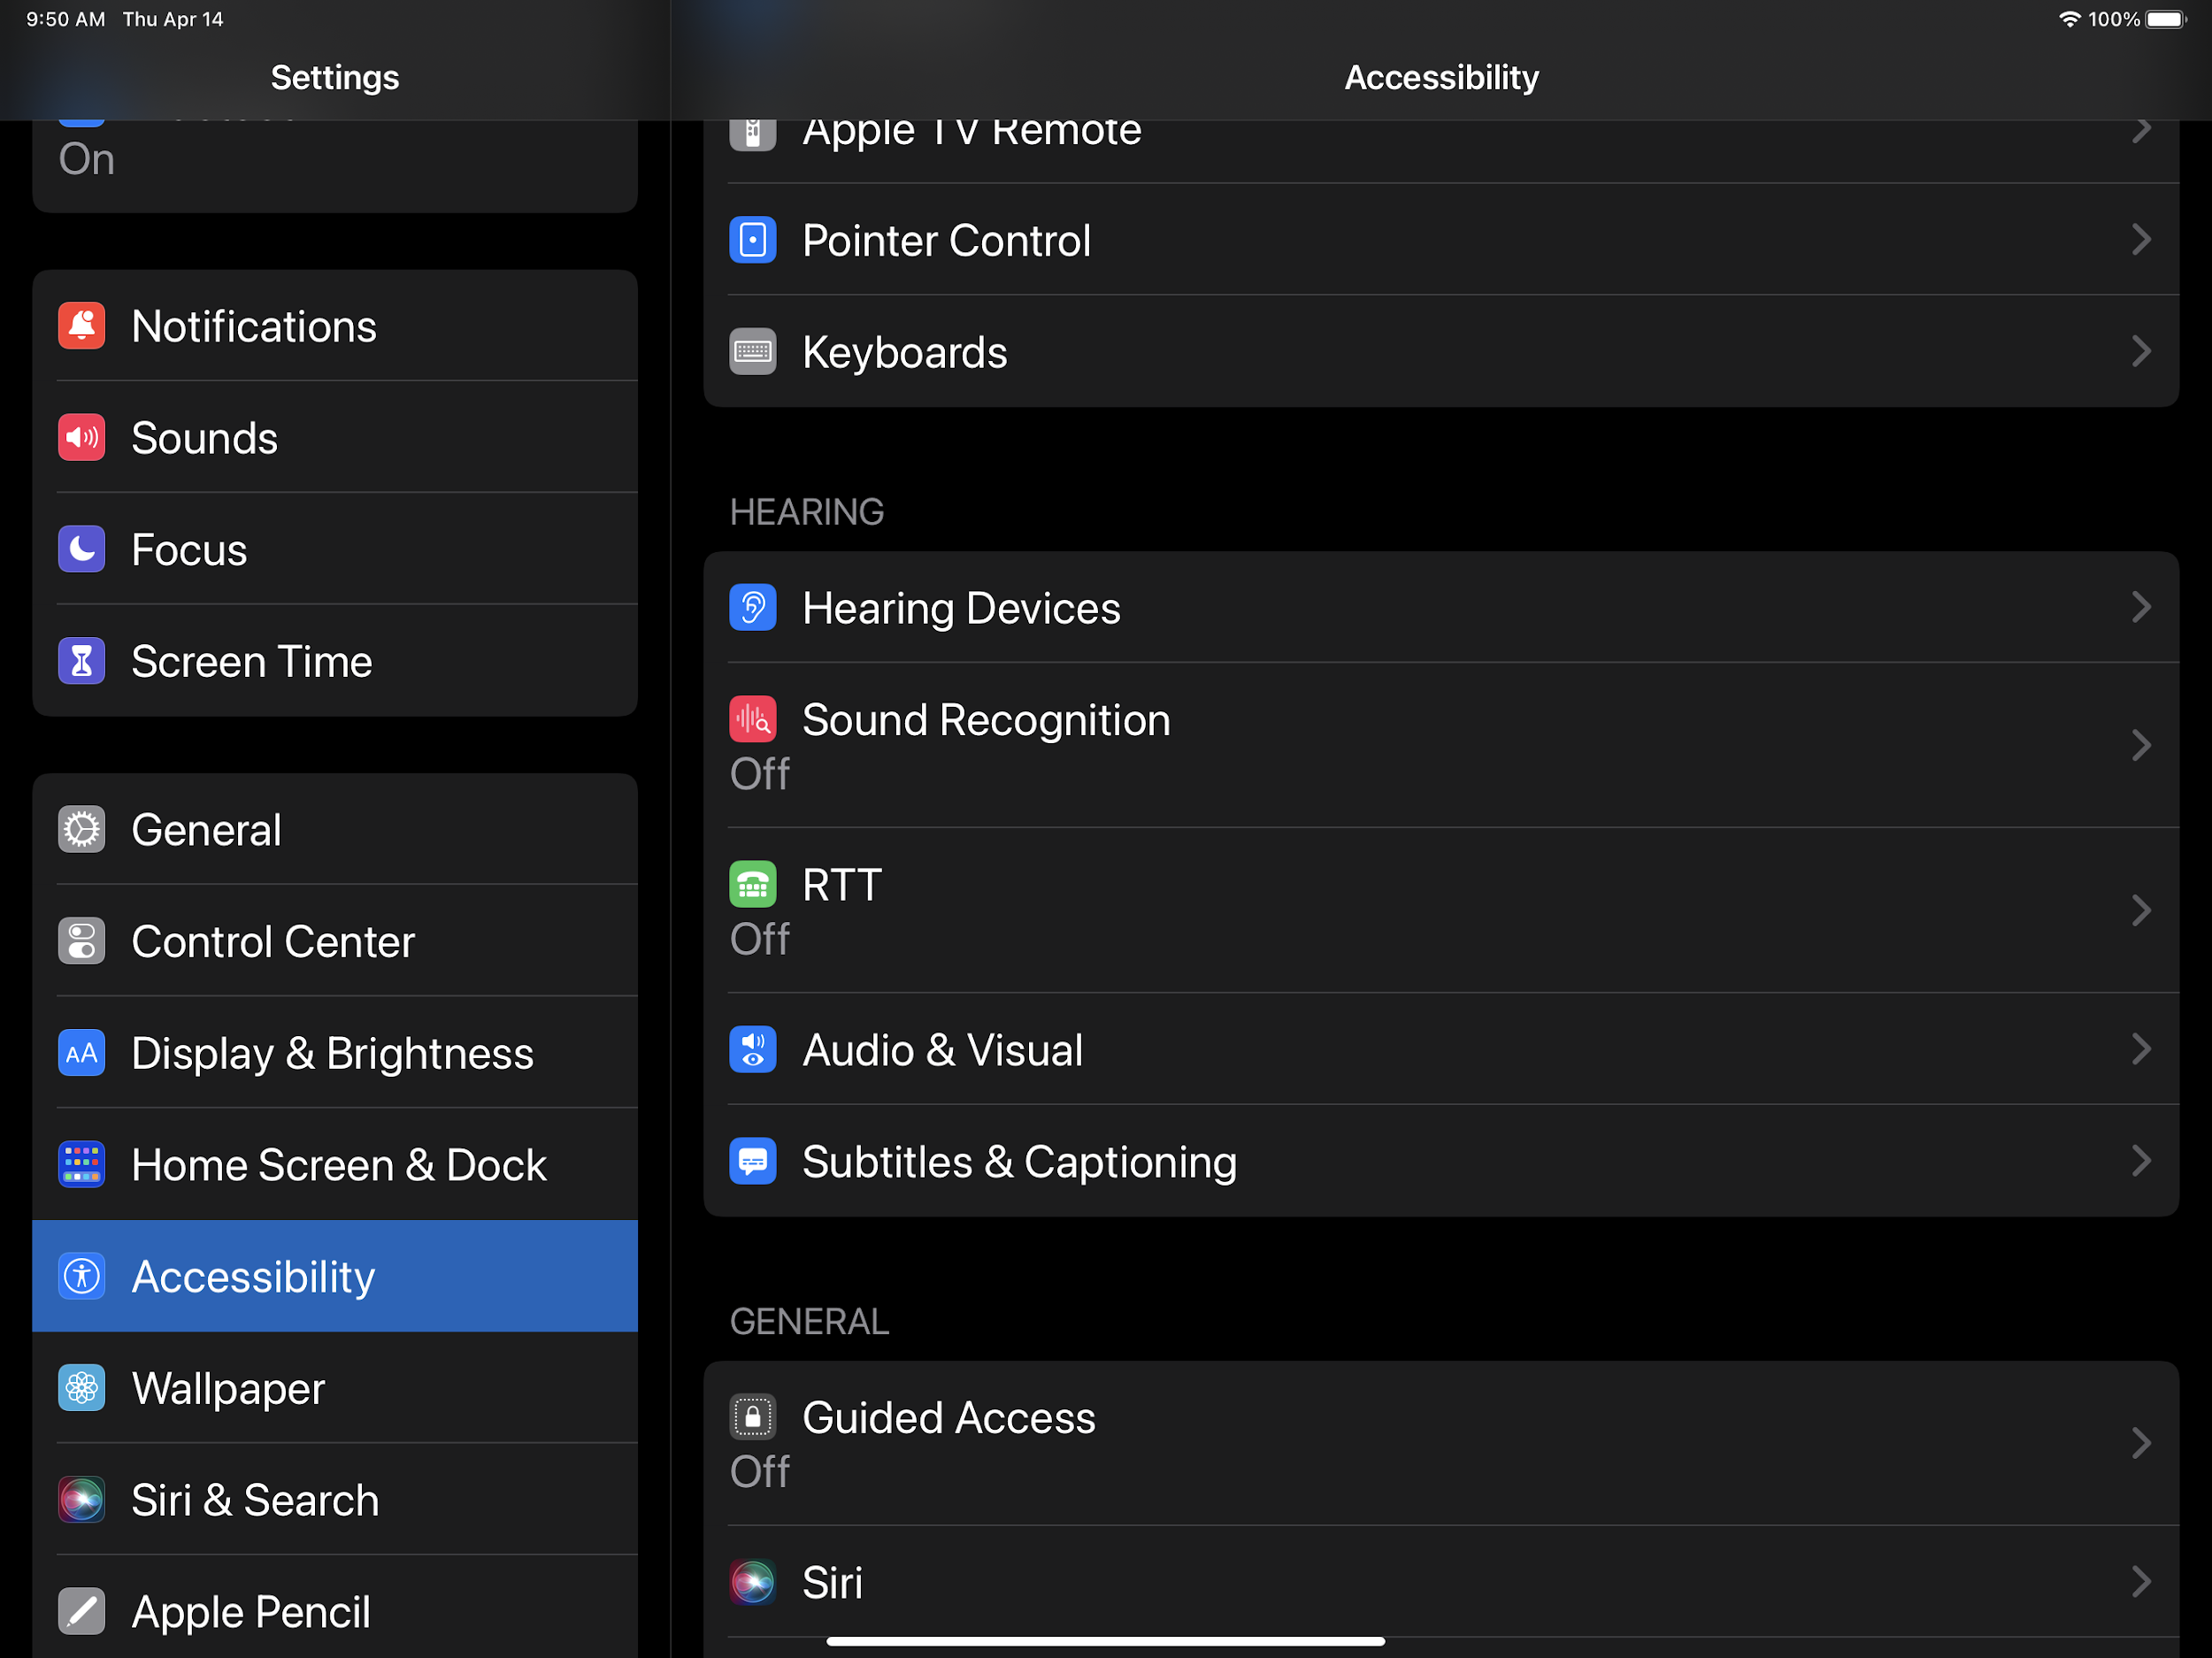

Slide 24
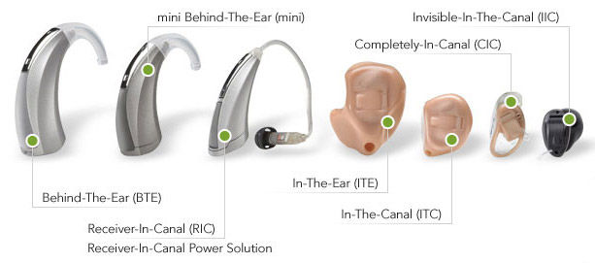
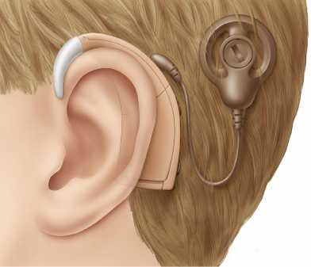
Hearing Aids, BAHA Cochlear Implant
Bluetooth
Photo Description: 7 hearing aids in different styles
Photo Description: medical illustration, cochlear implant
Hearing Aid
Cochlear Implant
BAHA (Bone Anchored Hearing Aid

Slide 25
Bluetooth-
Hearing Aid

Slide 26
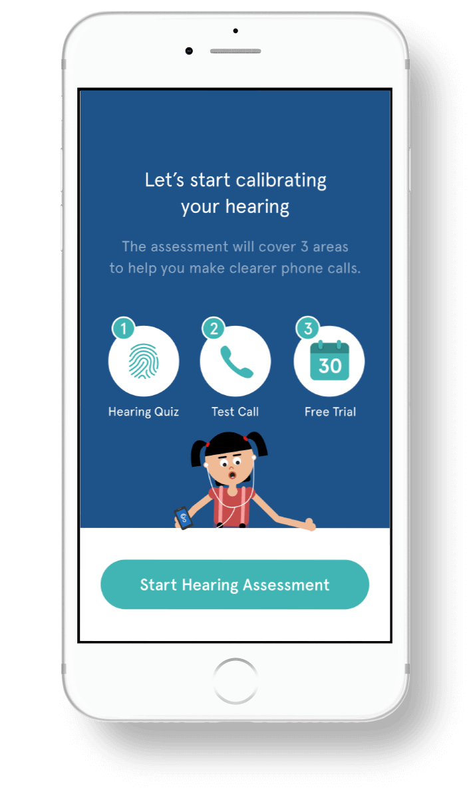
Iphone/iPad Apps
SonicCloud: Hearing App
"This app makes every call sound just perfect!" This game-changing app amplifies & personalizes audio on your phone calls - they’re tuned to your hearing in real time.

Slide 27
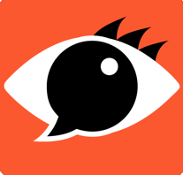
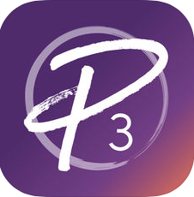
Captioning Apps
AVA
CaptionCall Mobile
CaptionMate
Hamilton Captel
InnoCaption+
Live Caption
Notes:
Ava – 24/7 Accessible Life
An app that facilitates 2-way communication between deaf and hearing people who don’t know sign language. The app provides 24/7 real-time captioning (with up to 95% accuracy, based on artificial intelligence), on their smartphone.
CaptionCall Mobile
Free app that enables people with hearing loss to make and receive telephone calls from their iPad by captioning those calls. The user must be able to speak.
CaptionMate
Caption Mate is a free service for individuals with hearing loss. It allows you to read both sides of the phone conversation instantaneously. CaptionMate works on smartphones, tablets, and all other phones, even your landline. Registration is free and creates no obligation.
Hamilton Captel
With this app you may listen to your phone conversations while reading word-for-word captions of what’s said to you – similar to captions on TV.
Developer: Hamilton Captel
InnoCaption+
InnoCaption is a mobile phone app for the deaf and hard of hearing that want to use their own voice to talk to others, but struggle hearing what is being said by them. InnoCaption provides captioned phone services.
Live Caption
Captions in-person communication in real time so that you can more easily participate in conversations.

Slide 28
Video Phone Apps
& Video Calling
ntouch Mobile- Sorenson
P3 Mobile
AVA
CaptionMate
Purple VRI
Convo VRS
CaptionCall Mobile
InnoCaption+
Hamilton Captel
Wavello
FaceTime
Notes:
ntouch Mobile
Ntouch Mobile, the SVRS app that turns your phone into a VP.
P3 Mobile for iOS
Make VRS, V2V and P2P calls with friendly interpreters – anywhere, anyplace.
Purple VRI
Video Remote Interpreting (VRI) is a convenient, on-demand sign language interpreting service delivered over a live Internet video connection. To use Purple VRI, you need a Purple VRI account. VRI services require payment for use.
Convo VRS
From the only Deaf-owned VRS provider comes the most natural calling experience for deaf and hard of hearing people. Always maintain ownership of your call - achieved through highly-qualified interpreters and intuitive app design.
Zoom
Using the Zoom Cloud Meetings app on iOS, you can join meetings, schedule your own meetings, chat with contacts, and view a directory of contacts.
FaceTime
FaceTime is a great way to communicate using sign language. With high‑quality video and a fast frame rate, FaceTime helps you catch every gesture and facial expression

Slide 29
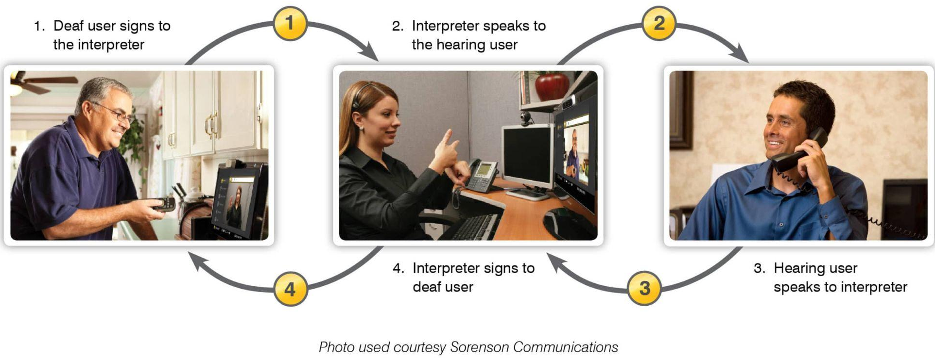
Video Relay Interpreter

