Slide 1
Marketing and Outreach
Notes:
GOOD MORNING!! Welcome to this morning’s session on Marketing and Outreach!
First things first, a copy of this PowerPoint and several handouts were uploaded to the MOCIL website for you to print off. If you didn’t print them off prior to the conference, feel free to go on there and print them off after the conference. I’m glad to provide copies of any of our paperwork, booklets, flyers, etc. for anyone so if there’s something you want to see that I didn’t submit for you to print on the MOCIL website, please just shoot me an email which is on the last page of this PowerPoint. (CLICK!)

Slide 2
Basic Information
Brooke’s background
If you fall asleep or nod off, I will embarrass you!
Speak up! (Even the newbies)
A brief history of NEILS
Some of my inspiration
Notes:
(CLICK)
Some of you know me, others don’t. My name is Brooke Kendrick and I’m the Executive Director at NEILS in Hannibal. I’ve been with the Center for 20 years now. I started as summer help after my first year of college and I was supposed to head back that fall for my 2nd year to continue my schooling in psychology and law enforcement because I wanted to be an FBI agent and get in the minds of serial criminals. LOL Yet, here I am, 20 years later, lecturing on marketing for CILs. LOL During that summer, I fell in love with the philosophy and became engrossed in the history of the disability rights movement. Apparently, I was doing a good job because the ED at the time asked me to stay, so I did. Since that time, I’ve been a PAS Specialist, Data Manger, Outreach Coordinator, and Executive Director. It’s been a ride, to say the least.
(CLICK) (CLICK!)
I intend on this being a fun session, so if it starts to get boring and I see someone yawn or nodding off, I will embarrass you. I am a serious person when I need to be, but I have my ornery, mouthy, sarcastic side as well. I’m probably one of the most sarcastic people you’ll ever meet and yes, I do throw out a few cuss words from time to time. I like to think I’m a pretty cool ED, but our staff would probably tell you otherwise. Some have said I’m scary and I just can’t wrap my head around that. I know I have RBF, but that does not define me as a person. But in all seriousness, I want this to be an interactive session.
(CLICK!)
If you have ideas that I don’t discuss, bring it up and let’s talk about it. I LOVE new ideas. If you’re new to the CIL world, I expect you to speak up too! If you’re seasoned in the CIL world, you shouldn’t be scared of asking a question or sharing information. Yes, I’m an Executive Director, but I don’t treat Center staff any differently than I treat their EDs. In fact, if I’m not particularly fond of your ED, I’ll probably treat you better than I treat them. 😉 Just kidding, but seriously (wink wink).
(CLICK!)
Okay, okay, I am NOT in any stretch of the imagination an EXPERT at marketing, but I do think NEILS has kicked some butt in the past when it comes to marketing and outreach so at the very least, I’d like to share with you how we did it.
When I first took over as Executive Director, we were not in a good financial position. Things were a mess. We were flat, busted broke, had been put on probation and weren’t allowed to take on new CDS consumers. What we thought would be just a short period of time on probation, ended up lasting a full year even though we had the issue resolved within the first two months of being put on probation. It was torture because we watched the “competition” grow hand-over-fist and there wasn’t a single thing we could do about it.
Our IL services continued to flourish during the year we were on probation for CDS, even though there were a couple of services we had to cut back on or terminate because we could no longer afford them. So, we knew our focus needed to be CDS growth. Prior to being put on probation, we had about 170 CDS consumers. By the time that year was over, we were down to 120. Not only did we lose several consumers to our “competitor,” but naturally we lost consumers due to death and other means. We lost nearly 1/3 of our revenue in one year’s time. – at a time when we were already broke and we didn’t think we could get any broker. We had already thinned the budget cutting out every. single. extra expense. I cannot emphasize that enough. We were operating with ZERO meat on our bones. We were truly in survival mode.
(CLICK!)
I am fortunate to have a family member who is very business minded. In fact, he lives in Springfield and for any of you from that area, I’m sure you’ve heard of SRC. You might have heard of the “Great Game of Business.” For those of you unfamiliar with it, SRC is a manufacturing facility that, at one time, was completely broke and was on the verge of closing their doors which would have left hundreds of people without a job. A group of employees purchased SRC, one being my great uncle. Throughout my years of growing up and visiting my great aunt and uncles home a couple times a year for family reunions, I always remembered hearing him talk about business and this incredible philosophy behind reviving SRC. It wasn’t until I was hired as Executive Director that I really started thinking about all the little things I had heard him say over the years. So, at our next family function held at their house after I became E.D., I sat down and started talking to him about it. The non-profit world and for-profit world are incredibly different, but there are also so many similarities. Regardless, we’re a business and we must generate revenue in order to survive, just as for-profits have to generate profits in order to survive. To make a long story short, from his experience with SRC, he shared with me so much knowledge that would bleed into the non-profit world. The SRC story is fascinating, but hearing first-hand how they accomplished what they did, gave me incredible ideas of how I move NEILS forward. Uncle Joe’s close friends, Jack Stack and Bo Burlingame wrote a book called “The Great Game of Business” that outlines the history of SRC and how they evolved into the business they are today. Joe handed me a copy of the book just before I left his house to head back home. That book gave me a whole new outlook on the future of NEILS. The business model that SRC used to rebuild the company became world-renowned. It became so popular, that the model itself grew into a business called “The Great Game of Business.” And I’m fortunate that my cousin is the President of that company. They provide coaching to businesses to change their business models and become employee owned. I’m not telling you all this because I want you to go out and buy the book or hire The Great Game of Business. I did neither. But I’ve got two incredibly passionate, business geniuses in my family that provided me a glimpse of guidance that I’m sharing with you today.
(CLICK!)

Slide 3
WHAT WE NEED TO ACCOMPLISH TODAY
Share marketing and outreach ideas with one another so we can improve our respective organizations
Do not fall asleep
Give Brooke rave reviews on the survey at the
end of this session (if there even is a survey…
if not, just tell everyone how awesome I am)
Notes:
So, what we need to accomplish today…
(CLICK!)
I want us to share marketing and outreach ideas with one another so we can improve our Centers. Again, I want this to be very interactive!
(CLICK!)
Do NOT fall asleep
(CLICK!) (CLICK!)
Oh! And give me RAVE reviews on the survey at the end of the session. I actually don’t even know if there is a survey, so if there’s not, just tell everyone how awesome I am!
(CLICK!)

Slide 4
WHAT WE WILL NOT ACCOMPLISH TODAY
Managing social media
Google Analytics
Website Development
SEO Campaigns
Notes:
(CLICK!)
What I’m not planning to cover today (CLICK!) are how to manage your social media pages(CLICK!), Google analytics(CLICK!), website development(CLICK!), and SEO campaigns.
I do not manage these things, except for our Facebook Page and I even struggle to figure that stuff out half the time. We hire an outside company to do these things for me because I’m NOT a marketing genius. If there’s anyone in the room that knows about these things and there are questions about them, I sure hope you will speak up and help others (including me) with navigating these things.
(CLICK!)

Slide 5
KNOW WHAT YOU WANT TO DO BEFORE YOU CAN FIGURE OUT HOW TO ACCOMPLISH IT…
Make sure the Board is on board with your vision
Make sure the staff are on board with your vision
Notes:
“Know what you want to do before you can figure out how to accomplish it.”
First things first, I had to sell my ideas to the board and, more importantly the staff. I knew the position we were in when I accepted the position of Executive Director, but I wasn’t about to let this organization fail. Growth became my ultimate challenge and, for those of you who know me, you know I enjoy a good challenge.
(CLICK!)
Make sure the board is on board with your vision.
Prior to me being hired as E.D., our board had had the wool pulled over their eyes when it game to the financial aspects of the Center. So, I sat down with the board and laid out all the financials until they really understood the financial position we were in. I explained my vision – we needed to completely re-brand ourselves – start from scratch. In our case, we had nothing to lose, so we didn’t have a choice but to go all-in.
(CLICK!)
Make sure the staff are on board with your vision.
I then sat down with the staff and did the same. I gave them copies of the budget, profit, and loss reports, so on and so forth. I didn’t hide anything. They knew EVERYTHING I knew. We reviewed them line by line together because I wanted them to know that we have a lot of work ahead of us and we needed, more than anything, to have everyone on the same page and dedicated to moving forward even though it was going to be exhausting, emotional, and trying. We all unanimously agreed we were going to do anything and everything in our power to re-build ourselves and make NEILS better than ever. We essentially started from scratch rebuilding the organization that we all loved and believed in.
(CLICK!)

Slide 6
Create your Plan of Attack!
RE-BRANDING
Logo
Design
Mission Statement
Consistent Theme
Handouts
Flyers
Brochures
Paperwork
Website
Social Media
CREATE A “LIKE BOARD”!
ANALYZE YOUR CONSUMERS
“Export SSN/Medicaid” Report
Report of all consumers by DCN
Filter out deceased/moved
Make spreadsheet of their past services, which staff worked with them, why they closed, any previous issues, etc.
Mail personalized letters
DO FOLLOW-UP CALLS!!!
MARKETING PLAN
Grow CDS
Develop a new TV Commercial
Create new handouts/flyers
Mail info about CDS to consumers
Hang flyers around town
Set a goal
Review your branding
Rebrand (if necessary)
Create a Marketing Plan
Create a Marketing Budget
Develop Action Steps
Analyze your services
Analyze your past consumers
CELEBRATE your accomplishments!
Notes:
You’ve got to create your plan of attack!
(CLICK!)
Set a goal
We knew what we had to do. Our goal was to rebuild our CDS program. It was a broad goal, but we KNEW we were the best CDS provider in our area and we were going to prove it. While my story particularly pertains to CDS growth, it ended up also adding to the growth of IL which I’ll discuss a little later. Your goal will likely vary from ours, but there’s no one better at goal-setting than Centers so you just need to choose an area you want to focus on and set a goal to aim for.
(CLICK!)
Review your branding.
We started with Branding - but we were broker than broke. So, I sat down with some off-the-wall free program I happened to have on my computer and started playing with it to create a new logo. I learned very quickly that you don’t have to have a lot of money to pour into marketing to start seeing results. You also don’t have to have marketing experience to be successful. But it is INCREDIBLY time consuming more than anything because it requires you to dedicate an enormous amount of time and energy to achieve your goal. Also, a tiny bit of creativity and vision can go a long way!
Branding is the process of creating a strong, positive perception of an organization and its services in the consumer’s mind. To do so, you combine elements such as logo, design, mission statement, and a consistent theme throughout all marketing communications. Branding is strategic, while marketing is a tactical plan.
Branding goes much further than just a new logo. We re-created everything, from every handout to all our forms and paperwork. We wanted it to be top-notch and coordinate with one another. If nothing else, we would appear we have gotten our s*** together despite some of the rumors that were floating around town about our sad financial state.
When we were finally removed from probation and able to take on new CDS consumers again, we celebrated! It was a brief sigh of relief and then our chaos began…
(CLICK!)
REBRAND
Find someone at your Center who has at least an ounce of creativity and vision. Get them on board. I suggest looking at your organization from the outside – in. Look at your mission, vision, and values. Are these things still true today or is it time to revise them? Mission, vision, and values can constantly change depending on the present day. We had a mission statement with no vision and no values. The board drafted a new mission, vision, and values for NEILS and adopted it along with a new logo. We used to have one of those logos of a person in a wheelchair that we found in Microsoft Word’s clipart gallery. If your Center has that logo, I’m not knocking it. We were there too at one time, but I believe it’s important to brand yourself with something timeless and unique. Something you actually have to put some thought into that really, truly represents what you stand for as a Center. Something people will recognize and know that’s YOUR organization.
Do you still copy paperwork that’s all crooked and you can barely read it anymore. You know what I mean… If this is your Center – STOP. IT. NOW. There is absolutely no need for that. Again, at the very least, appear your Center “has it together”. We literally went through all our paperwork, modernized the look of it, added our logo to all of it to really hammer the brand into people’s heads. If they see our logo in the community, we want them to recognize who it is immediately. Again, re-developing and modernizing the look of your paperwork and handouts is relatively inexpensive. However, don’t just let anyone do it. Find someone who can dedicate the time to working on the paperwork, handouts, flyers, brochures, everything so that it’s all consistent – using consistent fonts, logos, colors, etc. We actually when page-by-page through all of our forms. We combined everything we possibly could to minimize the number of papers consumers had to sign. I bet you I cut out at least 25%, maybe more, of our forms.
Spend time looking at other CILs websites, social media, etc. Make a “Like Board”. On this board, you’ll put things you like – logos you like, colors you like, websites, missions, visions, values you like, etc. Then take your “Like Board” to a staff meeting. When NEILS created a new logo, we knew the actual logo we wanted to go with, but we let the staff vote on the variations of colors.
(CLICK!)
CREATE A MARKETING PLAN
Create a Marketing Plan. Making plans like this sucks, I’ll be the first to admit it. But it doesn’t have to be fancy or exhaustive. It can be as basic as this:
Grow CDS
Develop a new TV commercial
Create new handouts
Mail information about CDS to consumers
Hang flyers around town
It can be something simple like that, but I would HIGHLY suggest this be done in a staff meeting with ALL your staff. You might be surprised at the ideas people have and when you get them involved, they get excited to participate. Some of our best ideas came from staff meetings. One staff would have an idea and then the next staff would build on it and it would become this really awesome idea that we were trying to figure out how to pull it off.
(CLICK!)
CREATE A MARKETING BUDGET
I knew we had to compete. If we wanted to prove we were the best, we were going to have to compete. The competitor was paying more than we were and we weren’t in a financial position to increase the attendant pay. But, we had saved up just enough money that we would put about $50,000 into advertising. I went to the board and told them now was the time to start making our moves. We had to get ourselves back out there and crush the rumors that were going around that we were going to have to close our doors. The board approved a $50,000 marketing budget and we hired a local marketing company to manage our marketing. Hiring a marketing company wasn’t as expensive as I had originally thought it would be. I was pleasantly surprised to see how far they could stretch our $50,000. The problem we ran into was that marketing companies don’t really understand our philosophy. They struggled to grasp the concept that we weren’t a medical-model type organization that pities people with disabilities. It took a ton of my time trying to get our philosophy through to them. I don’t think they ever truly grasped it but I made clear that I had the final say on anything that be used for advertising. We did billboards, tv, newspaper ads, a new website, the whole gamut. We were flying by the seat of our pants – just doing anything and everything we could to get our name out there.
If your Center is fortunate enough to be able to scrape up a bit of money to throw at marketing, then you need to know what the bottom dollar is. Again, share this number with the staff. It isn’t top secret. The more the staff know, the more they will participate and get creative. We started out with $50,000 a year for the first couple years, then dropped it down to $25,000 for a few years, then would adjust it accordingly. You do NOT have to put that much into marketing if you don’t have it. In fact, DON’T! If you don’t have that kind of money, it’s just going to require some creativity and penny pinching to come up with some ideas, but we wouldn’t be Centers for Independent Living if we didn’t know how to stretch a dollar or figure out how to get something without a dollar at all. If you can’t afford anything, then there’s $0 in the marking budget, if you can afford $50,000 and that’s what you want to throw at it, then $50,000 is your marketing budget. But I’m here to tell you, you don’t have to break the bank to grow. Looking back, I think we could have saved some money on marketing by doing things different, but we were so desperate for growth that we threw everything we could at it.
Again, what we learned is that you don’t have to go broke, trying to make money.
I can say from experience that at that point in time, the $50,000 we spent on re-branding was well worth it. It was necessary for us to do at the time. But it was what we did AFTER we spent that money that made all the difference in the world.
(CLICK!)
ACTION STEPS
Once you’ve gotten a basic outline of your marketing plan and have a budget number in mind, it’s time to start developing action steps. Our staff came through clutch, folks! They were way more creative than I ever thought they were. You only need about 5% creativity, but you’re going to need about 95% sweat equity. Putting the action steps into place requires a lot of work – TEAMWORK. Prior to being Executive Director, I was the Outreach Coordinator for NEILS. I did marketing and outreach for the Center and I can tell you, one person cannot do everything themselves. It requires a team. Every single person at your Center should WANT to participate and be a part of the team. If they don’t want to help in any way, maybe it’s time to re-think their employment. If you have staff that care so little about the CIL that they don’t want to see it grow and prosper – “Houston, you have a problem!”
In this action steps phase, again, gather the staff together and pull out your marketing plan. Have there since been any new ideas? If so, add them on. If not, it’s time to start breaking down your plan. Do you want to develop a tv commercial? If so, what ideas do the staff have? Do you have a consumer who can articulate the message you’re wanting to get across? Oh, BTW, NEVER hire an actor. CILs have the best consumers in Missouri and all it takes is someone seeing someone they know in your commercial for that to result in a referral.
Do you want to hang flyers around town? Who can create the flyers? What do you want on the flyers? Then you schedule a day for staff (in pairs makes it more fun) to do every direction and hit all the counties you serve. Just one day to hang up hundreds or thousands of flyers. Let those staff go to lunch for the day while they’re out and about (on the Center, of course).
You get the gist.
(CLICK!)
ANALYZE YOUR SERVICES
All Centers provide similar, yet different programs and services. Take a deep look at each of your programs. What makes them unique? What makes them something that a person with a disability, particularly, a person with a disability who utilizes CDS would want? We took a good, hard look at each of our services and identified services we wanted to key on that would draw individuals in. A good example is if you provide some type of DME program where you give away or loan used medical equipment. You can add that flyer into a mailing you do when you outreach to consumers. While we’d like to believe that all our present and past consumers know this is a service we offer, more often than not, we found out that they had no clue it was available to them or they simply forgot about it. It happens. And since these services are unlike anything other home care providers offer, we used it to our advantage.
(CLICK!)
ANALYZE YOUR PAST CONSUMERS
This is BIG – BIG, BIG. Pretty much ENORMOUS and more important than ANYTHING else I’ve mentioned above. This is where we hit JACKPOT! Often times, we provide a service to a consumer, they’re with the Center for a while, then they close their file because they don’t need anything else. And just like that, they’re “forgotten” because it’s in the past and we’re all overworked and under-paid so no one has time to think about the past. Look at numbers of consumers, geographical locations, ages, genders, the whole shebang. Then identify how you can market or outreach to that specific population. For instance, we have 197 CDS consumers. Our overarching goal is to get to 240 CDS consumers before we can/need to hire another CDS staff. This is a caseload of 80 per CDS Coordinator. The staff are aware of this and, again, I have a handy-dandy spreadsheet that automatically calculates the number of consumers we have in CDS and IH along with their authorized units, who is shared between CDS and IH, what the caseloads are per staff member, etc. So I can see at any given moment all this information.
We use CIL Suite for our data management system and at the time I had this grand idea to look at our past consumers, there was no reporting mechanism to pull a report of consumers we have ever served by Medicaid #. So…I had them add it. That being said, I’m not sure every Center has access to that report because they were super hesitant to add it because of the concern of the privacy issue, but needless to say, I ended up forcing them to do it. If you don’t have that report, request CIL Suite to add the “Export SSN/Medicaid” report for you. For those of you who don’t use CIL Suite, you’re on your own LOL. But - BEST. THING. EVER.
So, I sat down and eagerly ran the report. BOOM – 1200 records! That’s right! 1,200 people that we’ve served since our inception that have/had Medicaid. Of course, I had to continue filtering out people who were deceased, moved out of our service area, etc. But it was a massive list and we started hammering away!
Now, I’m not a lucky Center who has the funding to have all these extra staff. No assistant, no office support, nothing like that. So, I spent WEEKS sifting through records and information, but let me tell you. In no time flat, we saw our numbers rising! This was a combination of various methods of marketing and outreach as well as a CDS attendant pay increase.
Here's what we did…
Once I got through the list and sifted out the deceased consumers and the ones who had moved out of our service area, I literally went ONE-BY-ONE and reviewed the services we had provided them in the past. Tedious – Yes, Worth it – OH YES!!! I identified:
The staff person/people who had worked with them in the past
What services we provided
Why they closed their services with us
As you can tell, I LOVE spreadsheets, so all this data went into a massive spreadsheet that I could filter and sort. It was beautiful. Once I had all the information and notes I needed in the spreadsheet, it was time to start outreaching. We started with personalized letters. For instance, if we identified a consumer that Penny had assisted to get a TAP phone 8 years ago, then the letter was geared toward TAP Telephone and that the consumer could be eligible for a new TAP phone and to contact Penny directly to schedule an appointment. The letter would also include a flashy flyer that highlighted our CDS program along with other services we thought the consumer might be interested in. If the consumer called in to schedule a TAP Telephone appointment, we were able to look at our fancy spreadsheet and know that she could be a potential CDS consumer so while she was here to get her TAP Phone, our CDS Director made it a point to drop in while Penny was getting the TAP Paperwork prepared and speak to the consumer about CDS services. You wouldn’t believe the number of people who were interested! So not only did we get people coming in for some of our IL services, but they also became interested in CDS. Circuit Breaker season was AWESOME! We identified people who we had done Circuit Breakers before in the past, mailed them letters to schedule again. When they did, our CDS Coordinator or other CDS staff would coordinate their schedule with the circuit breaker appointments and when that individual came in for circuit breaker and Penny was preparing that paperwork, Stacey was sitting with them talking to them about CDS and all our other services. It truly was a team effort. During this process, we also identified SEVERAL consumers who had used our CDS services in the past and no longer used them, so they also got personalized letters and flyers. The most important step? FOLLOW-UPS! After we mailed out all the flyers, we started making follow-up calls about a week or two later. Remember I mentioned when I was creating my beautiful spreadsheet, I went into CIL Suite to see which staff had worked with that consumer in the past, those staff members got lists of people to call and follow-up with. Diana would call her old CDS consumers, Penny would call people who likely qualified for updated TAP Telephones and circuit breakers, etc.
Understandably, many phone numbers were disconnected and addresses had since changed, but in many cases, when the letter was returned to us, the post office provided us with the newest address so we updated that in our database. We spent time online looking people up (whitepages.com was a lifesaver) and we used every platform possible to find updated contact information for each consumer. We even identified previous consumers through Facebook and invited them to like our NEILS Facebook page in hopes of generating a referral.
In all these calls we had, it’s unbelievable the number of people who identified they had another home care provider. So we started tracking those separately. At the time, we were paying $10.15 per hour for attendants. (this was 2 or 3 years before the incremental minimum wage passed). Like I had mentioned previously, we had absolutely cleared all unnecessary items from our budget and we were starting to see revenue growth. But what we were finding is, a lot of consumers who identified they currently had another provider, also said they wouldn’t leave because their provider was paying a little bit more ($10.30). So, I started crunching numbers and ran it by our Finance Director multiple times. I wanted to go all-in and raise our CDS Attendant wages up to $12.00 per hour. If it worked, we’d gain TONS of new CDS consumers, if it failed, I was mentally prepared to dig my own grave and resign. I took it to the board. I laid out all the numbers and the what if’s. I talked about the pros and cons. I stressed how risky this decision would be and after a bit of deliberation, the board voted to increase the CDS Attendant wage threshold to $12.00 from $10.15. At the time, it was going to cost us hundreds of thousands of dollars so if my plan failed, it would likely be the last of NEILS. We didn’t immediately post it for the world to see. Instead, we wanted to keep it as under-wraps as long as possible to evade other providers from finding out about it and quickly increasing their wages. So, we mailed yet another letter to all the Medicaid consumers we had identified. Again, with fancy fliers, but this time, it included the fact we were increasing the wage threshold to $12.00 which was unprecedented in our area at the time. The highest wages at the time was $10.30 per hour that we were able to identify. Suddenly the phone started ringing, attendants were calling us wanting to switch all their consumers over to NEILS and staff continued making follow up calls to hundreds of consumers. What also worked in our favor at the time was that our biggest competitor happened to have a couple office staff in their Hannibal office that were absolutely rude and hateful to attendants and sometimes even consumers.
We gained about 50 new consumers during this one-year period and have continued to maintain those numbers ever since, even though the number of providers has increased drastically over the past few years.
(CLICK!)
CELEBRATE YOUR ACCOMPLISHMENTS
Outreach and Marketing aren’t everyone’s cup of tea. If you’re anything like us, you’ve got some staff who are a little on the quiet side and being so direct and forward, as is the case with outreach and marketing, isn’t exactly their forte. Regardless, your entire team has or needs to have some type of role to play. That way, when you achieve a goal, your entire Center is celebrating, not just a select few. Make. It. A. Big. Deal.
Make your goals attainable. Whatever you’ve outlined in your marketing plan, break it down so you can celebrate MORE THAN ONCE. For instance, let’s say your overarching goal is to attain 50 new CDS participants, then you need to celebrate for each 10 you accomplish to gain. Or, even better, each ONE! We have an office group chat so every time we gained a new CDS consumer, we were chatting it up, posting celebration gifs, etc. I know I went out and bought some individual gourmet bags of popcorn that I gave to each of the staff as a congratulations, I let everyone go home early one day, etc. Celebrations don’t have to cost a lot of money. Fun little perks you can throw on their desk showing appreciation goes a LONG way.
Anyhow, about once a year, we do a massive outreach initiative of the things I told you previously – pulling consumers from CIL Suite with Medicaid numbers, doing mailings, follow-up calls, etc. We are just getting ready to start the process again. The reality is, you can’t continually do it because there simply aren’t enough staff to do it right. Hit it hard, celebrate your accomplishments, then take a break or you’ll burn yourself out. That’s why we only do it once a year or so.
(CLICK!)

Slide 7
Center Logos
What do you like/dislike about your current logo?
What message do you want to convey?
How can you convey it?
Look at your “competitors.” How can you be different?
A logo that can stand the test of time.
Notes:
I think most of us can agree there are generic logos in the world that we easily forget, and then there are great logos that we'll always be able to recognize. And while a logo may seem quite simple to create, designing a great one isn't always easy. You can literally go online and google “creating a logo” and hundreds of sites will pop up wanting you to day $49 for them to create a logo for you. Don’t do that. Take your time. Again, enlist your board or your staff to help with design options. Here’s a few pointers when it comes to your logo.
(CLICK!) Look at your current logo – what about it do you like and dislike? Ask someone who isn’t familiar with your Center to describe what they think your non-profit does by just looking at your logo. Did they describe it or come close? If they did, you probably have a good logo. If they couldn’t, maybe you want to re-think the logo?
(CLICK!) What message do you want your logo to convey to the public and your consumers? Why are you here? What do you do, and how do you do it? What makes you different? Who are you here for? What do you value the most? All these answers are the foundation of your brand identity that needs to be communicated with your new logo.
(CLICK!) How can you convey that big message into a small, visual logo? The most important thing about a logo is that your consumers can remember it very easily. So many things are competing for our attention every day, try to create a memorable logo that your consumers love and relate to.
(CLICK!) Look at “competitors.” How do their logos stand out to the consumers they serve? Yes, you should consider a lot of things before you create your logo, but since every logo needs to be unique you just have to think outside the box. Try to look at your competitor’s logos as an inspiration: as an inspiration to create something completely different. A logo that has the chance to disrupt the industry. But it’s not enough to make it different – make it better.
(CLICK!) Create a logo that will stand the test of time. Yes of course, you can always rebrand your organization, but that is a costly and sometimes risky adventure.
To be honest, I really struggled with this area. The name NorthEast Independent Living Services or NEILS isn’t exactly simple for the public or potential consumers to understand what we do. I had even juggled the idea of changing our name with our Board of Directors because so many nursing homes have stolen the term “Independent Living” and turned it into something it’s not. And I was tired of getting calls from sales companies wanting to sell us the newest and coolest hospital bed so we could furnish our “rooms.” We went back and forth so many times, but ultimately decided, we are NEILS. We have been and we always will be and we just need to come up with something different to help people understand who we are and what we do. So when we developed our new logo, we simply added the tagline “YOUR Disability Resource Center.” (I actually wanted to change the name to Disability Resource Center – sorry DRA - , so that’s where the tagline came into play)
(CLICK!)

Slide 8
Center Logos (continued)
Do not regularly change your logo. If you’re wanting to do something special (say for Breast Cancer Awareness Month), change your logo to pink, but KEEP the logo the same!
Disclaimer – some marketing geniuses will tell you not to change the color of your logo EVER, but I, personally, think if you’ve got a fun reason to temporarily modify your logo colors (i.e. a holiday or breast cancer awareness month, then by all means…)
Notes:
(CLICK!) Do NOT regularly change your logo. Design it and stick with it. But if you’re wanting to do something special every now and then, like support Breast Cancer Awareness Month, then change your logo to pink, but keep the logo itself the same.
(CLICK!) As a disclaimer – some marketing experts will tell you NOT to change the color of your logo EVER, but I personally, think if you’ve got a fun reason to temporarily modify your logo colors (i.e. a holiday or event, then by all means, knock yourself out!
(CLICK!)

Slide 9
NEILS Logos in various colors
Notes:
(CLICK!)
Here are some examples of what it would look like if you re-colored your logo for some special occasions. We have not actually done this, but it’s something we might consider for future Facebook advertising. But you can see how just changing the color really affects the look of the logo and makes it much more difficult to recognize based on your branding.
(CLICK!)

Slide 10
Logos 1
Notes:
(CLICK!)
So we’re going to take a look at each of the Missouri CILs logos. I pulled these either off the CIL’s website or their social media. If what I pulled off isn’t your actual logo, you might want to revise your website or your social media because these were what I, as an outsider, perceived to be your logo.
The purpose of this is not to knock anyone’s logo, nor are we going to discuss or criticize any of these individually. What I want you to do, is take a couple minutes to look at each of them and think to yourself if these logos 1) give you the perception that they are disability-related organizations and 2) if they appear to be a solid piece of the branding puzzle for each Center.
In your head, what do you like or dislike about each of them? Do you think your own Center’s logo is a good reflection of the type of organization you are? Does your logo reflect a good, stable, organization? If an outsider looked at your logo for the first time, would that outsider say, “Yes! This looks like a legit, well-run, organized non-profit!”
(CLICK!)

Slide 11
Logos 2
Notes:
(CLICK!)
(CLICK!)

Slide 12
Logos 3
Notes:
(CLICK!)
(CLICK!)

Slide 13
Logos 4
Notes:
(CLICK!)
(CLICK!)

Slide 14
Logos 5
Notes:
(CLICK!)
(CLICK!)

Slide 15
Logos 6
Notes:
(CLICK!)
(CLICK!)

Slide 16
NEILS Branding…
Notice how my PowerPoint coordinates with the color of my logo to compliment it?
Everything with marketing and branding needs to be intentional and thought out
Notes:
As I mentioned previously, when we re-branded, we went all out. I literally changed EVERYTHING within the Center. Ask my staff – they LOVE it when I make changes! LOL
(CLICK!)
Notice how my PowerPoint coordinates with the colors in my logo so that it compliments the logo?
(CLICK!)
(CLICK!)
Again, everything we do when it comes to branding and marketing is intentional and thought out.
(CLICK!)

Slide 17
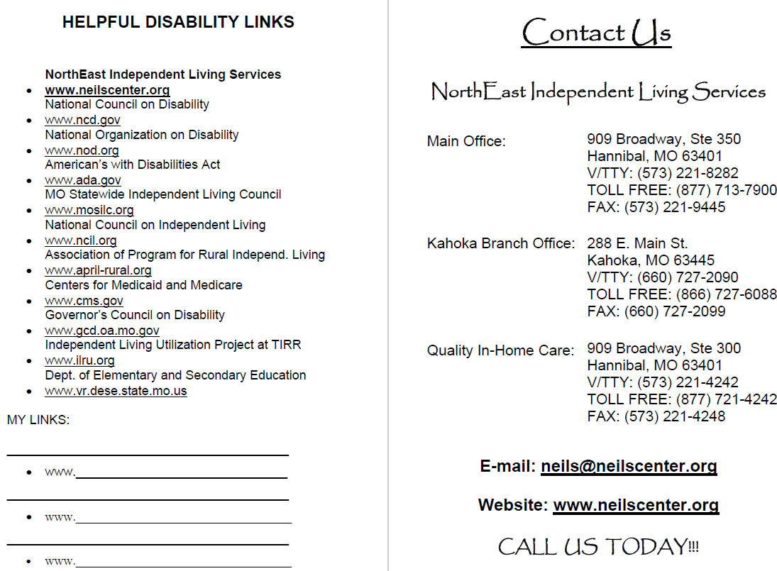
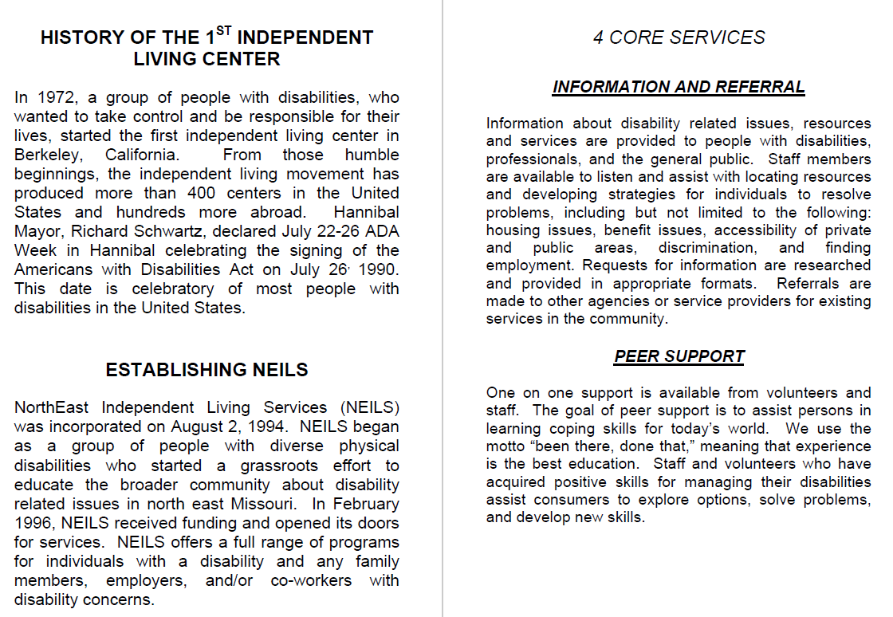
OLD…
Notes:
So, I wanted to give you guys an example of how much we’ve changed. Our Center did away with individual service brochures years ago for a couple reasons, 1) we were tired of designing and re-designing a dozen DIFFERENT brochures because we had one for EVERY service we offered and 2) it was getting to the point people were only taking the home care brochures and not paying attention to our other services.
So, we developed a handy-dandy booklet instead that included information on all our services and programs. We simply printed them ourselves at the Center and used our archaic binding machine to bind them all. I remember back when we did this for the first time that I thought these things were incredible and very eye catching!! And yes, I have to tell on myself, I created this hideous thing myself back in my Outreach Coordinator days.
(CLICK!) (CLICK!) (CLICK!) (CLICK!) (CLICK!)
All black and white, no pictures – why would ANYONE even consider flipping through this and reading it?! I’m pretty sure 99% of them got thrown in the garbage after we handed them out.
(CLICK!)

Slide 18
New NEILS Brochure Booklet
NEW…
Notes:
Fast forward to our re-branding days, we are still doing our brochure booklet, but it’s much more eye catching and professional printed and bound. I have a few copies up here if anyone would like one or we can pass them around.
Again, the reason we went this route is because we wanted everyone to always have all the information about all the services and programs we offer.
(CLICK!)
(CLICK!)
(CLICK!)
(CLICK!)
Yep, much more appealing!!
(CLICK!)

Slide 19
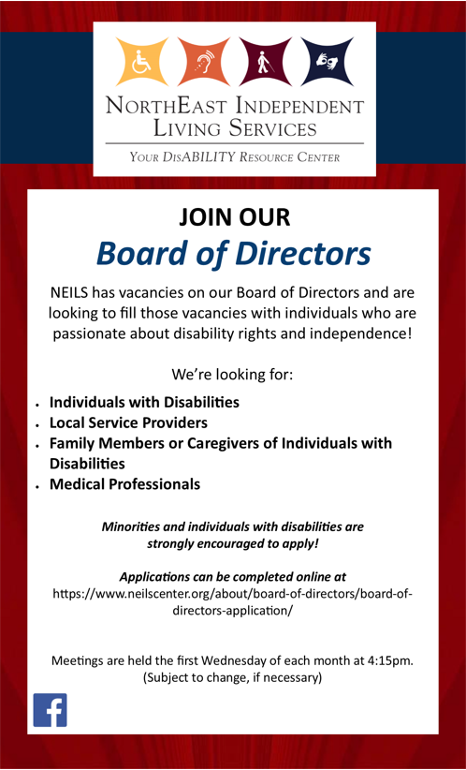
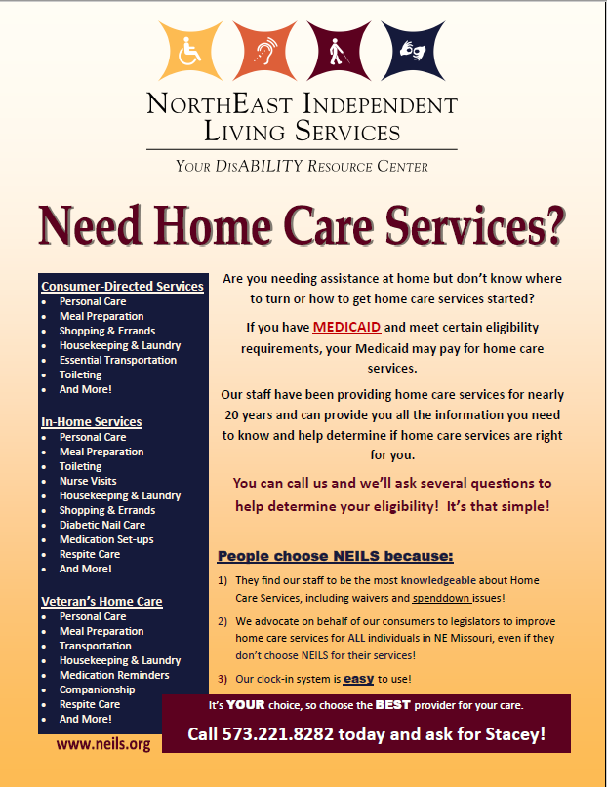
NEILS Sample Flyers and Handouts 1
Notes:
Our staff are not permitted to create their own flyers for services and use them without my permission. I must review them and make sure they meet my “branding standards.” 9 times out of 10, I create all the flyers, etc.
(CLICK!)
These are some examples of flyers we’ve created. Bear in mind, some were created very quickly so looking at them now,
(CLICK!)
there’s certainly things I would change, but more importantly, you can see how we used the same color-scheme and logo throughout, ensuring the logo was not distorted in any way.
(CLICK!)

Slide 20
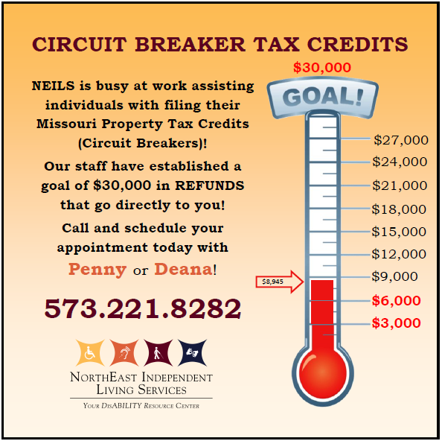
NEILS Sample Flyers and Handouts 2
Notes:
(CLICK!)
Again, a couple more flyers or images we used on our Facebook page
(CLICK!)

Slide 21
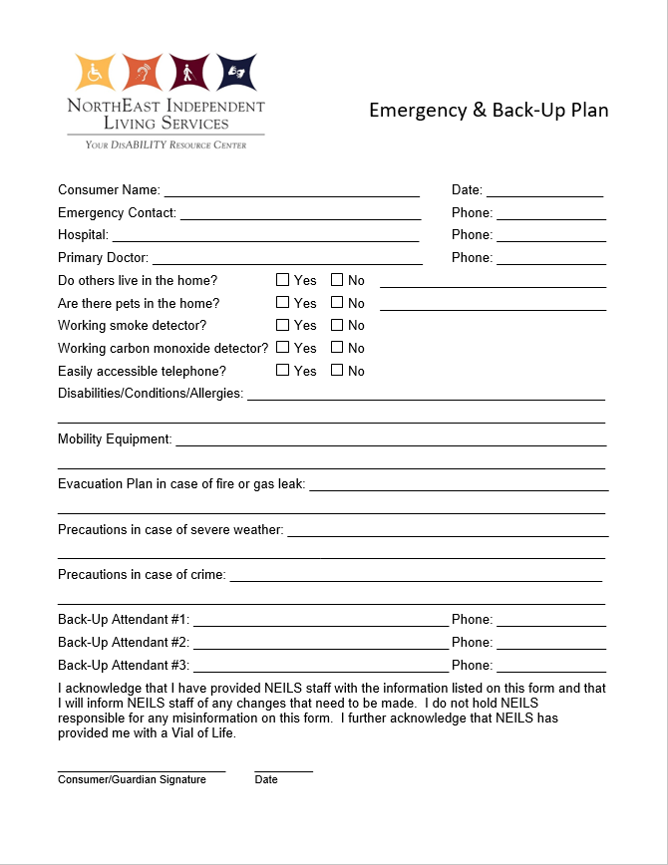
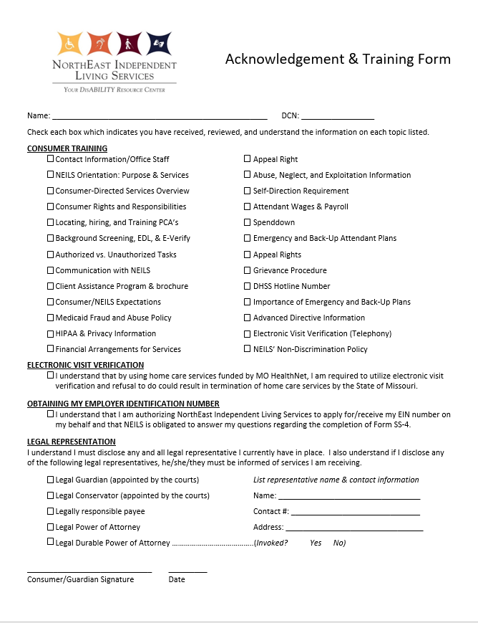
NEILS Coordinating Consumer Paperwork
Notes:
And these are a couple examples of our consumer paperwork. (CLICK!) (CLICK!)
Notice the layout, same font used, etc. All our paperwork is uniform and does not get copied over and over creating distorted forms.
(CLICK!)

Slide 22
Questions?
Brooke Kendrick
bkendrick@neils.org
Notes:
I want you guys to know I’m here to help. Like I said, I’m not a guru of marketing and branding. I learned all this on my own while trying to improve our organization, but I can tell you it worked for us!! I absolutely HATE hearing about other Centers struggling because we have absolutely been there! It’s hard as hell to dig out of it. There were a lot of early mornings, late nights, anger, tears, frustrations, and panic attacks. Branding and marketing is a TON of work and takes a massive commitment from EVERY PERSON in your Center. I will gladly help out other Centers as much as I possibly can because I know we all have things we can improve upon to make ourselves stronger as Centers.
My email address is listed on the slide and it’s a whole lot easier for me to follow-up through email than return a phone message, so I very much prefer email if you have any questions or want some help figuring some things out.

