Slide 1
COVID Response and Recovery for PWD
Stephanie brady
sbrady@joplinclinic.org

Slide 2
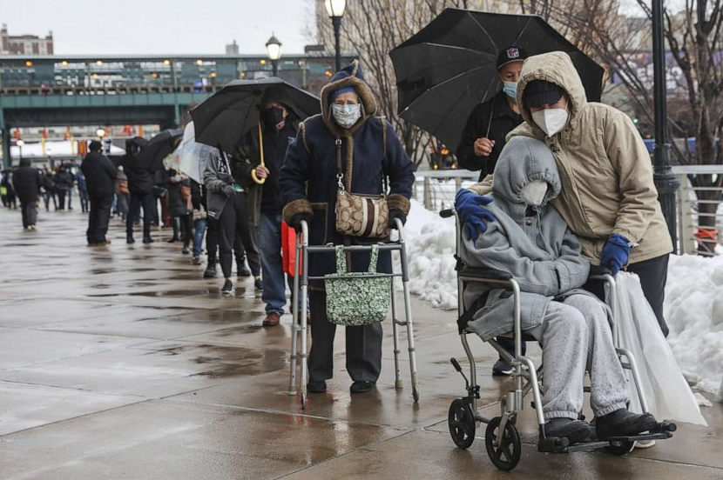
Issues Faced by People with Disabilities During COVID
Information and Testing Supplies not provided in accessible formats
Information about vaccine eligibility was confusing—It was hard to know when you were eligible to get the shot
Accommodation Requests Ignored in Healthcare Settings
Inaccessibility of Telehealth—Many providers reduced their in-office options and required patients to use telehealth
Isolation, Negative Impacts from Social Distancing—PWD faced high rates of depression, stress, and suicide during the pandemic
Difficulty Finding Personal Care Attendants—Shortage of Direct Care Workers
Notes:
PWD as a population are especially at-risk

Slide 3


Increases in Neglect and Abuse
Students with Disabilities were cut off from much needed in-person educational instruction
People Who are Deaf and Hard of Hearing Faced Profound Communication Issues due to Masks
People with Mental Health Disorders Reported Worsening Symptoms and Difficulty Finding Treatment
Postponement of general medical care or rehabilitation due to the pandemic
Difficulty in accessing general social services

Slide 4

Inequalities of Accessing Healthcare During COVID for PWD
Selective Treatments—PWD being discriminated against in receiving scarce treatments for care of COVID
Accessing Testing and Vaccination—Many of the early testing and vaccination options were drive-thru or services that were not friendly to PWD
Hospitals and doctors were taxed in general, making on-going health issues and treatments delayed
PWD often were denied the assistance of support staff during hospital stays or doctor visits

Slide 5
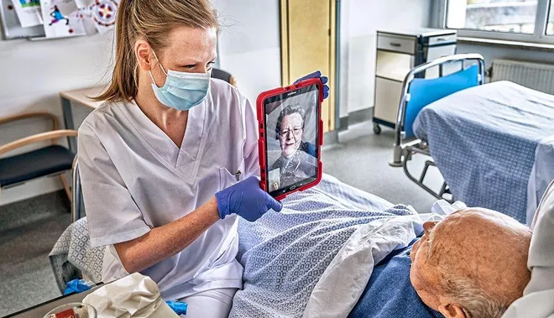
Impact of COVID on PWD Living in Institutional Settings
Isolation—Support Staff and Family Not Being Allowed to Visit
Facilities Were Short-Staffed so Residents Often Received Poor Care
Outbreaks in Institutional Settings—Has led to changes in infection control practices
Long-Term Care Facility Residents and Staff Accounted for over 23% of all COVID-19 Deaths in the US as of 1/30/2022 (Kaiser Family Foundation)

Slide 6
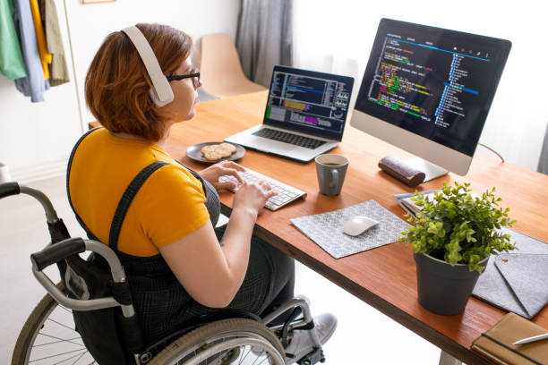
Impact of COVID on Livelihood for PWD
Pandemic-Related Layoffs—PWD have been disproportionately impacted by layoffs
Recession—Historically, recessions also disproportionately impact PWD in the workforce
Difficulty Maintaining Employment—The Pandemic made it harder for PWD to stay employed due to underlying health conditions where they were more at-risk in various employment settings
Public Transit Reductions—Many areas faced public transit reductions making getting to employment difficult for PWD
Advantage of Telework www.peatworks.org/digital-accessibility-toolkits/telework-and-accessibility/
Notes:
People with disabilities are more likely to have become unemployed due to the pandemic. Historically, people with disabilities generally experience higher rates of unemployment. However, prior to the pandemic, the share of the disabled who were employed was increasing at a faster rate than for people without disabilities, indicating progress in closing the disability unemployment gap.iv However, pandemic-related layoffs have disproportionately impacted people with disabilities. Based on trends observed in previous recessions, it is likely people with disabilities who experience job loss will be slower to recover their previous employment status.

Slide 7
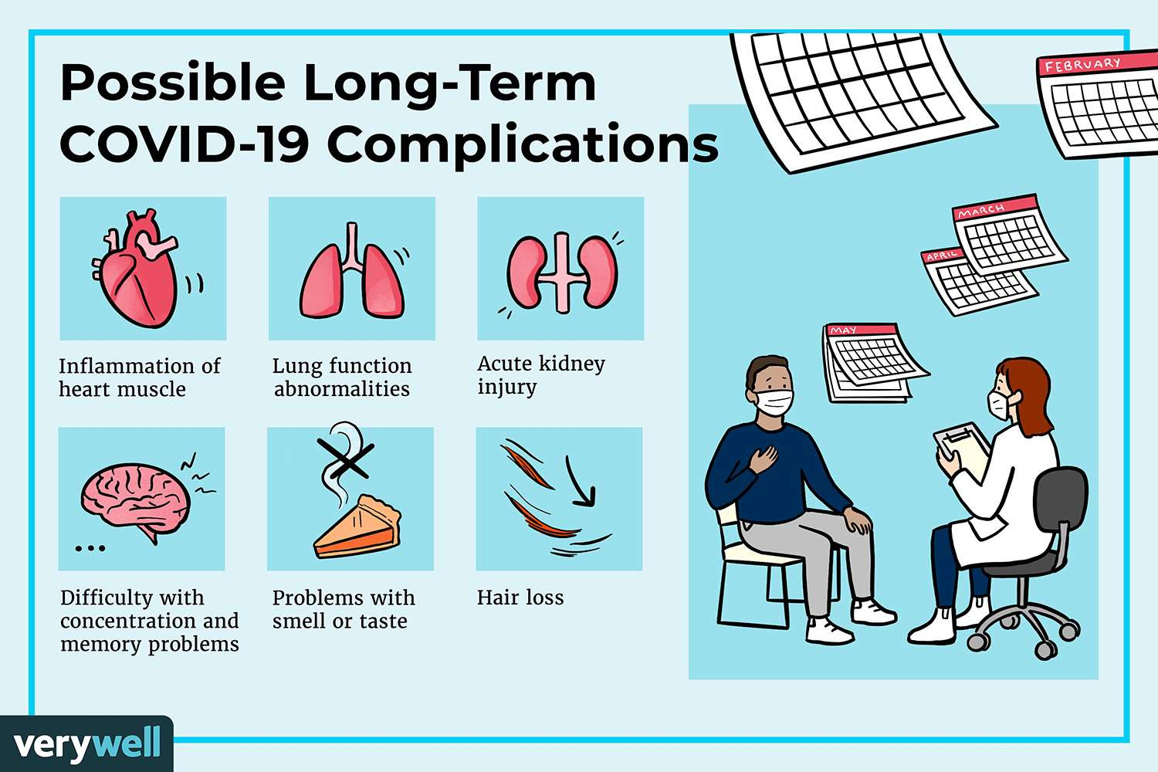
New to the Disability Movement—COVID Patients
Long-Haulers and Pulmonary Disabilities as a result of COVID
Long-COVID can be defined as a disability under Titles II and III of the ADA, Section 504 of the Rehab Act and Section 1557 of the Patient Protection and Affordable Care Act
www.hhs.gov/civil-rights/for-providers/civil-rights-covid19/guidance-long-covid-disability/index.html
Notes:
While it is defined, Long_haulers may have struggles getting Long-Term Disability benefits because a true diagnosis is still difficult to determine and the medical community is not certain if the symptoms will eventually lessen.

Slide 8

Best Practices for Administering Vaccines
Prioritizing Need Based on Health Concerns
Diverse Options for Vaccination Sites with Accessibility Features
Forms Available in Alternative Format
Set Up Vaccine Stations Specific to the Person
  Privacy for someone with sensory issues
  Ease of movement for someone with mobility issues
Home Administration of Vaccinations for People who are at High-Risk or Cannot Access other Options

Slide 9
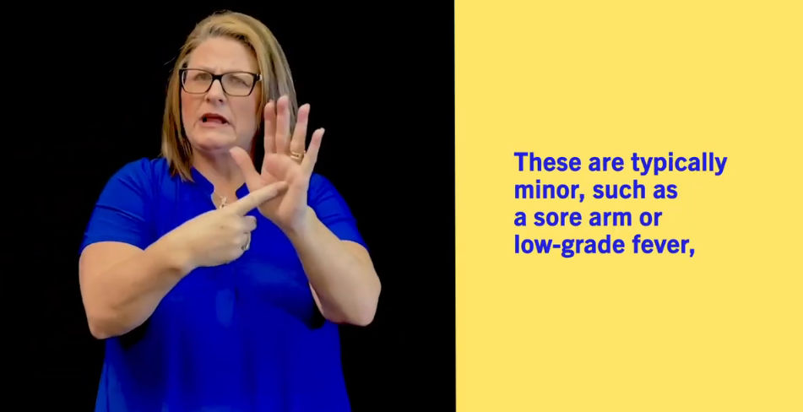
Lessons Learned from COVID for PWD
Developed Equitable Registration Options for PWD signing up for testing and vaccination
The Disability Information and Access Line has setup options for people who need help in using at-home testing supplies. https://acl.gov/DIAL
Provide COVID Vaccine Information in ASL, Braille and other alternative formats
Provide COVID Vaccination Status Cards Electronically, not Just in Paper Format
Provide Accessible Testing Supplies to People with Disabilities
Adhere to Polices that Ensure any Facility Receiving Government Funding Does Not Discriminate Against a PWD, including Hospitals During a Pandemic

Slide 10

Lessons Learned Continued
Improved Institutional-Setting Infection Control Policies
The Disability Rights Movement would not allow the Anti-Mask Movement to harm the strength of the ADA by claiming personal “exemption” under the ADA for not wanting to wear a mask as a matter of personal preference.
Distribute Masks and PPE through community-based organizations and Independent Living Centers
The Need to Improve School Response to provide better options for students with disabilities to have safe learning in-person
The Need to Implement Free Universal Internet to Everyone
The Importance of FREE Home Administration of Vaccine and Testing

Slide 11

Resources
Administration for Community Living COVID Resources: https://acl.gov/COVID-19
Combat COVID https://combatcovid.hhs.gov/
White House’s COVID Task Force www.cdc.gov/coronavirus/2019-ncov/index.html
NCIL’s Resource List https://ncil.org/covid-19/
CDC’s COVID Resources for PWD www.cdc.gov/ncbddd/humandevelopment/covid-19/index.html

