Slide 1
The Importance of Community Collaboration
Shelby Butler
Community Outreach Coordinator, e:a
Ashley Corsolini, MNCL
Director of Community Collaboratives, CPO

Slide 2
Collaboratives History
The Community Collaboratives have been around for over 25 years.
The Collaboratives are responsive to communities needs
Past Collaboratives: Religion, Senior Link, Healthy Community
Future: Community Health and Wellness
Achievements:
The O’Reilly Center for Hope
Jordan Valley Community Health Center
Triple P
Rare Breed
Notes:
In the early 90’s, a Community Needs Assessment was conducted to identify gaps in services as well as duplications of efforts. There were several focus groups of various community components convened, which later became the basis for Collaboratives of what would be initially called the Community Task Force. This group, along with Ozarks Fighting Back, later evolved into the present day Community Partnership of the Ozarks.
The Collaboratives ebb and flow depending on specific and timely community needs. Over time, some Collaboratives have become inactive and new ones have been formed to meet emerging community needs.
There are a number of achievements that have come from the Collaboratives. These are just a few of the more visible projects.
The Springfield Affordable Housing Center, Jordan Valley Community Health Center, Triple P, and Rare Breed are all examples of community projects that were started in the Collaboratives.

Slide 3
Community Partnership of the Ozarks Board of Directors
Council of Collaboratives
Child Abuse & Neglect
Early Care & Education
Environmental
Food
Housing
Let’s Go Smart: Transportation Collaborative
Notes:
As you can see here there are 6 Community Collaboratives at CPO, we serve as the backbone organization for these groups. These are groups of diverse stakeholders that work together toward goals revolving around community needs. Each Collaborative focuses on their own sector, but they also constantly look for opportunities to cross-collaborate.
Each Collaborative has an action plan with specific goals and action items.
All Collaboratives meet monthly. Most of our groups have subcommittees to work on specific tasks outside those meetings.
Each Collaborative has a chair, vice-chair and/or a co-chair. The leadership of each Collaborative also sits on the Council of Collaboratives. This group oversees the direction of the Collaboratives and also looks for areas of cross collaboration. The Chair of the Council of Collaboratives sits on the CPO Board of Directors. The Council facilitates communication flow between the community leaders (CPO Board) and the direct service providing agencies and organizations (Collaboratives).

Slide 4
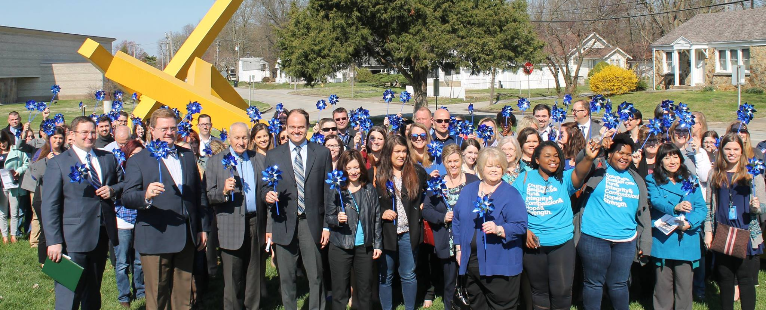
Child Abuse & Neglect Collaborative
Chair - Dan Patterson, Greene County Prosecuting Attorney
Vice-Chair – Laura Farmer, CASA Executive Director
Working together to prevent child abuse and neglect
Notes:
Child Abuse & Neglect Collaborative (or CAN) is our largest Collaborative.
Mission: Working together to prevent child abuse and neglect through the following priorities
Child abuse and neglect is a red flag issue in our community. Locally over the last few years our number of children in foster care has been trending up and that is something that has continued through COVID. For some context in 2018 there were an average of 569 children in foster care in Greene County. In 2019 that number was 633 and as of last week there were over 700 children in foster care. The average month sees around 30 children come into care in Greene County. This month by the 8th of July 22 children were brought into care.

Slide 5
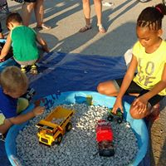
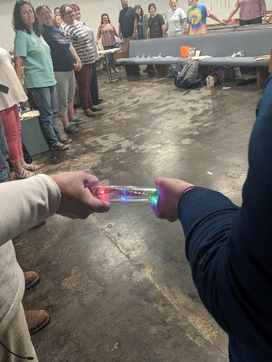
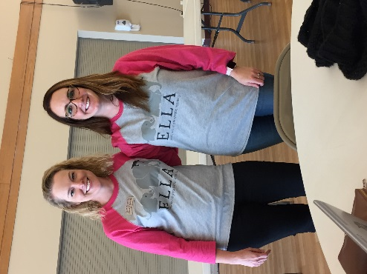
Early Care and Education Collaborative
Co-Chairs – Anitera Jackson Springfield Public Schools
Vice-Chair – Shirley Kerns, Small Wonders
Mission:
The Early Care and Education Collaborative advocates to identify, prioritize and develop strategies to address the quality, affordability and availability of early care and education.
Notes:
The Early Care and Education Collaborative advocates to identify, prioritize and develop strategies to address the quality, affordability and availability of early care and education.
Collaboration was a blue ribbon in the 2017 Community Focus Report due to how well these organizations work together to improve the education of the children in our community.

Slide 6
Environmental Collaborative
Chair – Doug Neidigh, MSU
Vice-Chair – Angie Snyder, Ozarks Headwaters Recycling
Mission:
To serve as a vehicle to bring together leadership of all various environmental and conservation groups for opportunity, to avoid overlaps in efforts, and identify gaps in services, as well as provide communication to keep all parties informed.
Priorities:
Membership education
Subcommittee Ozarks Clean Air Alliance
Notes:
Intro - Barbara Lucks is the chair of this group and Ronda Burnett serves as the Vice Chair.
The Environmental Collaborative works to bring people together from different areas in the environmental world to focus on improving our natural environment.
This group consists of local government representatives, consultants, university staff, and area non-profits and serves as a forum for current environmental topics as well as a group of representatives that are knowledgeable in a wide variety of environmental areas.
Originally established, as were all the Collaboratives, to identify gaps in service and avoid duplicates in service, the group recently changed the structure of their meetings due to there being more of a need for a discussion forum on emerging issues. The environmental community has now matured and has well-established techniques to ensure ongoing communication and works together very well. They now meet quarterly and focus on bringing in speakers to present topics and stimulate discussion among the members.
They held their first meeting with the new structure in May and had Vital Farms as the speaker. Todd Parnell spoke at the August meeting and included a book signing.

Slide 7
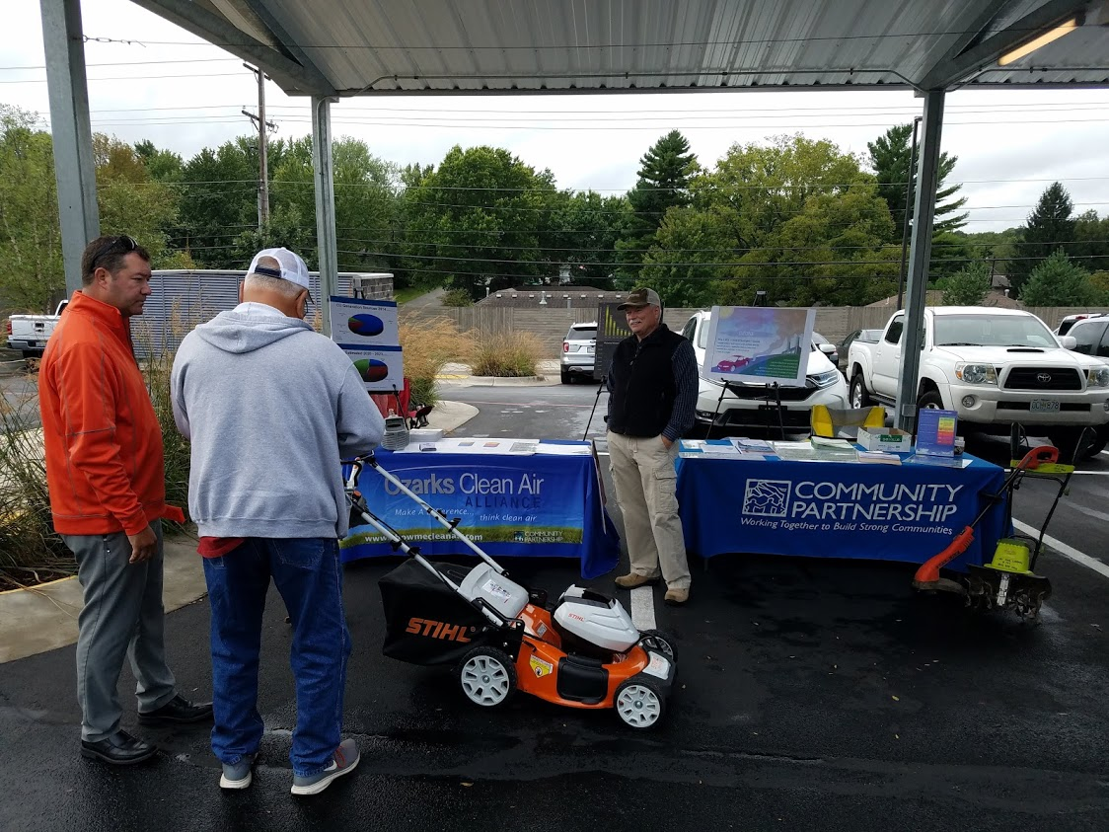
Environmental Collaborative and OCAA
Increased use in greenspaces in the community
Air quality improvements during stay home order
Notes:
The Environmental Collaborative focuses on preserving and increasing access to our natural environment. This group has one subcommittee: Ozarks Clean Air Alliance that focuses on air quality.
The city has continued to see increases in use of our public parks, trails, and greenspaces, a trend that we hope continues!
Due to the global pandemic there was a report that showed carbon emissions were down by 17% compared to last year. This has had a positive effect on our air quality. While traffic has pretty much returned to normal locally our air quality monitoring is a bit better than last year.

Slide 8
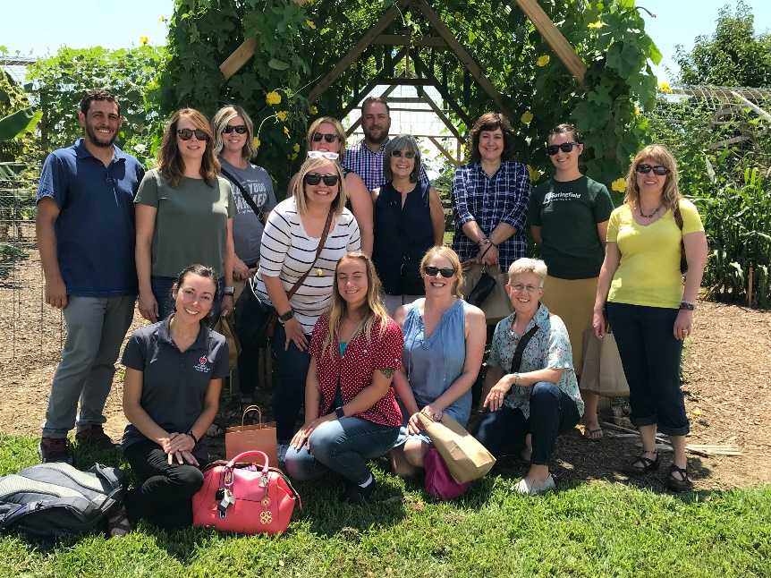
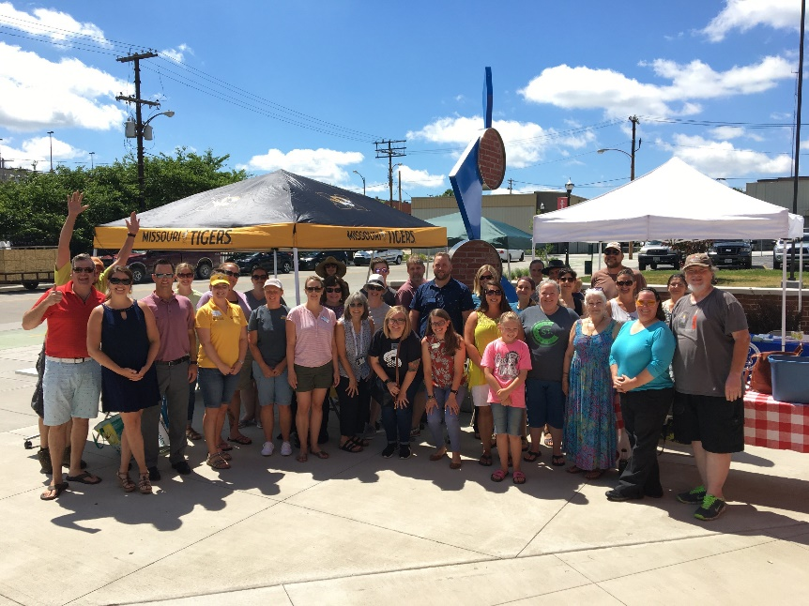
Food Collaborative
Chair – Ashley Krug, City of Springfield
Vice-Chair – Mary Ellison, Springfield-Greene County Health Department
Mission:
To support the development of a healthy, functioning local food system, bringing food groups together and representing all parts of the community, including those not at the table.
Notes:
The Food Collaborative seeks to take the community to a place where we have a healthy, local food system.

Slide 9
Housing Collaborative
Chair – Shelby Butler, empower: abilities
Vice-Chair – Isabelle Walker, Eagle Management
Mission:
To advance knowledge on issues related to affordable housing by creating forum for community-wide problem solving that targets all populations at every stage of assistance, ensuring safe, decent, affordable housing for elderly to youth and homeless to home owner.
Notes:
The Housing Collaborative seeks to advance knowledge on issues related to safe, decent, and affordable housing, from homelessness to home ownership.
This group has two subcommittees working to advance their mission. One that focuses on legislation and advocacy and the other that focuses on landlord and tenant education.

Slide 10
Let’s Go Smart: Transportation Collaborative
Co-Chair – Natasha Longpine, Ozarks Transportation Organization
Co-Chair – Derrick Estell, City of Springfield
Mission:
The Let’s Go Smart: Transportation Collaborative facilitates connections between people, jobs, and community, through multiple modes of transportation, throughout the greater Springfield area.
Notes:
The Let’s Go Smart: Transportation Collaborative seeks to facilitate community improvement through all modes of transportation.
Last year there our Transportation Collabroative merged with Let’s Go Smart a committee with Ozark Greenways to create one group with a greater voice for all modes of transportation.

Slide 11
The Collaborative Model
DEI should be a large focus
Business representation
Ability level
Strict meeting parameters
Action-oriented
Notes:
Do the people in the room represent who you’re serving?

Slide 12
The role of a CIL
To have a voice representing those with living with a disability
To give guidance on things like accessibility and inclusion
To partner and expand resources that will positively impact your service area
To share your organization as a resource to other orgs

Slide 13
How can you engage
Look for Community groups like CPO
Get on list servs that announce meeting times and places
Figure what groups exist and find the gaps
Look at strengths and experiences of those you work with
Identify those representatives to plug them in

Slide 14
Tips and Best Practices
Be consistent with attendance
Make sure staff are prepared to share
Use this as a way to promote your work and events
Keep them informed of staff changes

Slide 15
Ideas for Collaboration
Domestic Violence Education
Housing Issues (affordable and accessible)
Voting Engagement
Public policy or ordinances
Discussions about poverty and employment

Slide 16
Other ways to connect
Offer your building space for community meetings
Share community events on your social media and calendars
Look for opportunities to share personal stories on community campaigns

Slide 17
Thank you for your time!
Shelby Butler – sbutler@swcil.org
Ashley Corsolini, MNCL – acorsolini@cpozarks.org

