Slide 1
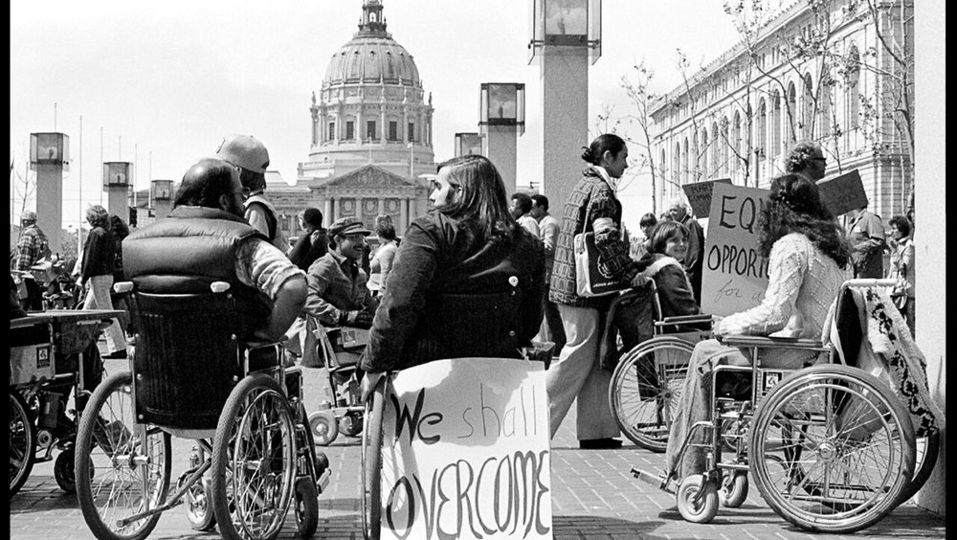
Employment For All

Slide 2

Let’s start with some

Slide 3
Barriers to Employment
In 2019, 47.5% of people with a disability aged 16-64 who were not employed reported at least one barrier to employment. -U.S. Bureau of Labor Statistics
Own disability as a barrier- 79.0%
Lack of education and training- 14.3%
Lack of transportation- 12.1%
Need for accommodations at the job- 12.5%
Employer or Coworker attitudes- 9.1%
Lack of job counseling- 6.4%
Loss of government assistance- 5.3%
Other (Not Specified)- 13.5%
In July 2019 20.8% of unemployed people with a disability reported using a career assistance program.
10.1% of employed reported using a career service.

Slide 4
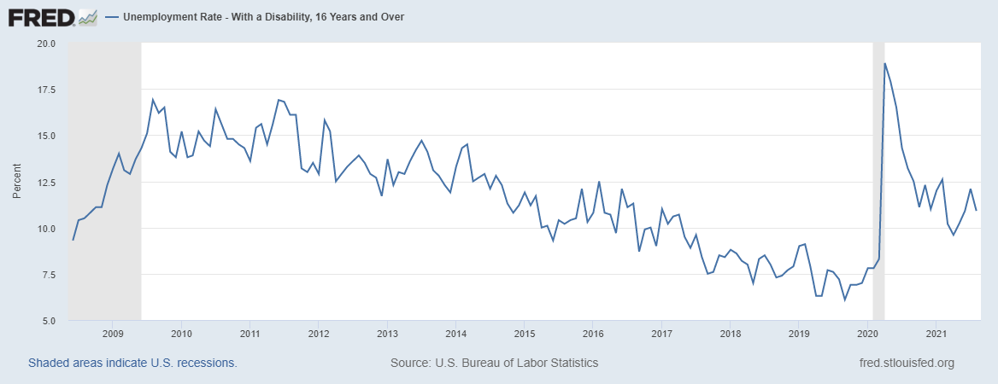
2008 High 12.3% December Low 9.3% June 2015 High 11.9% January Low 9.3% June
2009 High 16.9% August Low 12.9% April 2016 High 11.3% August Low 8.7% September
2010 High 16.4% July Low 13.8% February 2017 High 11.0 January Low 7.5% September
2011 High 16.9% June Low 13.0% November 2018 High 8.8% January Low 7.0% May
2012 High 15.8% December Low 11.7% December 2019 High 9.1% February Low 6.1% September
2013 High 14.7% July Low 11.9% December 2020 High 18.9% April Low 7.8% January
2014 High 14.3% February Low 10.8% November 2021 High 12.6% February Low 9.6% April
Current: August 2021 10.9%
Notes:
2011-State economy grew just 0.04%. Slower than the national average of 1.5%. We were 43rd in the nation. Illinois grew at 1.3%.

Slide 5
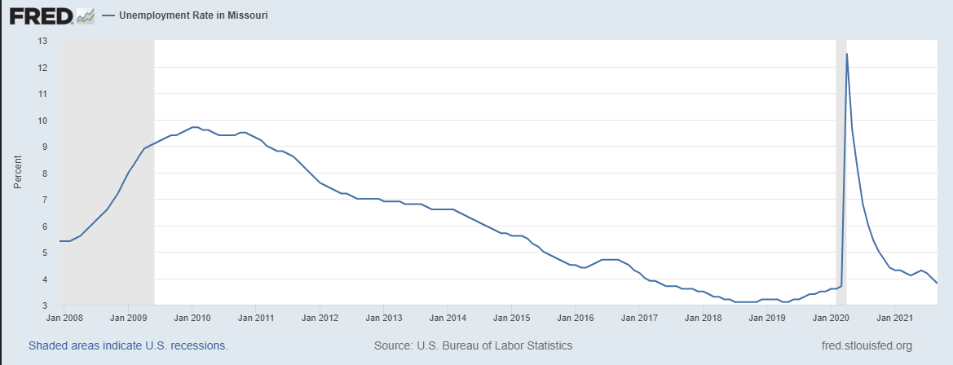

Slide 6
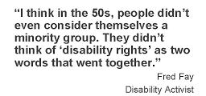
Over The Years
1938
Fair Labor Standards Act Section 14C
1973 The Rehabilitation Act of 1973 (Section 504)
2009
Disability Employment Statistics
1920
The Smith Fess Act
1950 National Barrier-Free Standards
1990
Americans with Disabilities Act
1935
League of the Physically Handicapped
1940
American Federation of the Physically Handicapped (Now NDEAM)
1954
Vocational Rehabilitation Amendment
1986
Employment Opportunities for Disabled Americans Act
1996 Telecommunications Act
2014
Section 503
WIOA
ABLE Act
Notes:
1920
The Smith-Fess Act: Also known as the Civilian Vocational Rehabilitation Act, this established a federal program to provide vocational assistance to Americans with physical disabilities through guidance, training, occupational services and job placement.
1935
League of the Physically Handicapped: This group formed a protest at the Emergency Relief Bureau (ERB) to demonstrate job discrimination that people with disabilities were facing. This group started as only 6 people who began the 9-day sit-in and it quickly grew. The League eventually led to the creation of 1,500 jobs in NYC.
Social Security Act: The Social Security Act was signed by President Franklin D. Roosevelt, to provide payment of benefits to people with disabilities who contributed to the Social Security through taxation on their earnings.
1938 Fair Labor Standards Act Section 14C: Fair and equal wages to be paid to people with disabilities based on prevailing wages.
1940 American Federation of the Physically Handicapped: This was the first national organization to urge an end to job discrimination; which later resulted in the National Employ the Physically Handicapped Week (the first week in October). In 1988, changed to NDEAM
1950 National Barrier-Free Standards:This was a combination of the U.S. Veterans Administration, the President's Committee on Employment of the Handicapped and National Easter Seals Society, and more, to develop the national standards for "barrier-free" buildings for people with disabilities to be able to access.
1954 Vocational Rehabilitation Amendment of 1954: Targeting people who could return to work with assistance; but had intellectual disabilities, this amendment helped thousands of people obtain employment and funded more than 100 university-based rehabilitation programs. Later it contributed to funding for research, which lead into the creation of the National Institute on Disability and Rehabilitation Research.
1973 The Rehabilitation Act of 1973 (Section 504): Section 504 was the first federal civil rights protection for people with disabilities that they can not be excluded from the participation, be denied the benefits of, or be subjected to discrimination under any program or activity receiving federal financial assistance such as hospital, schools, welfare and government offices. This also extended to additional sections such as hiring by the government (Section 501) or subcontractors of the government (Section 503), and transportation and building accessibility (Section 502),
1986 Employment Opportunities for Disabled Americans Act of 1986: The EODAA enhances work incentives for people with disabilities under the Supplemental Security Income (SSI) program; which provides special SSI payments and Medicaid coverage while eligible individuals with disabilities make attempts to work.
1990-ADA The law guarantees Americans with Disabilities unrestricted access to public buildings, equal opportunity in employment, equal access to government services and employment opportunities. The ADA is an "equal opportunity" law for people with disabilities. 1992 EEOC enforcement for businesses with over 25 employees.
1996- Telecommunications Act requires technology to be accessible for all.
2009- Disability Employment Statistics: U.S. Dept. of Labor's bureau of Labor Statistics adds disability to the monthly Current Population Survey (CPS), making it the first time that government officially collects data on the employment status of people with disabilities.
2014
Section 503 of the Rehabilitation Act: U.S. Dept. of Labor's Office Contract Compliance Program updates 503 regulation which prohibits federal contractors and subcontractors from discriminating in employment against people with disabilities and to take affirmative action to recruit, hire, promote and retain people with disabilities.
The Workforce Innovation and Opportunity Act (WIOA) of 2014: This provides a comprehensive change to a number of employment and education-related programs, including services for people with physical, intellectual, and developmental disabilities.
Achieving Better Life Experience Act (ABLE): ABLE improved financial stability and employment options for people with disabilities by authorizing tax-advantaged savings accounts for youth and adults with disabilities.

Slide 7
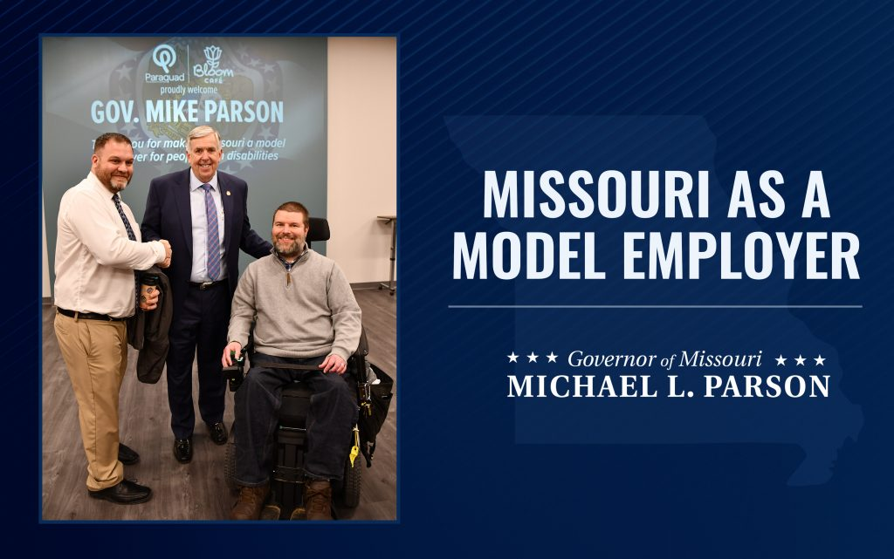
2019 Executive Order 19-16 Missouri as a Model Employer Initiative
In 2019 79.8% of working age individuals without a disability were employed while only 37.1% of working age individuals with a disability were employed.
The Model Employer classification is an emerging trend supported by the Federal Department of Labor's Office of Disability Employment Policy to help more people with disabilities obtain competitive, integrated employment in state government and hopes to serve as a model example to the employer community.

Slide 8

Employment First is a concept to facilitate the full inclusion of persons with disabilities in the workplace and community in which community-based, competitive integrated employment is the first and preferred outcome for employment services for people with disabilities.
Key beliefs of Employment First
Everyone can work
Everyone has the right to earn a living wage in a job of their choosing, based on their unique talents, gifts, skills and interests.
Employment is a way for people to achieve their personal dreams of success, respect, control and choice.
Having a job can be an important part of one’s self-identity and value in society today.

Slide 9
Myth vs Fact
Misconceptions effect employment

Slide 10
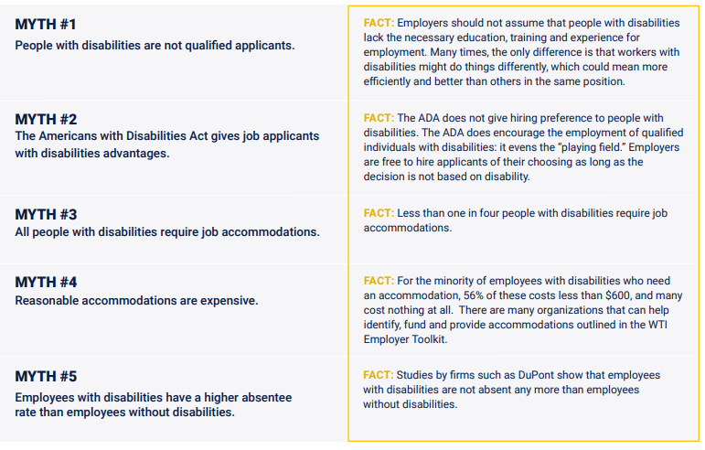

Slide 11
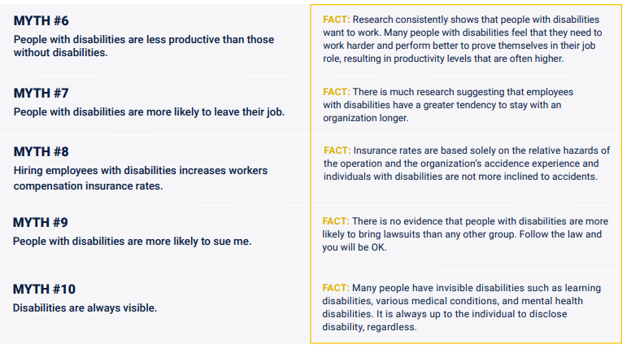

Slide 12

Promoting Inclusion
With an aging workforce and projected shortfall in the overall workforce, we must look at the untapped group of people with disabilities that are ready and able to work.
These candidates are keenly dedicated, hard working and have a great appreciation for the opportunity to work.
Research proves that employees with disabilities meet or exceed productivity, quality and attendance standards.
Hiring people with disabilities leads to diversity. Diversity leads to business and organizational innovation. Innovation adds value and can create wealth or savings for businesses.
Hiring people with disabilities gives businesses access to tax incentives and deductions.
Businesses can receive no-cost technical assistance & training from area employment providers on how to best support and work with people with disabilities.

Slide 13
Businesses that are succeeding with inclusion!

Slide 14






Notes:
Starbucks Inclusion Academy, many stores with ASL order stations.
JP Morgan Chase- Has entire department for disability inclusion ran by a man who has lived with a disability
Coca Cola- Joined the Valuable 500 which is a global disability inclusion initiative which encourages major businesses to recognize the value of the worlds 1.3 billion people with disabilities
Walgreens has training programs designed for people with and without disabilities. Same job, same performance operating model.
IBM for years has been designing technology for PWD and in 2000 set up the IBM human ability and accessibly center within IBM research division
UPS Training program implemented in their main air sorting hub in Kentucky

Slide 15
Over a 4-year period these companies reported
28% Higher Revenue
Double Net Income
30% Higher Economic Profit Margins
Notes:
That’s because people with disabilities bring unique characteristics and talents to the workplace that benefit employers and organizations. If we find the right jobs for the right people, it can and will increase the bottom line of companies.
Given the unprecedented situation created by the COVID-19 pandemic and economic crisis, new ideas, new efforts and new leadership are need to remake the economy and make it more inclusive for all. Our community has been hit hard by the pandemic and needs to be at the forefront of any recovery efforts.

Slide 16






Notes:
Meet the Moore Family - Ben, Jackie, Jordyn and Hudson. Jordyn has autism. The shirt project was started in June of 2018 with the purpose of teaching her job skills. It is now a family business where Jordyn works independently rolling shirts, adding wristbands and signing/stamping thank you cards for every package.
This Kettle Korn company has production sites in both KS and Georgia and makes gourmet kettle korn. CEO Joe Steffy creates over 5 different types of kettle korn. Joe has owned his company for 15 years, moved to online sales, and has even spoken before the US Congressional Small Business Committee Hearings! I should also mention Joe has Down Syndrome.
This life changing business is one of my new personal favorites in the KC area. This coffee and ice cream shop gives an innovative and meaningful employment for individuals with developmental disabilities. Every scoop of their made from scratch ice cream is incredible. They are currently seeking volunteers to help out at the shop.
Dreamers Merchants Coffee Company began in 2015 when Diane Grover learned of the low rate of employment of individuals with a disability. In hopes of creating a future job for her daughter, Mary Ellen, Diane started a coffee company. Today 30 Dreamers can be found in 13 states and both the company and the movement are growing rapidly. Every Dreamer's purchase allows them to hire individuals of all abilities in an inclusive environment.
This is a father-son business with a social and retail mission of spreading happiness in the world. Check out John’s Crazy Socks to meet John, a young man with Down syndrome who believes in giving back as his business donates five percent of their earnings to the Special Olympics!
Collettey's is changing the world, one cookie at a time. Collette is an individual with Down syndrome and after being turned down in many job interviews, she decided to pursue her passion for baking. She now employs 13 individuals with disabilities and speaks frequently about how the disability community is often overlooked.

Slide 17
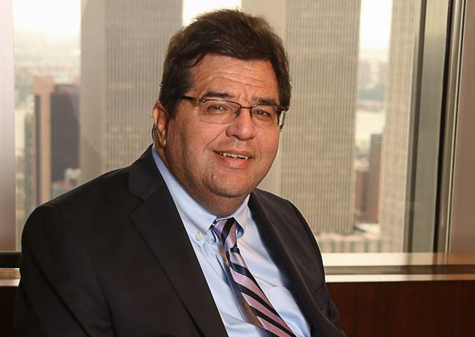
"Disability inclusion is no longer about automatic doors, curb cuts, ramps, and legislation. These historic efforts were essential at the time and represented the thinking and necessary change required for people with disabilities in the 20th Century.
Today, the new era of disability inclusion is about “assimilation” – – hiring professionals with disabilities into the robust culture of the firm. Full assimilation requires a leadership team with the will, commitment and attitude to identify, train and groom professionals with disabilities for leadership positions at the firm as we do with mainstream employees."
Jim Sinocchi, Head of the Office of Disability Inclusion JP Morgan Chase

Slide 18










Steps Businesses Can Take
Workplace Flexibility/Customization
Internships & Mentoring
Expression of Commitment
Partnerships
Accommodations
Return to Work/Stay At Work Strategies
Disability Inclusion Training
Ensuring Accessibility
Transportation Considerations
Targeted Hiring

Slide 19
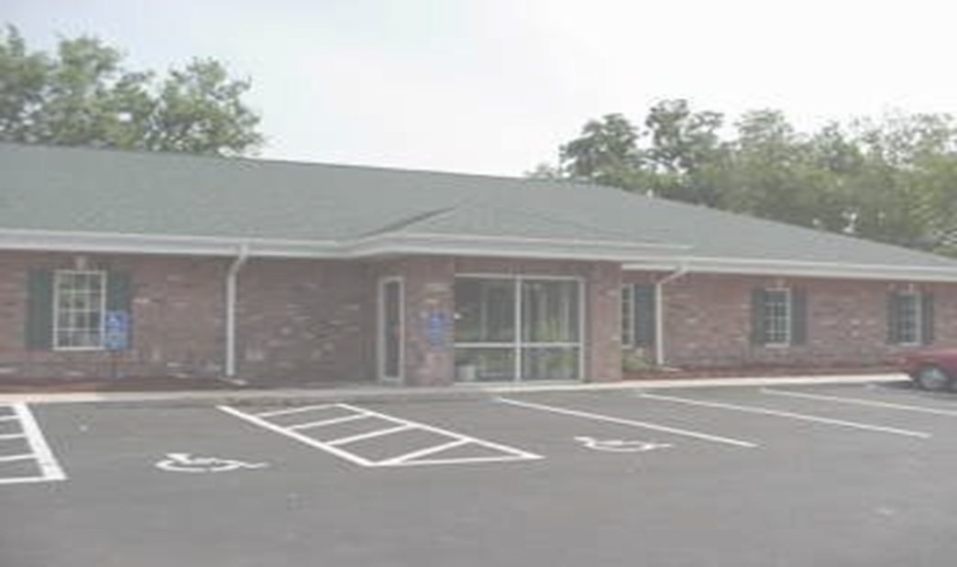
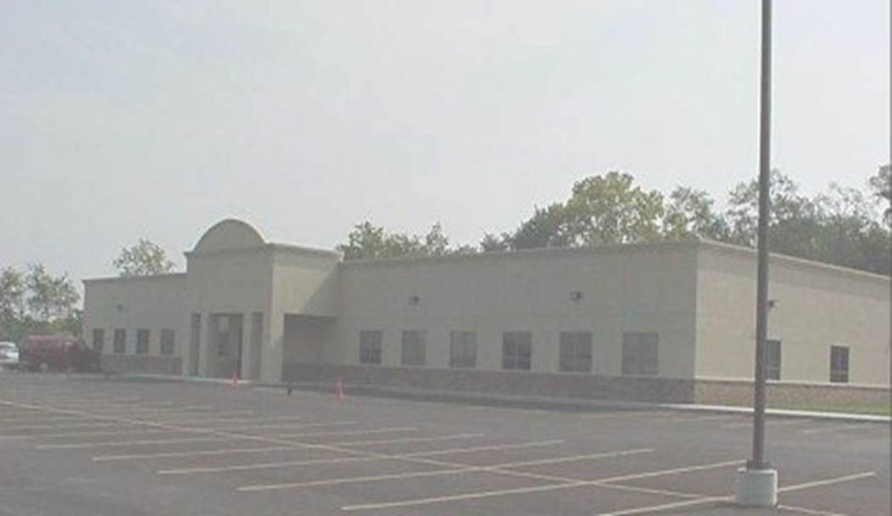
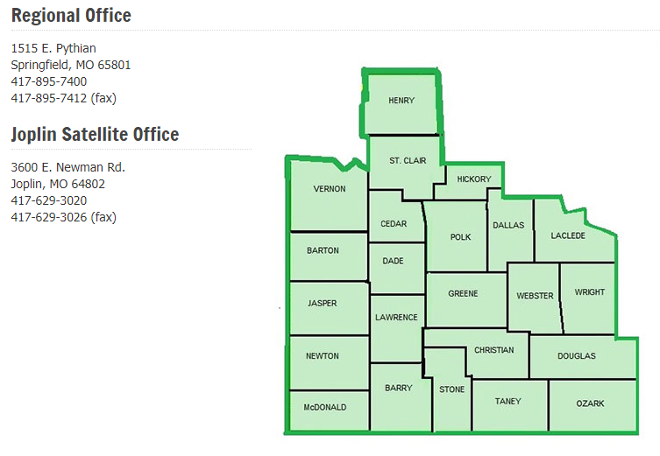
First steps to find employment supports
VR North
613 E Kearny St.
417-895-5863
Serving: Greene County by zip codes:
65801, 65803, 65806
Also serving: Dade, Dallas, Douglas, Laclede
Polk, Webster and Wright Counties.
VR South
1735 W. Catalpa, Suite C
417-895-5720
Serving: Greene County by zip codes:
65802, 65804, 65805, 65807, 65808, 65809, 65810, 65814
Also serving: Lawrence, Stone and Taney Counties
Notes:
If you want to work but have a disability that keeps you from finding, keeping or advancing in a job, Vocational Rehabilitation (VR) may be able to help you. VR specializes in employment and training services that can assist you in becoming employed. A VR counselor will determine your eligibility for services. To be eligible, you need to have a physical or mental impairment that causes problems with working and need VR services to be successfully employed. Once eligible, you will work with a counselor who will help you develop a plan for your rehabilitation. We will give you vocational information and guidance allowing you to make informed choices about your vocational plan.
VR offers a wide range of services that are individualized for your needs. You and your counselor decide which services will help you become employed. Some of the services that may be available are
Guidance and counseling
Job-seeking skills and job placement
Vocational training
VR also provides assistance with
Transition Services
Supported Employment Services
Rehabilitation Technology Services
Ticket to Work Program

Slide 20
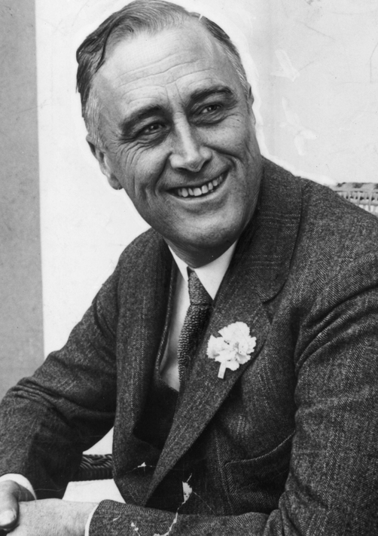
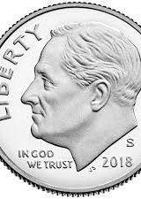
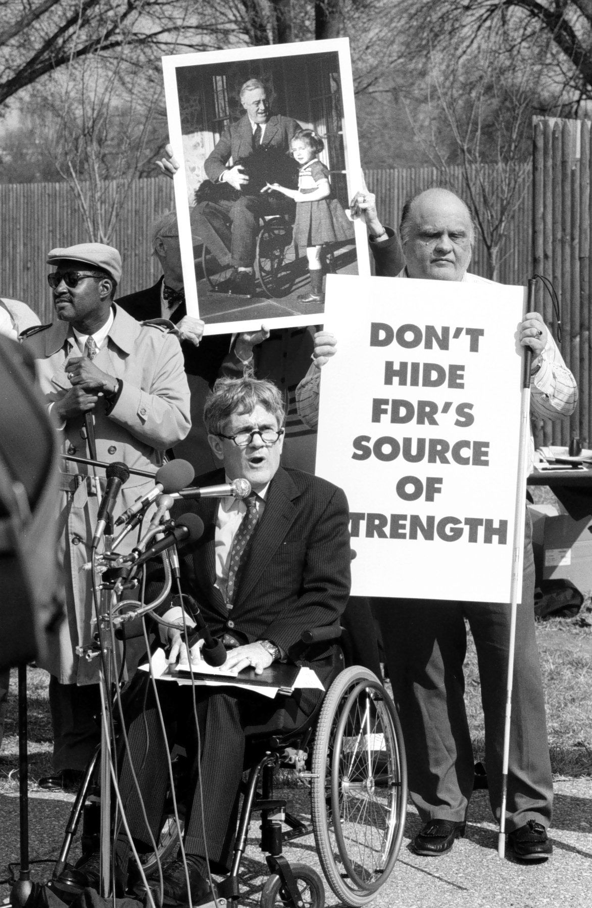

Notes:
FDR Was the 32nd President of the US and was reelected 4 times. Contracted polio in 1921. Was urged and required for most of his Presidency to hide his disability because his team thought it would make people see him as weak or unfit to lead but also due to “Ugly Laws” that had been in effect since the 1800’s. “No person who is diseased, maimed, mutilated or in any way deformed so as to be an unsightly or disgusting object or improper person to be allowed in or on the public ways or other public places in this city, or shall therein or thereon expose himself to public view.”
In 1938, having served more than one term as president, he renamed the organization the National Foundation for Infantile Paralysis (NFIP).
Roosevelt used his position as president to appeal to the public for help. Singer Eddie Cantor jokingly urged people to send dimes to the president to help him with the cause. More than 2.68 million dimes were sent to the White House.
This deluge of dimes led to the NFIP’s new name—the March of Dimes. 1945 FDR was placed on the dime.

Slide 21
