Slide 1
Housing: Challenges and Innovations
Wayne Crawford and Travis Rash

Slide 2
Housing Challenges
Lack of affordable housing
Discriminatory rental application fees
Housing density ordinances
Elimination of affordable housing

Slide 3
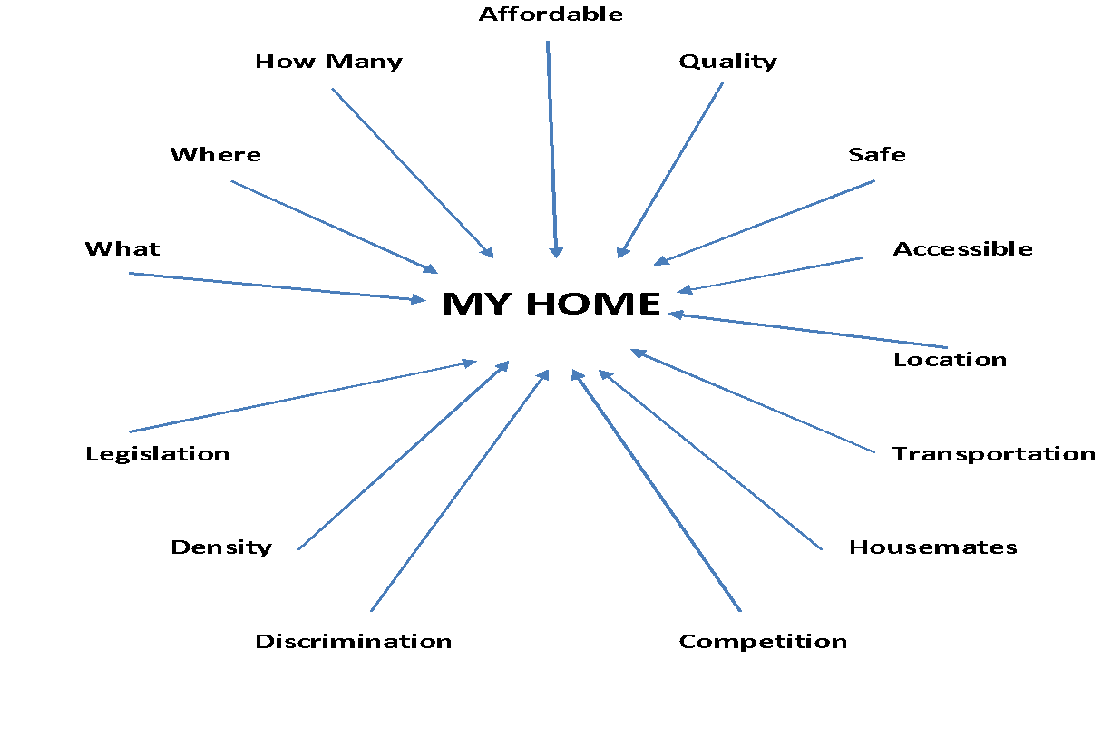

Slide 5
Housing Innovations: Real Estate with a Social Purpose
Intentional focus on Diversity, Equity, and Inclusion in Real Estate Service Provision
Nonprofit Real Estate Expansion and Participation
Realtors with a Social Purpose
Revenue Generation for Nonprofits
Affordable Housing Policy Development and Advocacy

Slide 6
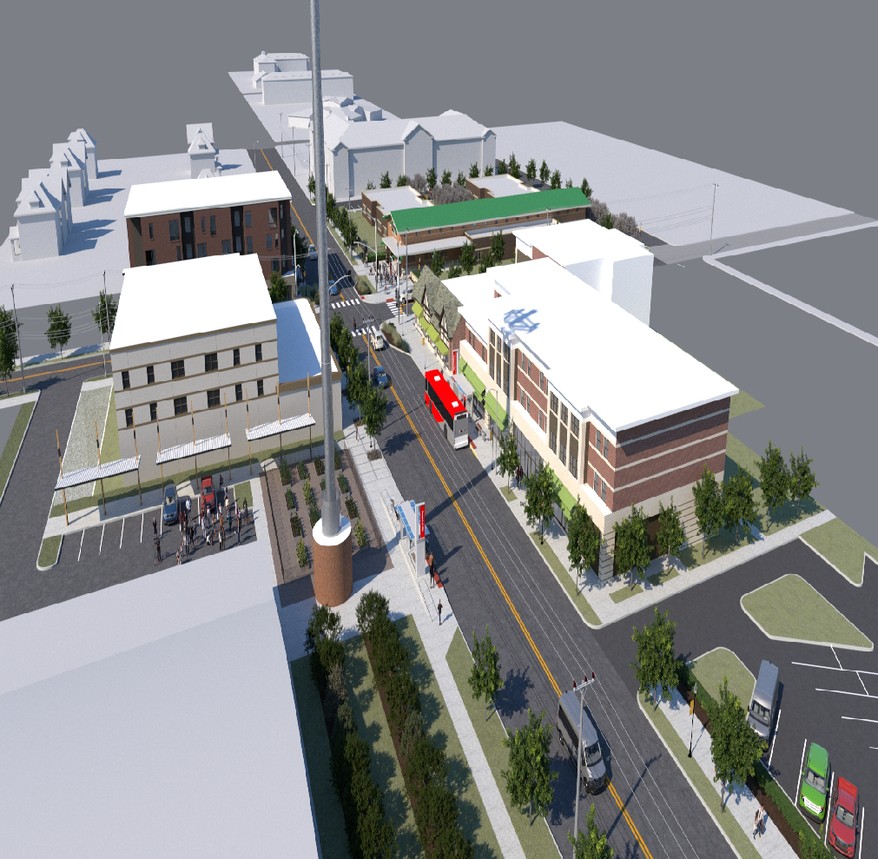
Housing Innovations: Affordable Housing Development Partnerships
Project Team: The Whole Person, Dromara Development, Scott Associates
Community Partners: RideKC Development Corp., Key Coalition Neighborhood Association, Ivanhoe Neighborhood Council, Oak Park Neighborhood Association
Universal Housing and Program Space with The Whole Person and Key Coalition
• Universal design focused affordable housing — 33 units
• Universal design park with programming by The Whole Person
• $6.78 mm Affordable Housing budget
35P/Station Area Plan Purpose:
• To promote sustainable development with a preference for community-based organizations to create and also capture wealth
• To mobilize and amplify present community developers' efforts by establishing an organizational approach and structure for development that can provide accountable Equitable Transit Oriented Development in the Prospect corridor at the 35th and Prospect node.
• To establish a comprehensive planning model for the redevelopment of the 35th and Prospect node
https://docs.google.com/presentation/d/1u9x2TfNV1wIYVAjyqAYDsHSMWXnmLkpnZ7MVurhIaQI/edit#slide=id.p

Slide 7
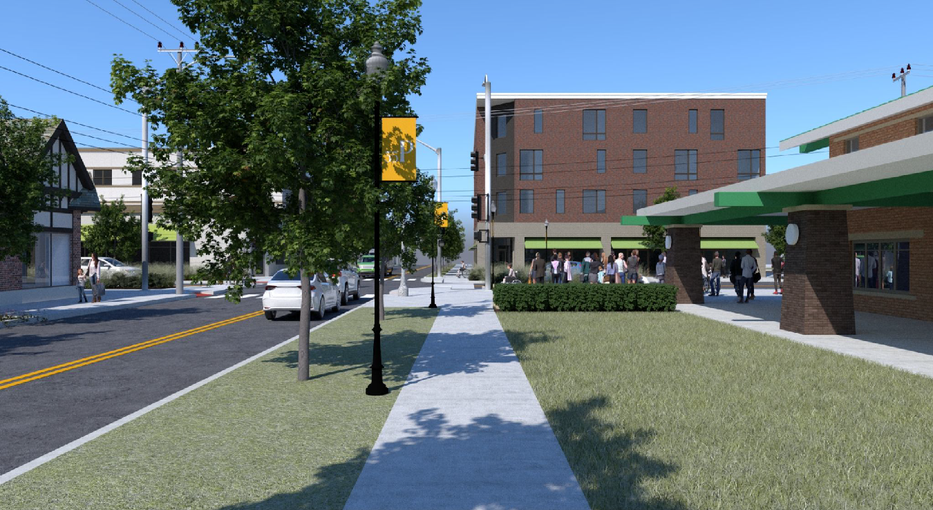
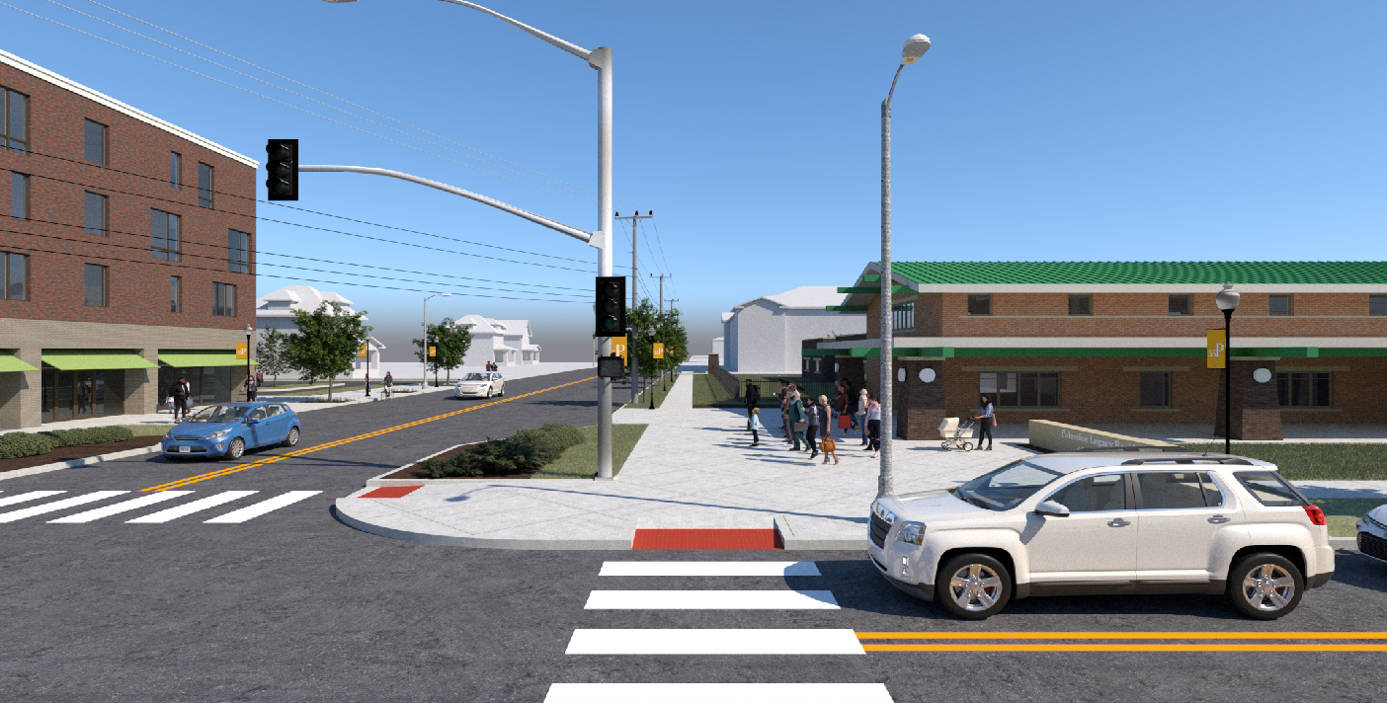
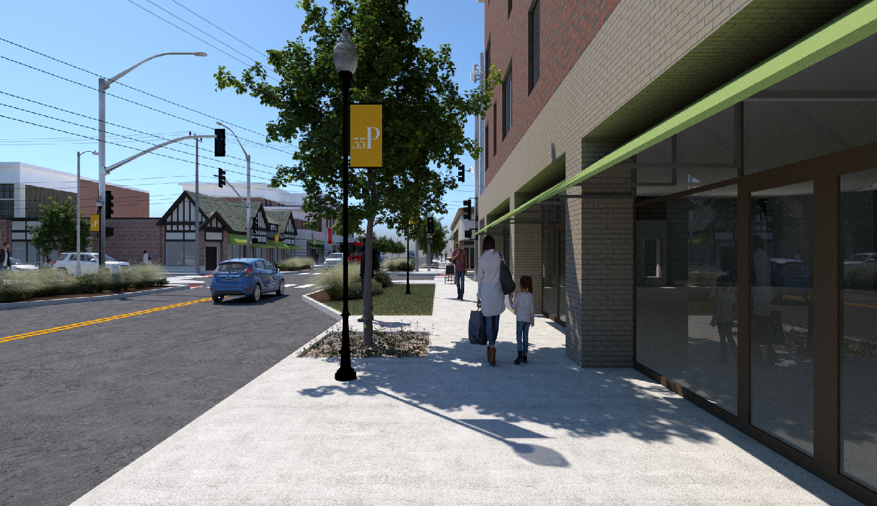
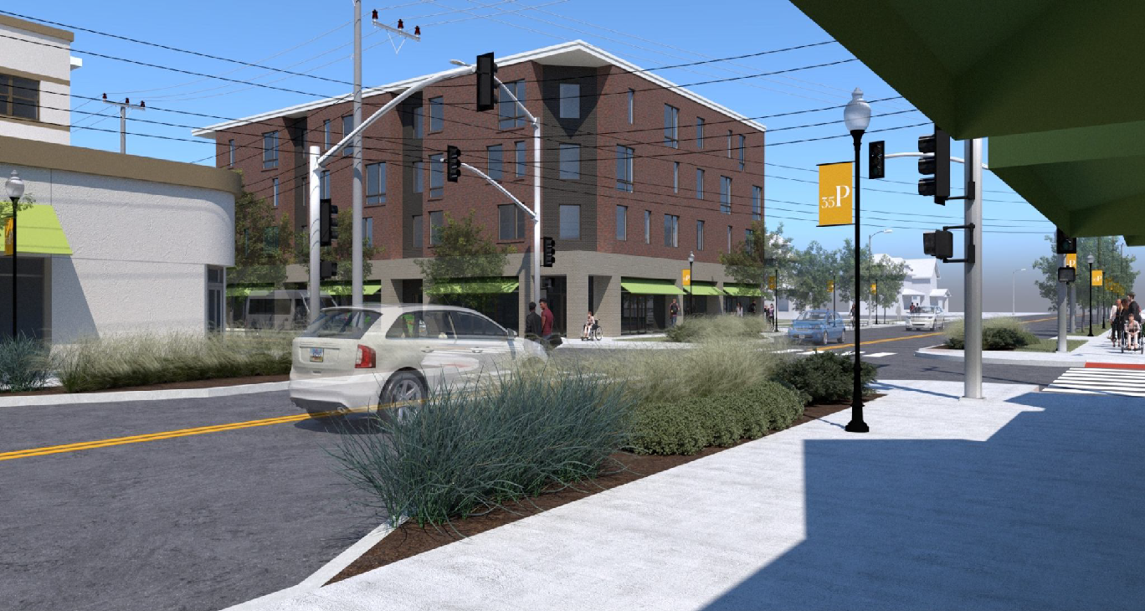

Slide 8
Questions/Additional Information
E. Wayne Crawford
Executive Director
Missouri Inclusive Housing
E: waynecrawford@mohousing.com
Ph: 855.444.5100
Travis Rash, MPA
Real Estate Consultant
The Whole Person
E: TravisR@thewholeperson.org
Ph: 816-627-2279

