Slide 1
MO SILC Statewide Surveys
Presented by Justin Clarke (TWP) & Mike Parker (Paraquad)

Slide 2
Overview
Learn about the three core surveys: Consumer Needs, IL Outcomes, and SPIL Tool
Demonstrate how the different surveys encompass an overall strategy for independent living services
Review results of performance on Consumer Needs
Review the progress on SPIL Tool

Slide 3
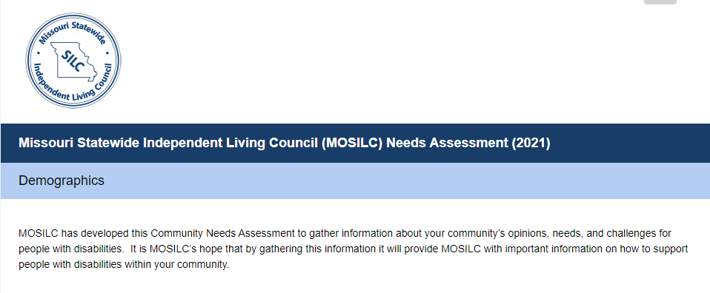
Consumer Needs Assessment
The survey is attempting to determine service gaps throughout the state
Questions are asked to identify location, types of services available, and quality of accessibility in their area
New survey layout introduced in 2021
Notes:
The previous layout asked only whether services were “available” or “not available”
In analyzing, it was determined the survey could be used to
Identify needs by geographic location
Target specific services
Provide options for follow up from both the person completing the survey and the CIL

Slide 4
Consumer Needs Assessment
Who can complete the survey?
CIL Staff
CIL Volunteers
CIL Board Members
People with Disabilities
Family Members/Friends
Community Partners
How is the survey completed?
Online at website sent via SurveyMonkey
Link is sent when survey is open
Responses are due --/-- to 9/30
Notes:
Various delivery methods can be used to solicit responses
Email
Social Media
Community partners
Newsletter

Slide 5
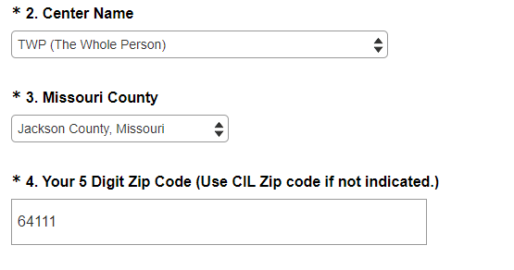
Consumer Needs Assessment
Identifying needs by geography
Notes:
We are able to identify consumer needs by
CIL
County
Zip code
It is recognized that service needs may differ by rural, urban, suburban, ex-urban, etc locations

Slide 6
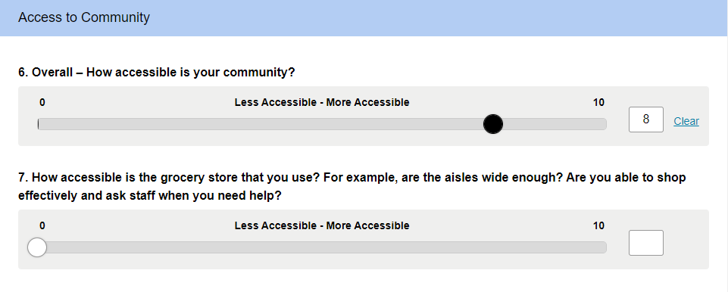
Consumer Needs Assessment
New question types
Notes:
Different forms of questions with the aim of providing useful input were created
Questions were built to identify needs in core areas of focus
Transportation
Emergency Preparedness
Housing
Health Care
Communication
Voting
Advocacy

Slide 7
Consumer Needs Assessment
Locate and contact a CIL

Slide 8
IL Outcomes
Identifies the quality of services provided throughout the state
20% of consumers who received services the previous year are asked about their experience
Individual response are entered into SurveyMonkey
Responses are due 11/15

Slide 9
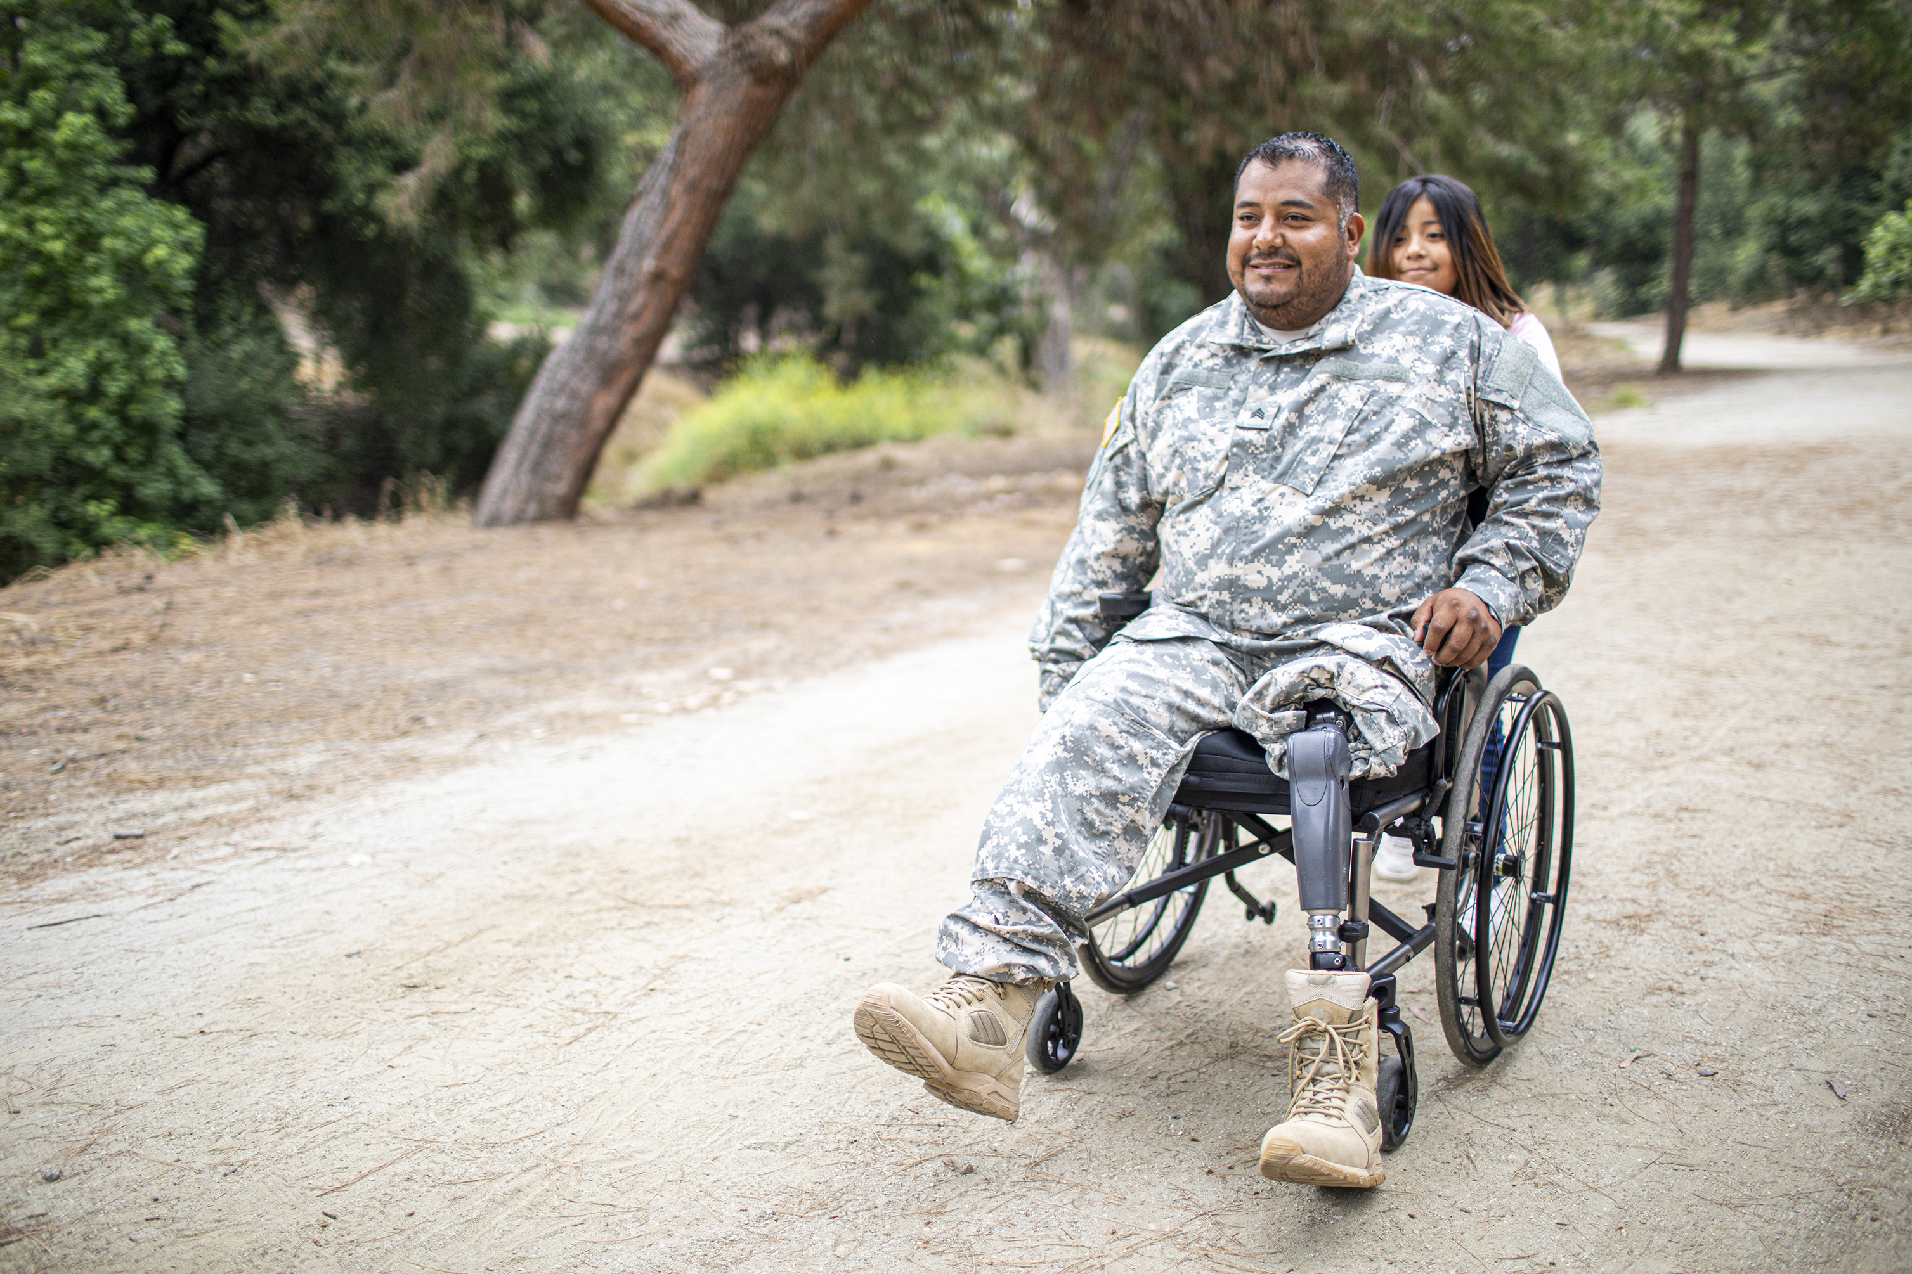
IL Outcomes
Consumers are asked to provide demographics at the start of the survey.
Demographics established are:
United States Veteran status
Missouri Medicaid status
Voter registration status

Slide 10
IL Outcomes
Advocacy
Benefits Advisement
Employment Advisement
Home Modification
Housing Referral
Independent Living Skills
Information and Referral
Peer Support
Personal Assistance Services
Adaptive Equipment/Assistive Technology
Youth Services
Emergency Assistance
Institutional Diversion
Transportation
Respondents were asked if they received services during the previous fiscal year.

Slide 11
IL Outcomes
“What was your experience with ______services you received?” (Respondents are asked to rate the service as Satisfied, Somewhat Satisfied, or Dissatisfied)
*Respondents providing an answer of Somewhat Satisfied or Dissatisfied are asked to provide feedback
“Did you gain knowledge, skills and/or independence from the _______service?”
“Did this ______service make a positive change in your life?”
Respondents providing a Yes answer are asked to describe the change made by the service.
Respondents reporting received services during the year were asked follow-up questions about their experience.

Slide 12
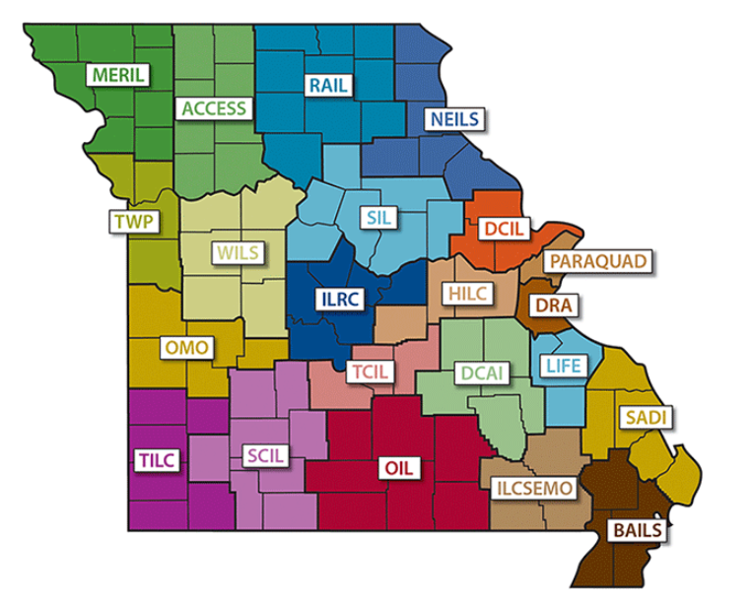
SPIL Tool
Aggregates CIL performance toward State Plan for Independent Living
Entered each quarter via SurveyMonkey
Aligns with SPIL three-year period
Due within 30 days of the QSR
Questions are designed to target key areas: Housing, Employment, Transportation, Civic Engagement, and Emergency Preparedness
Notes:
Focus on how data is used and the benefit of collecting quarterly
Point out goals in current SPIL with results of current goals (year to date)
Goal 1: Increase community integration of persons with disabilities across Missouri in the areas of: (1) housing, (2) employment, and (3) transportation.
Goal 2: Stimulate civic engagement of Missourians with disabilities and Centers for Independent Living (CILs) to result in increased inclusion and independence.
Goal 3: Expand emergency preparedness, response and recovery for people with disabilities in Missouri.
Goal 4. Increase the capacity of the Missouri Statewide Independent Living Council.

Slide 13
SPIL Tool
Goal 1: Increase community integration of persons with disabilities across Missouri in the areas of: (1) housing, (2) employment, and (3) transportation.
Goal 2: Stimulate civic engagement of Missourians with disabilities and Centers for Independent Living (CILs) to result in increased inclusion and independence.
Goal 3: Expand emergency preparedness, response and recovery for people with disabilities in Missouri.
Goal 4. Increase the capacity of the Missouri Statewide Independent Living Council.
Notes:
Focus on how data is used and the benefit of collecting quarterly
Point out goals in current SPIL with results of current goals (year to date)
Goal 1: Increase community integration of persons with disabilities across Missouri in the areas of: (1) housing, (2) employment, and (3) transportation.
Goal 2: Stimulate civic engagement of Missourians with disabilities and Centers for Independent Living (CILs) to result in increased inclusion and independence.
Goal 3: Expand emergency preparedness, response and recovery for people with disabilities in Missouri.
Goal 4. Increase the capacity of the Missouri Statewide Independent Living Council.

Slide 14
SPIL Tool
Identify your Center Name from the dropdown
Notes:
)

Slide 15
SPIL Tool
Select the appropriate fiscal year
The current reporting period is FY21 to FY23
Select the quarter based on fiscal year

Slide 16
SPIL Tool
Provide the date you are completing the report
Provide the contact information of the person completing the report

Slide 17
SPIL Tool
Provide the date you are completing the report
Provide the contact information of the person completing the report

Slide 18
SPIL Tool - Housing
Educational opportunities and resources will be developed and provided to increase centers for independent living influence on their local housing market and to educate statewide stakeholders.
Centers for independent living statewide and other stakeholders participate in policy making processes that impact consumer housing options.
The MOSILC Housing Committee will support centers for independent living statewide to play an active role in the development of affordable and accessible housing.
Notes:
The housing strategy-
33% of CILS utilize Universal Design by 9/30/22> 50% by 9/30/23. Measured by the number of in-person/virtual education opportunities
Centers for independent living statewide and other stakeholders participate in policy making processes that impact consumer housing options. MO Housing committee will create talking points to utilize at MO State Capitol and provide support through letters and education.
MOCILC will provide Multiple Listing Service (MLS) info to CILS by 9/30/23. to assit with educating realtors to include accessibility options in listings.
Goal: The number of affordable, accessible housing in the entire state of Missouri will increase by 10% from 2021 to 2023.

Slide 19
SPIL Tool - Employment
. Provide education for employers and consumers regarding state and federal work incentives.
Engage community partners to advocate for competitive employment.
Promote education for CIL staff regarding Social Security incentives for employment.
Increase CIL participation in VR programs such as summer employment and Pre-ETS.

Slide 20
SPIL Tool - Transportation
Increase awareness of existing transportation systems by making information available in an easily accessible format.
Work closely with local, regional, and state planning entities and providers to promote transportation.
Increase the number of CIL consumers who use public transportation.
Notes:
The housing strategy-
33% of CILS utilize Universal Design by 9/30/22> 50% by 9/30/23. Measured by the number of in-person/virtual education opportunities
Centers for independent living statewide and other stakeholders participate in policy making processes that impact consumer housing options. MO Housing committee will create talking points to utilize at MO State Capitol and provide support through letters and education.
MOCILC will provide Multiple Listing Service (MLS) info to CILS by 9/30/23. to assit with educating realtors to include accessibility options in listings.
Goal: The number of affordable, accessible housing in the entire state of Missouri will increase by 10% from 2021 to 2023.

Slide 21
SPIL Tool – Civic Engagement
Encourage and educate persons with disabilities on the importance of civic engagement, promoting self-advocacy.
Educate self-advocates about serving on local and state boards, committees, and commissions.
CILs will educate policymakers on prioritizing disability rights in all areas of public policy.
Notes:
The housing strategy-
33% of CILS utilize Universal Design by 9/30/22> 50% by 9/30/23. Measured by the number of in-person/virtual education opportunities
Centers for independent living statewide and other stakeholders participate in policy making processes that impact consumer housing options. MO Housing committee will create talking points to utilize at MO State Capitol and provide support through letters and education.
MOCILC will provide Multiple Listing Service (MLS) info to CILS by 9/30/23. to assit with educating realtors to include accessibility options in listings.
Goal: The number of affordable, accessible housing in the entire state of Missouri will increase by 10% from 2021 to 2023.

Slide 22
SPIL Tool – Emergency Preparedness
Persons with disabilities in Missouri are prepared for emergencies and are included in the response and recovering planning made by local and state officials.
The Missouri SILC (MOSILC) and the CILs will foster a spirit of disability inclusion into all aspects of emergency management through partnerships and collaborations with local, state, and federal emergency management and others.
Notes:
The housing strategy-
33% of CILS utilize Universal Design by 9/30/22> 50% by 9/30/23. Measured by the number of in-person/virtual education opportunities
Centers for independent living statewide and other stakeholders participate in policy making processes that impact consumer housing options. MO Housing committee will create talking points to utilize at MO State Capitol and provide support through letters and education.
MOCILC will provide Multiple Listing Service (MLS) info to CILS by 9/30/23. to assit with educating realtors to include accessibility options in listings.
Goal: The number of affordable, accessible housing in the entire state of Missouri will increase by 10% from 2021 to 2023.

Slide 23
Results
Consumer Needs
Notes:
Questions about accessibility of polling places

Slide 24
Total Respondents by Zip Code
County | Zip Code | Respondents
St. Louis County, Missouri | 63110 | 41
St. Louis City County | 63110 | 40
Butler County, Missouri | 63901 | 35
Greene County, Missouri | 65807 | 29
Pettis County, Missouri | 65301 | 25
Howell County, Missouri | 65775 | 22
St. Francois County, Missouri | 63640 | 22
Iron County, Missouri | 65566 | 19
Gasconade County, Missouri | 65066 | 18
Boone County, Missouri | 65201 | 17
Livingston County, Missouri | 64601 | 13
Cape Girardeau County, Missouri | 63701 | 12
Cape Girardeau County, Missouri | 63755 | 12
Johnson County, Missouri | 64093 | 12
St. Charles County, Missouri | 63376 | 12
Dent County, Missouri | 65560 | 11
Grundy County, Missouri | 64683 | 10
St. Louis County, Missouri | 63136 | 10
Adair County, Missouri | 63501 | 9
Crawford County, Missouri | 65565 | 9
Marion County, Missouri | 63401 | 9

Slide 25
Community Accessibility
Missouri County | ZIP Code | Respondents | Accessbile
St. Louis County, Missouri | 63121 | 1 | 0
Warren County, Missouri | 63357 | 1 | 0
Caldwell County, Missouri | 64649 | 1 | 1
Greene County, Missouri | 65616 | 1 | 1
St. Louis County, Missouri | 63138 | 2 | 1.5
Andrew County, Missouri | 64485 | 1 | 2
Carroll County, Missouri | 64623 | 1 | 2
Dent County, Missouri | 65542 | 1 | 2
St. Charles County, Missouri | 63303 | 1 | 2
St. Louis City County | 63367 | 1 | 2
St. Louis County, Missouri | 63133 | 1 | 2
Pettis County, Missouri | 65337 | 3 | 2.333333333
Benton County, Missouri | 65326 | 2 | 2.5
Chariton County, Missouri | 63552 | 2 | 2.5
Benton County, Missouri | 65355 | 4 | 2.75
Buchanan County, Missouri | 64505 | 1 | 3
Caldwell County, Missouri | 64625 | 3 | 3
Camden County, Missouri | 65020 | 1 | 3
Dent County, Missouri | 63601 | 1 | 3
Franklin County, Missouri | 63056 | 1 | 3
Jefferson County, Missouri | 63010 | 2 | 3
Jefferson County, Missouri | 63050 | 1 | 3
Randolph County, Missouri | 65259 | 1 | 3
Ray County, Missouri | 64017 | 1 | 3
St. Charles County, Missouri | 63301 | 1 | 3
St. Louis County, Missouri | 63021 | 1 | 3
St. Louis County, Missouri | 63117 | 1 | 3
Washington County, Missouri | 63080 | 1 | 3
Washington County, Missouri | 63660 | 2 | 3

Slide 26
Accessible Transportation
State | Missouri County | ZIP Code | Respondents | Transport
Missouri | Benton County, Missouri | 65326 | 2 | 0
Missouri | Clay County, Missouri | 64492 | 1 | 0
Missouri | Crawford County, Missouri | 65456 | 2 | 0
Missouri | Daviess County, Missouri | 64648 | 2 | 0
Missouri | Dent County, Missouri | 65440 | 1 | 0
Missouri | Dent County, Missouri | 65501 | 1 | 0
Missouri | Dent County, Missouri | 65542 | 1 | 0
Missouri | Franklin County, Missouri | 63056 | 1 | 0
Missouri | Franklin County, Missouri | 63090 | 1 | 0
Missouri | Greene County, Missouri | 65616 | 1 | 0
Missouri | Iron County, Missouri | 65456 | 1 | 0
Missouri | Jefferson County, Missouri | 63016 | 1 | 0
Missouri | Jefferson County, Missouri | 64050 | 1 | 0
Missouri | Johnson County, Missouri | 65613 | 1 | 0
Missouri | Mississippi County, Missouri | 63845 | 1 | 0
Missouri | Pettis County, Missouri | 65337 | 3 | 0
Missouri | Pettis County, Missouri | 65349 | 1 | 0
Missouri | Phelps County, Missouri | 65559 | 1 | 0
Missouri | Polk County, Missouri | 65613 | 1 | 0
Missouri | Saline County, Missouri | 65349 | 3 | 0
Missouri | Shannon County, Missouri | 65466 | 2 | 0
Missouri | St. Louis City County | 63367 | 1 | 0
Missouri | Washington County, Missouri | 63622 | 1 | 0

Slide 27
Emergency Preparedness
Missouri County | ZIP Code | Respondents | Emergency
Audrain County, Missouri | 65240 | 1 | 0
St. Louis City County | 63367 | 1 | 0
St. Louis County, Missouri | 63385 | 1 | 0
Iron County, Missouri | 63631 | 1 | 1
Iron County, Missouri | 63650 | 1 | 2
Jackson County, Missouri | 64114 | 1 | 2
St. Louis City County | 63134 | 1 | 2
Washington County, Missouri | 63080 | 1 | 2
Benton County, Missouri | 65355 | 4 | 3
Butler County, Missouri | 63935 | 1 | 3
Jefferson County, Missouri | 63010 | 2 | 3
Mercer County, Missouri | 64673 | 1 | 3
St. Louis County, Missouri | 63044 | 1 | 3
St. Louis County, Missouri | 63107 | 1 | 3
Washington County, Missouri | 63071 | 1 | 3
Washington County, Missouri | 63660 | 2 | 3
Carroll County, Missouri | 64623 | 1 | 4
Jefferson County, Missouri | 63049 | 1 | 4
Maries County, Missouri | 65013 | 2 | 4
Pettis County, Missouri | 65349 | 1 | 4
Ray County, Missouri | 64017 | 1 | 4
St. Louis City County | 63136 | 3 | 4

Slide 28
Accessible/Affordable Housing
Missouri County | ZIP Code | Housing | Respondents
Butler County, Missouri | 63901 | Yes | 30
Pettis County, Missouri | 65301 | Yes | 22
Howell County, Missouri | 65775 | Yes | 19
Iron County, Missouri | 65566 | Yes | 18
St. Louis City County | 63110 | Yes | 18
St. Louis County, Missouri | 63110 | Yes | 17
Greene County, Missouri | 65807 | Yes | 15
St. Francois County, Missouri | 63640 | Yes | 14
Cape Girardeau County, Missouri | 63755 | Yes | 11
Gasconade County, Missouri | 65066 | Yes | 11
Boone County, Missouri | 65201 | Yes | 9
Crawford County, Missouri | 65565 | Yes | 9
Cape Girardeau County, Missouri | 63701 | Yes | 7
Wright County, Missouri | 65711 | Yes | 7
Adair County, Missouri | 63501 | Yes | 6
Dent County, Missouri | 65560 | Yes | 6
Johnson County, Missouri | 64093 | Yes | 6
Macon County, Missouri | 63552 | Yes | 6
Marion County, Missouri | 63401 | Yes | 6
St. Charles County, Missouri | 63376 | Yes | 6

Slide 29
Health Care Needs Met
State | Missouri County | ZIP Code | Emergency | Respondents
Missouri | St. Louis County, Missouri | 63110 | Yes | 34
Missouri | St. Louis City County | 63110 | Yes | 33
Missouri | Butler County, Missouri | 63901 | Yes | 28
Missouri | Howell County, Missouri | 65775 | Yes | 21
Missouri | Greene County, Missouri | 65807 | Yes | 20
Missouri | Iron County, Missouri | 65566 | Yes | 17
Missouri | Pettis County, Missouri | 65301 | Yes | 17
Missouri | St. Francois County, Missouri | 63640 | Yes | 16
Missouri | Boone County, Missouri | 65201 | Yes | 15
Missouri | Cape Girardeau County, Missouri | 63701 | Yes | 12
Missouri | Cape Girardeau County, Missouri | 63755 | Yes | 12
Missouri | St. Charles County, Missouri | 63376 | Yes | 11
Missouri | Gasconade County, Missouri | 65066 | Yes | 10
Missouri | Johnson County, Missouri | 64093 | Yes | 10
Missouri | Crawford County, Missouri | 65565 | Yes | 9
Missouri | Dent County, Missouri | 65560 | Yes | 9
Missouri | Lafayette County, Missouri | 64076 | Yes | 8
Missouri | St. Louis County, Missouri | 63136 | Yes | 8
Missouri | Wright County, Missouri | 65711 | Yes | 8
Missouri | Livingston County, Missouri | 64601 | Yes | 7
Missouri | Saline County, Missouri | 65340 | Yes | 7

Slide 30
Access to Smartphone

Slide 31
Access to Internet

Slide 32
Polling Accessibility
Missouri County | ZIP Code | Accessible Polls | Respondents
Chariton County, Missouri | 63552 | 0 | 2
Jefferson County, Missouri | 63016 | 0 | 1
St. Francois County, Missouri | 63637 | 0 | 1
St. Louis City County | 63113 | 0 | 1
St. Louis County, Missouri | 63133 | 0 | 1
Andrew County, Missouri | 64485 | 1 | 1
Daviess County, Missouri | 64640 | 1 | 3
Jefferson County, Missouri | 63049 | 1 | 1
Jackson County, Missouri | 64114 | 2 | 1
Camden County, Missouri | 65020 | 3 | 1
Greene County, Missouri | 65721 | 3 | 1
Jefferson County, Missouri | 63010 | 3 | 2
St. Louis City County | 63134 | 3 | 1
St. Louis County, Missouri | 63138 | 3 | 2
St. Louis City County | 63106 | 3.333333 | 3
Iron County, Missouri | 63631 | 4 | 1
Marion County, Missouri | 63552 | 4 | 1
Polk County, Missouri | 65781 | 4 | 1
Cape Girardeau County, Missouri | 63747 | 4.5 | 2

Slide 33
Self advocacy
Missouri County | ZIP Code | Comfortable Advocating
Audrain County, Missouri | 65240 | 0.00
Ozark County, Missouri | 65761 | 0.00
Washington County, Missouri | 63660 | 1.00
Caldwell County, Missouri | 64649 | 2.00
Clay County, Missouri | 64024 | 2.00
Clay County, Missouri | 64492 | 2.00
Butler County, Missouri | 63935 | 3.00
Marion County, Missouri | 63552 | 3.00
Washington County, Missouri | 63071 | 3.00
Howell County, Missouri | 65793 | 3.50
Jefferson County, Missouri | 63010 | 3.50
Jefferson County, Missouri | 63016 | 4.00
St. Louis City County | 63120 | 4.00
St. Louis County, Missouri | 63026 | 4.00
Texas County, Missouri | 65542 | 4.00
Saline County, Missouri | 65340 | 4.75
Dent County, Missouri | 65501 | 5.00
Greene County, Missouri | 56807 | 5.00
Greene County, Missouri | 65802 | 5.00
Iron County, Missouri | 63650 | 5.00
Jackson County, Missouri | 64075 | 5.00
Jefferson County, Missouri | 63049 | 5.00
Jefferson County, Missouri | 64050 | 5.00
Polk County, Missouri | 65613 | 5.00
Ray County, Missouri | 64017 | 5.00
St. Charles County, Missouri | 63366 | 5.00
St. Louis City County | 63103 | 5.00
St. Louis City County | 63105 | 5.00
St. Louis City County | 63134 | 5.00
St. Louis City County | 63139 | 5.00
St. Louis County, Missouri | 63121 | 5.00
St. Louis County, Missouri | 63143 | 5.00
Texas County, Missouri | 65689 | 5.00
Warren County, Missouri | 63390 | 5.00

Slide 34
Communication With CIL
Missouri County | ZIP Code | Respondents | Contact with ILC
Howell County, Missouri | 65775 | 10 | No
Iron County, Missouri | 65566 | 10 | No
St. Louis County, Missouri | 63110 | 8 | No
Butler County, Missouri | 63901 | 7 | No
Pettis County, Missouri | 65301 | 7 | No
St. Louis City County | 63110 | 7 | No
Gasconade County, Missouri | 65066 | 6 | No
St. Francois County, Missouri | 63640 | 6 | No
Boone County, Missouri | 65201 | 5 | No
Cape Girardeau County, Missouri | 63755 | 5 | No
Johnson County, Missouri | 64093 | 5 | No
Saline County, Missouri | 65340 | 5 | No
Cape Girardeau County, Missouri | 63701 | 4 | No
Greene County, Missouri | 65807 | 4 | No
Marion County, Missouri | 63401 | 4 | No
Adair County, Missouri | 63501 | 3 | No
Buchanan County, Missouri | 64503 | 3 | No
Crawford County, Missouri | 65565 | 3 | No
Jackson County, Missouri | 64111 | 3 | No
Livingston County, Missouri | 64601 | 3 | No
St. Charles County, Missouri | 63376 | 3 | No
St. Louis City County | 63109 | 3 | No

Slide 35
Results
SPIL Tool
Notes:
Questions about accessibility of polling places

Slide 36
Response Rate by Quarter

Slide 37
Universal Design
The number of in-person and virtual educational opportunities regarding housing resources and best practices to all Missouri CILs covering all 114 counties and one independent city will increase by 15%.

Slide 38
Social Security Incentive Training
The amount of Social Security information shared to CIL staff will increase by 20% throughout the three years of the SPIL. This information will be available to all 22 CILs serving 114 counties and one city in the state of Missouri

Slide 39
Publicize Options for Accessible Public Transportation
Increase awareness of existing transportation systems by making information available in an easily accessible format.

Slide 40
Participation in Advocacy Days
At least 50% (11) of the CILs will participate in an advocacy day by the end of year one of the SPIL, at least 60% (13) by the end of year two, and at minimum 70% (15) by the end of year three of the SPIL.

Slide 41
Thank you!
For questions –
Mike Parker: mparker@paraquad.org
Justin Clarke: jclarke@thewholeperson.org

