Slide 1
Charting Our Own LifeCourse
David Forbes
Kyla Mundwiller

Slide 2
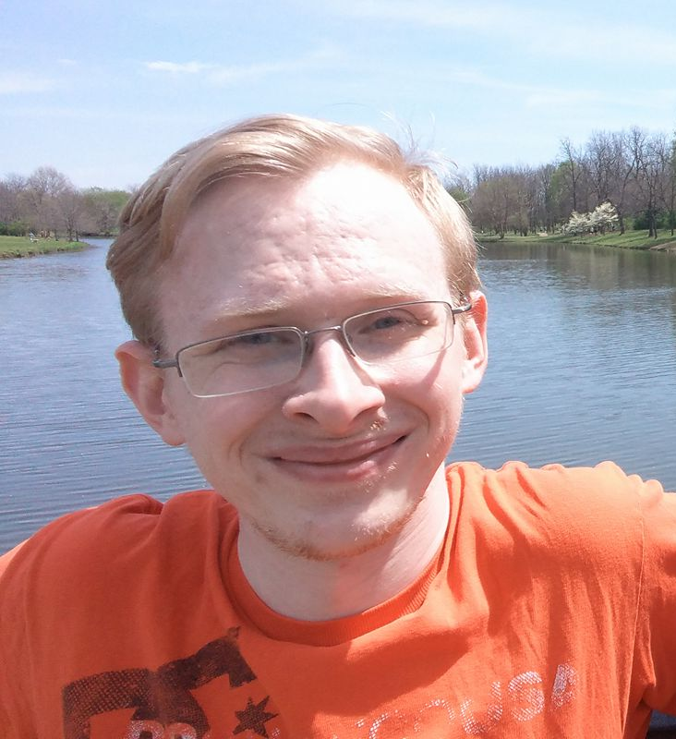
Nice to meet you
I’m David
I live in Springfield, Missouri
I am a member of People First of Missouri
I was an Advocacy Specialist for Missouri Division of Developmental Disabilities
Currently I am a Charting the LifeCourse "No Wrong Door" and "Person-Centered" Planning Ambassador
2022 Charting the LifeCourse Champion for Innovation in self-Advocacy Networks
Consultant with the LifeCourse Nexus and Individual and Family Supports at UMKC-IHD, UCEDD
Notes:
Hi, I’m David.
I’m a consultant with the LifeCourse Nexus at UMKC-IHD, UCEDD
I like to write
I’m a bit of an artist
And I have a creative soul
I am going to be guiding you through how to use LifeCourse tools, using some examples from my own personal life to show you the process.

Slide 3


Vision for People with Disabilities and their Families
Individual and Family Supports Goals
Individuals will achieve self-determination, interdependence, productivity, integration and inclusion in all facets of life.
Families will be supported in ways that maximize their capacity, strengths, and unique abilities to nurture, love and support all of its members to achieve their goals.
Recognizing that individuals exist within a family system

Slide 4











Charting the LifeCourse
Problem solving framework that supports self-determination and helps a person get organized and work on goals and advocate for themselves.
Creates common language around key values and principles
Independent Living Centers can use the tools with the people they support when planning, options counseling and Information and Referral.
Support Self-Advocates for Peer Learning
Build the capacity of self-advocate leaders to use the framework and tools for policy and practice change
Notes:
Overview of how to use Charting the LifeCourse for problem-solving and planning your own life… and with the people you support at your IL

Slide 5
Charting the LifeCourse Framework
Core Values
  Focus on All
  What we want to see
Vision for Good Life
Trajectory
Support STAR
Goal Attainment Tool
Notes:
The goal for this module is to:
Discover the main points of the Charting the LifeCourse framework

Slide 6


Core Value: Focus on All
75%
25%
100%
ONLY 1 in 4 people with IDD (25%) get paid DD Services
All 4,900,000 people with developmental disabilities
What About the OTHER 75%?
Notes:
The LifeCourse Framework was made for ALL people.
You might not know this, but a lot of your friends might not be getting the same supports and services that you are.
When we are talking about all people, we’re talking about all 4,900,000 people with developmental disabilities. A lot of times when we talk about what people with disabilities need, we’re only focusing on those who receive paid services from their state system.
Only 25% of all people with developmental disabilities in America receive paid services. That means only 1 person in 4 with a developmental disability actually receives paid services!

Slide 7
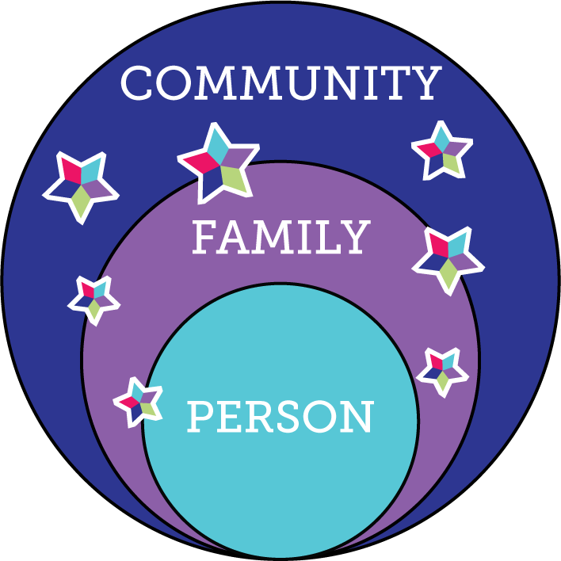
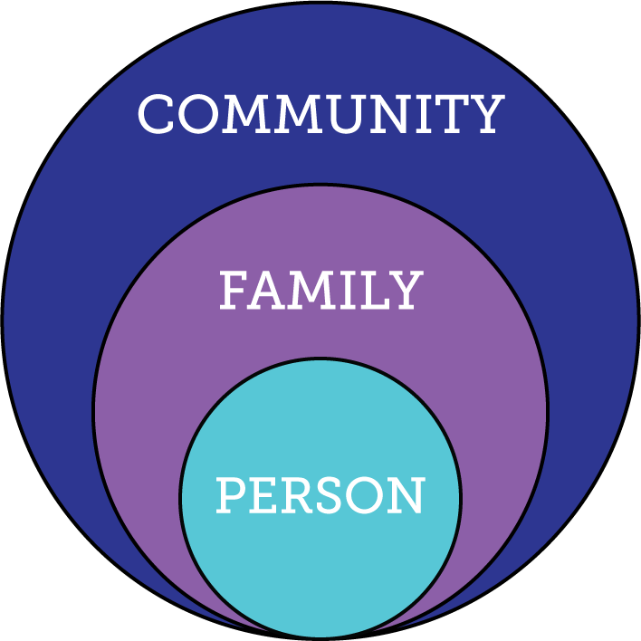
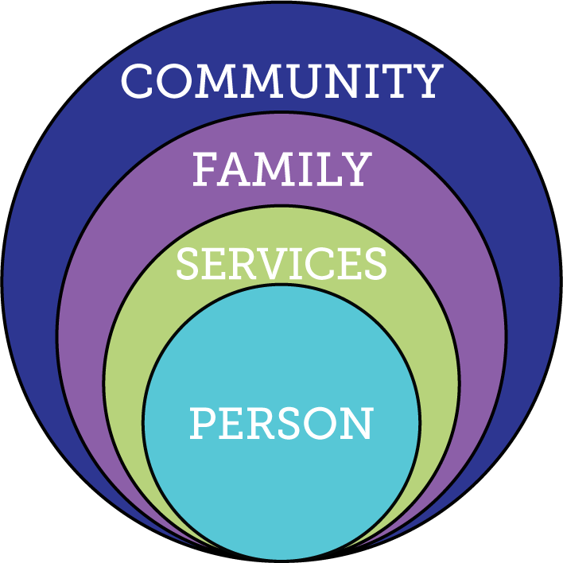
Core Value: What We Want to See…
Notes:
If you think about our lives, a lot of times they look like the circle on the left. You are part of your family and you live in the community.
In the past and even still today, when people need support, sometimes those supports wrap so tightly around them that they end up being cut off from their families and communities. When you think about the ALL, only 25% of people is receiving supports and services in the middle circle.
We want to see the circle on the right. We want everyone to have a good life with supports and services when and where they need them. The star is how we make that happen. We’ll learn more about the star in one of our next sessions. 100% of the ALL can be supported using this circle.

Slide 8

Core Value: Vision
What is your Vision?
What is YOUR GOOD LIFE?
What DON’T
you want??
Notes:
Vision,
What you want and don’t want for your “good life”

Slide 9


What is a TRAJECTORY?
Notes:
So what is a trajectory? It all starts with a vision - you have to have a vision of what you want and don’t want. The trajectory is the path your life takes to get you to your vision of a good life. Your trajectory helps you stay on the path towards what you WANT, and not go towards things you DON’T WANT. Just like shooting a nerf gun, without a vision, or knowing what you are aiming for, you can’t hit the target!

Slide 10
What Moves the Trajectory?
Friends, family, job, fun things to do, independence, your own place, happiness
Trajectory toward a good life
Vision of What I Don’t Want
Trajectory toward things you don’t want
Notes:
Trajectory is the path your life takes towards the future. It can change based on the choices your make, or because of other people’s actions and events that may be out of anyone’s control. Having life experiences – trying new things, learning skills, or doing the things most other people do, help to move the trajectory. The goal is the good life, so we want the trajectory to keep moving toward the vision of what you want for your good life.

Slide 11
My Trajectory
Notes:
Some of my stepping stones and personal examples on my trajectory that have helped me get towards my vision of a good life were:
6
having a supportive family,
8
a job at worlds of fun,
9
buying my mustang convertible and
11
moving into my own apartment.
Some things that lead towards things I don’t want for my life were:
15
an accident, 16
a bad student job experience,
17
a bad break-up and
19
leaving college early
.

Slide 12
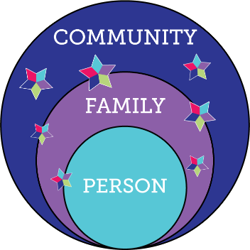
Charting the LifeCourse Integrated Supports Star
100%
Notes:
This is the Integrated Supports Star. The Integrated Star represents getting the support we need to have a good life.
Remember in an earlier module when we talked about our vision for people with DD and their families having good lives?
The good life is being part of our families and communities with the supports and services we need, when and where we need them.
Now, we are going to learn about each part of the star.

Slide 13
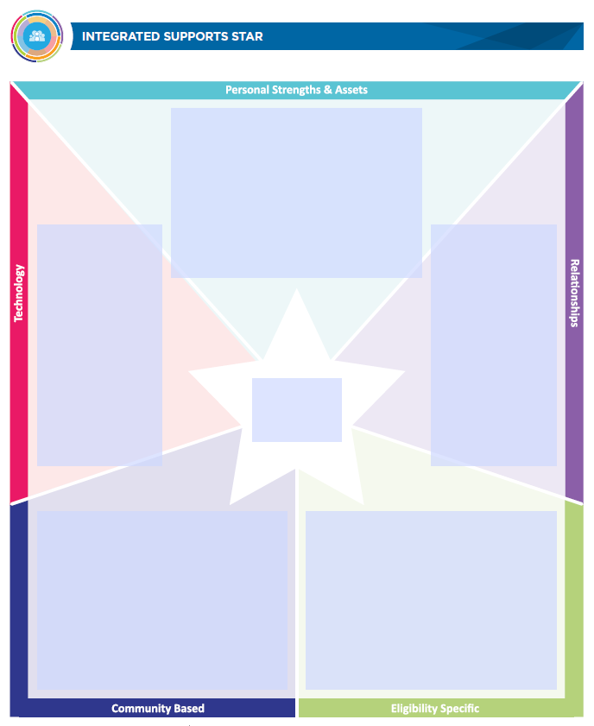
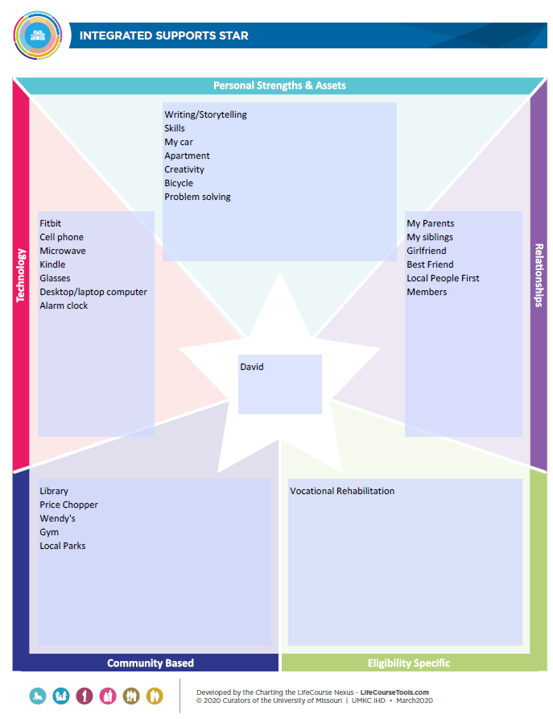
My Support STAR
Notes:
Some of my stepping stones and personal examples on my trajectory that have helped me get towards my vision of a good life were:
6
having a supportive family,
8
a job at worlds of fun,
9
buying my mustang convertible and
11
moving into my own apartment.
Some things that lead towards things I don’t want for my life were:
15
an accident, 16
a bad student job experience,
17
a bad break-up and
19
leaving college early
.

Slide 14
Goal Attainment Tool
Step 1: Decide on a GOAL
Step 2: Define what SUCCESS looks like
Step 3: Define Strategies to that will help you reach the goal
Step 4: Describe the Integrated Supports who can help you practice the strategies
Notes:
There are four steps to making a plan to reach our goals. The first step is to decide on what the goal is – what do we want. The second step is to decide how we know we have met that goal, or how we know that we are successfully working towards meeting that goal. Let’s talk about these two steps first. We can use the Goal Attainment planning and tracking tool to help us write a plan and track how successful we are.

Slide 15
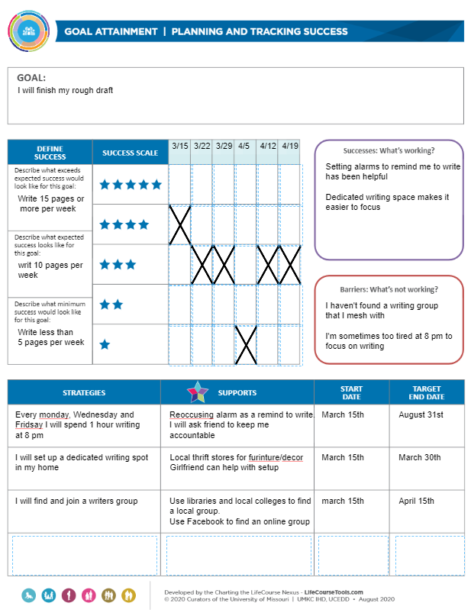
My Goal Attainment Tool
Notes:
Some of my stepping stones and personal examples on my trajectory that have helped me get towards my vision of a good life were:
6
having a supportive family,
8
a job at worlds of fun,
9
buying my mustang convertible and
11
moving into my own apartment.
Some things that lead towards things I don’t want for my life were:
15
an accident, 16
a bad student job experience,
17
a bad break-up and
19
leaving college early
.

Slide 16
My Goal Attainment Tool
Notes:
Some of my stepping stones and personal examples on my trajectory that have helped me get towards my vision of a good life were:
6
having a supportive family,
8
a job at worlds of fun,
9
buying my mustang convertible and
11
moving into my own apartment.
Some things that lead towards things I don’t want for my life were:
15
an accident, 16
a bad student job experience,
17
a bad break-up and
19
leaving college early
.

Slide 17
My Goal Attainment Tool
Notes:
Some of my stepping stones and personal examples on my trajectory that have helped me get towards my vision of a good life were:
6
having a supportive family,
8
a job at worlds of fun,
9
buying my mustang convertible and
11
moving into my own apartment.
Some things that lead towards things I don’t want for my life were:
15
an accident, 16
a bad student job experience,
17
a bad break-up and
19
leaving college early
.

Slide 18

Charting My LifeCourse On-Line Training Series
Assists persons with disabilities to explore their hopes and dreams, develop plans and advocate at formal planning meetings that will help achieve their good life
On-line, self-paced, interactive training modules for individuals with disabilities and supporters:
  Module 1. Discovering Charting the LifeCourse
  Module 2. Discovering the Support Star
  Module 3. Discovering Your Good Life
Free for anyone to access and use www.moddd.thinkific.com/courses/Charting-My-LifeCourse
Partnership between the Division of Developmental Disabilities and UMKC-IHD, LifeCourse Nexus

Slide 19
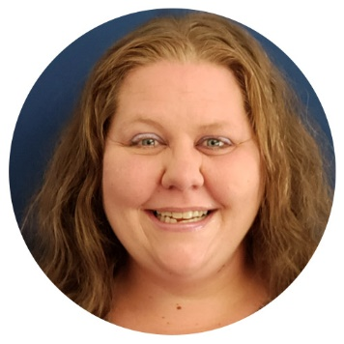


What are Self-Advocates Saying?
I lead my first ISP (Individual Support Plan) EVER!!!! Fully!!!!!!!
I have been a part of my ISP in the past but this was a game changer. I have come to realize some goals I didn’t need to keep and as well as some goals I needed to make a priority.
I get so excited at the thought of an individual like as myself getting to experience running their own ISP and or running their life!
You can use CtLC for so much in life you can use it to budget for a car, a vacation, for dreams and what you want your life to be like. You could use it anywhere and for anything!
It takes the work out of working out the nicks in life and takes your dreams however big or small and brings them to a reality.
I think other self-advocates will benefit not just from actually being in charge of their ISP but it will give anyone a hope that they can achieve their goals even if it means going from full guardianship to partial and or if someone wanted to buy a car or move. You name it CtLC can make it come to life!!
Susan Parker was selected at the 2022-2023 SARTAC Fellow with the Charting LifeCourse Nexus.
Fellowship project: “Charting My LifeCourse”
Notes:
David

Slide 20
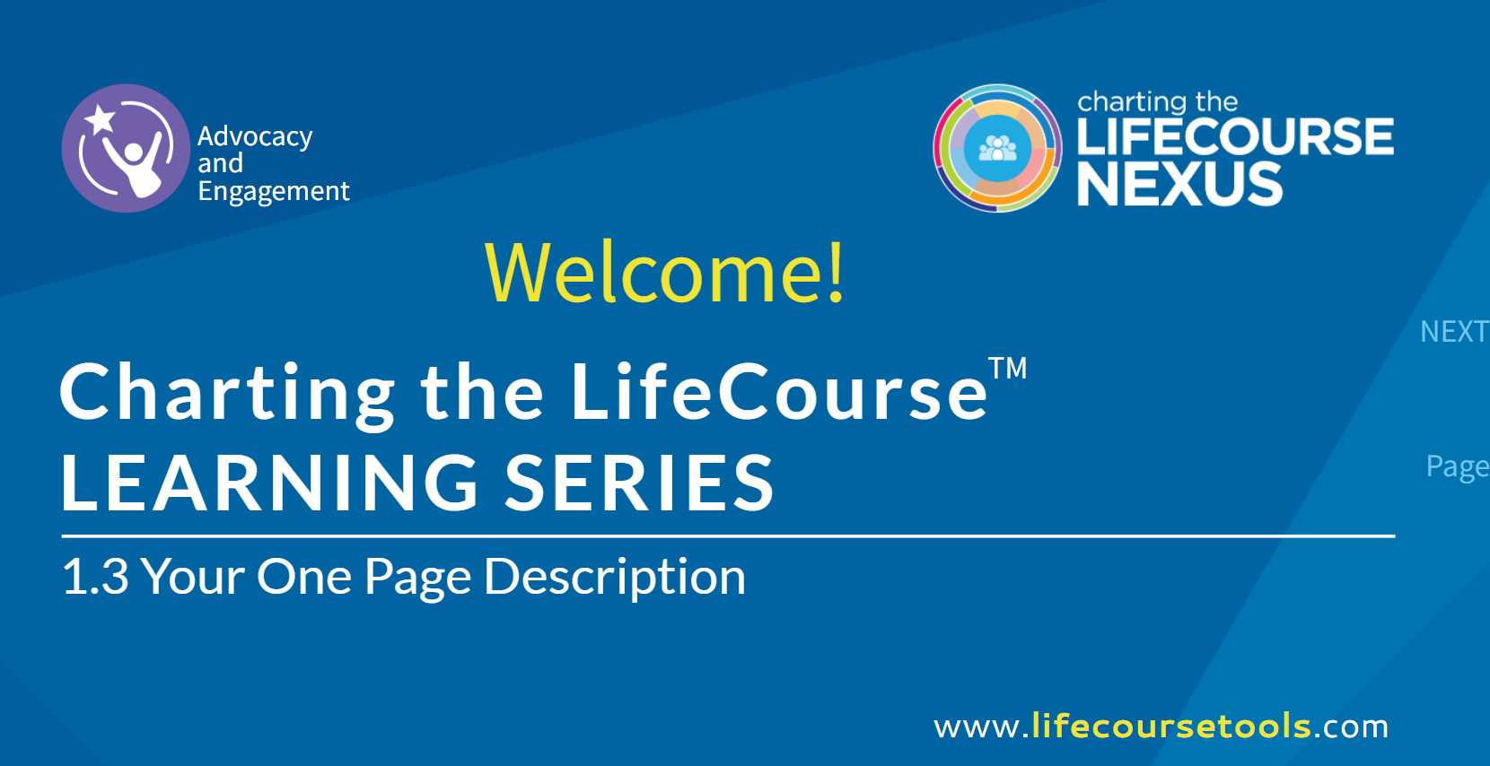
Charting My LifeCourse Online Training
1.3 Self-Advocacy CtLC 2021
Notes:
David

Slide 21
CtLC Statewide Chapter | Focus on Self-Advocates
CtLC Ambassador Self-Advocate Network
6 self-advocate have taken CtLC Ambassadors.
2 self-advocate leaders being trained as ambassador peer coaches.
Get Involved- We can support you to:
  Take the online series
  Host the series at your organization
  Train staff to use with self-advocates
  Train self-advocate peer coaches
Additional Activities with Charting My LifeCourse
Piloting presentation methods with 3 providers
Peer Coach 1-1 with Self-Advocate
Side-by-Side Training with DSP staff
On-Line Self-Paced
Developing Peer Coach training materials

Slide 22


People First of Missouri: What Is People First of Missouri?
www.missouripeoplefirst.org
People First of Missouri is a statewide organization that promotes equality for people with disabilities so they can live the life they want in the community. People First members:
Teach and empower people to understand their rights and responsibilities and to speak up for themselves (Self-advocacy);
Stand up for one another to help people live the life they want with the supports they need (Advocacy for one another);
Advocate for community services that allow people to have choices and control over their supports and lives (Advocacy at the systems level);
Create change in communities to ensure opportunity and full, meaningful participation for all people (Advocacy within the community).
Notes:
Patty –
People First of Missouri is a statewide organization that promotes equality for people with disabilities so they can live the life they want in the community. People First members:

Slide 23
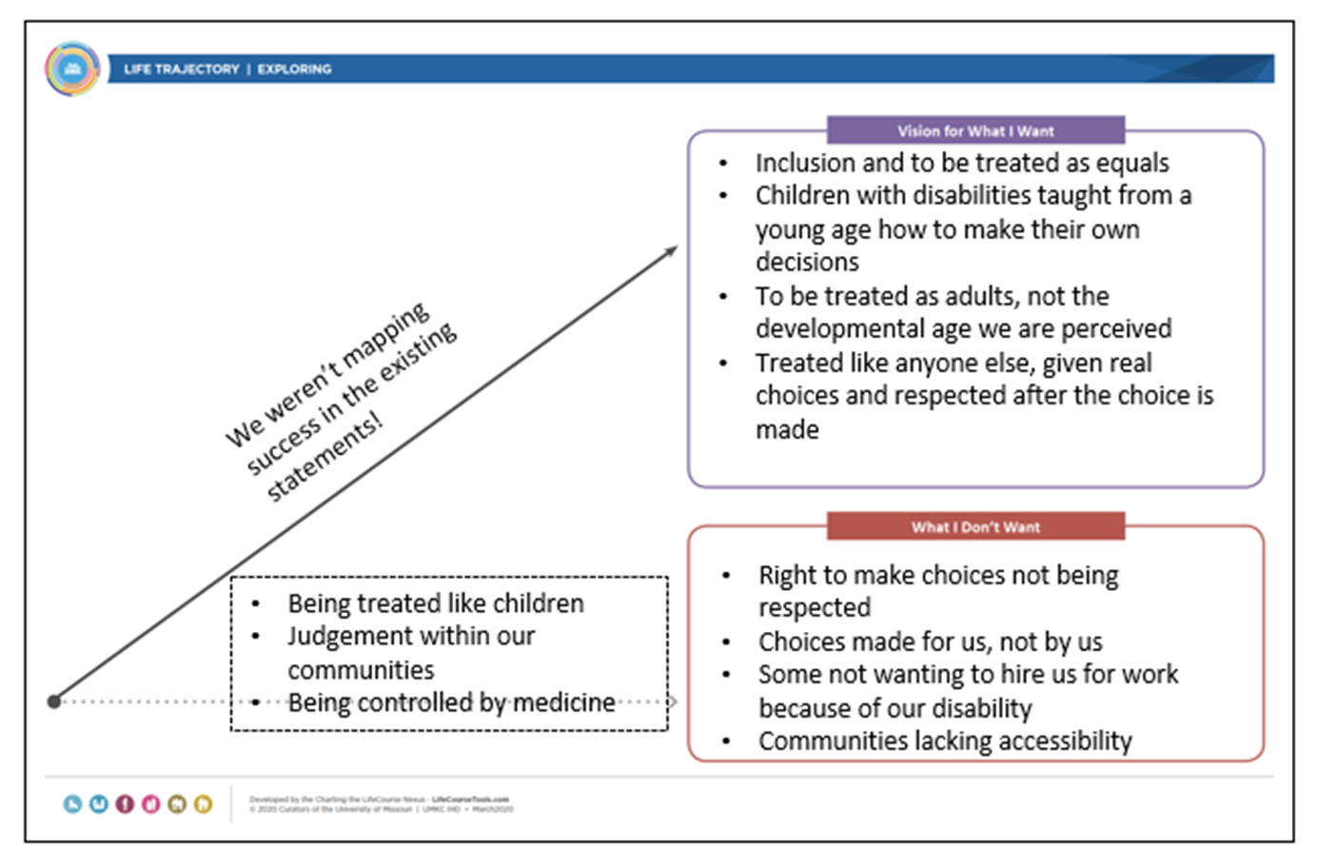
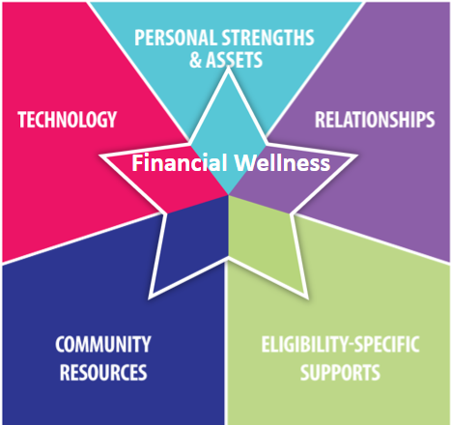
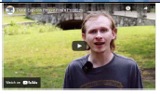
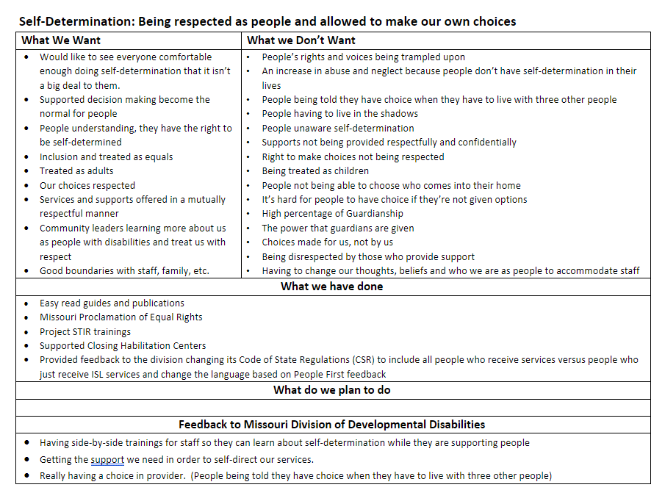

Build the capacity of self-advocate leaders to use the framework and tools for policy and practice change
People First Priorities
Transportation
Financial wellness
Self-Determination: Being respected as people and allowed to make our own choices
Supported Decision Making and Guardianship
Housing and being supported to live where a person wants to live
www.missouripeoplefirst.org
Notes:
David talk about using Ct LC for Priorities
Developing Videos
Using priorities to provide feedback to Division and IHD.

Slide 24
Thank You
Questions

