Slide 2
Aging in Place
Amanda Whittington-West, ADAC, Assistive Technology Coordinator
Bethany Hornbeck, Assistive Technology Specialist

Slide 3
What is Aging in Place?
Aging in place is when an individual makes a conscious decision to grow older in their own home, rather than to move into an assisted living facility or nursing home. This is accomplished by modifying the home and using assistive technology and adaptive equipment to promote independence.

Slide 4
Benefits of Aging in Place
Psychosocially, individuals may experience less depression and anxiety that is common in nursing facilities because they have more freedom and less isolation and may age more successfully when they have the ability to stay in the home of their choice.
Notes:
I have often heard the beds and rooms of nursing homes called the “depression beds” by the physicians who work there, as well as the directors. Sadly, many people who are forced to go into skilled nursing facilities feel that they are “out of sight, out of mind” and the social isolation that they experience because people are too busy to visit them causes them to sink into a deep depression, and they may feel that everyone would be better off if they simply passed away, which may cause someone to forgo eating or drinking water in order to speed the process.

Slide 5
Cost Comparison- Nursing Home
Springfield, MO National Average
Daily: $201 Daily: $297
Annual: $73,183 Annual: $108,405
These are the average costs of a private room. Shared rooms are about $37 per day less.
Notes:
https://www.medicaidplanningassistance.org/nursing-home-costs/

Slide 6
What Consumers Are Saying
“I don’t need THAT much assistance that I need to be in a skilled nursing facility but I do need a little help around the house.”

Slide 7
Requirements for Success
Good health
Home modifications
Safe home: fall safety and prevention, accessible
Assistive technology
Universal Design
Social Support
  Family/Friends/Church; Emotional Support System
Community Access
  Transportation
Financial Planning
Consumer Directed/In-home services

Slide 8
Areas To Look At
Mobility
Memory/Cognition
Hearing
Vision
Physical Health
Safety

Slide 9
Home Modifications
While it is easier to build a suitable home for aging in place, retrofitting is sometimes possible and includes options like:
Wheelchair Ramps
Walker Steps
Handrails
Grab Bars
Widening Doors
Accessible Showers
Swing Away Hinges
Notes:
Pros and Cons: Many people find wheelchair ramps unsightly, and there are times that they will not fit in the space provided; walker steps and handrails may not match the aesthetic of the home; grab bars in showers may not be possible due to the material the shower is made of and the placement of studs; door widenings are challenging because of load bearing walls and electricity; bathroom and shower remodels are expensive, and when you tear out a bathroom you do not know what you may encounter (mold, etc.) adding to the cost

Slide 10
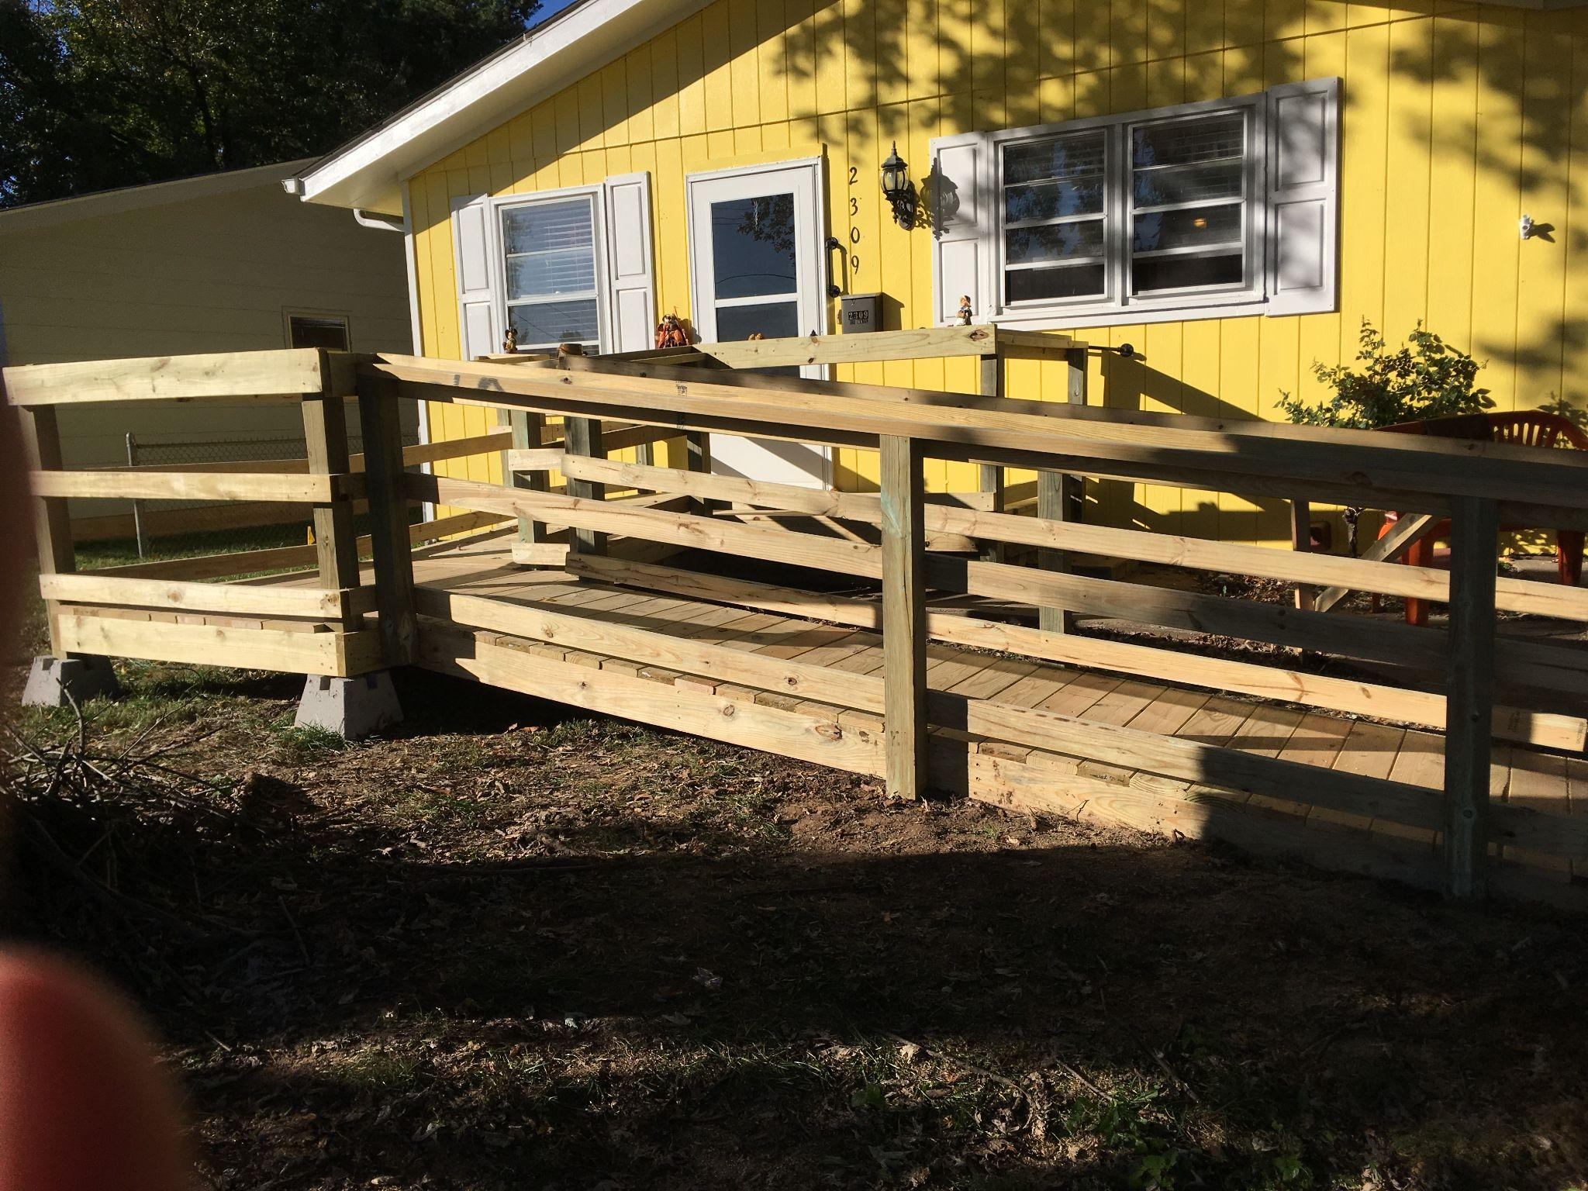

Slide 11
Universal Design-7 Principles
Equitable Use. The design does not disadvantage or stigmatize any group of users and is marketable to people with diverse abilities.
Flexibility in Use. The design accommodates a wide range of individual preferences (i.e. left or right handed) and abilities and provides choice in methods of use.
Simple and Intuitive Use. Use of the design is easy to understand, regardless of the user’s experience, knowledge, language skills or current concentration level; eliminates unnecessary complexity.
Perceptible Information. The design communicates necessary information effectively to the user, regardless of ambient conditions or the user’s sensory abilities; uses pictures, audible or tactical methods.
Tolerance for Error. The design minimizes hazards and the adverse consequences of accidental or unintended fatigue; elements most used should be most accessible, or fail-safe features included.
Low Physical Effort. The design can be used efficiently and comfortably and with a minimum level of fatigue.
Appropriate Size and Space. The appropriate size and space is provided for approach, reach, manipulation and use, regardless of the user’s body size, posture or mobility.
Notes:
https://www.hgtv.com/design/remodel/interior-remodel/universal-design-principles

Slide 12
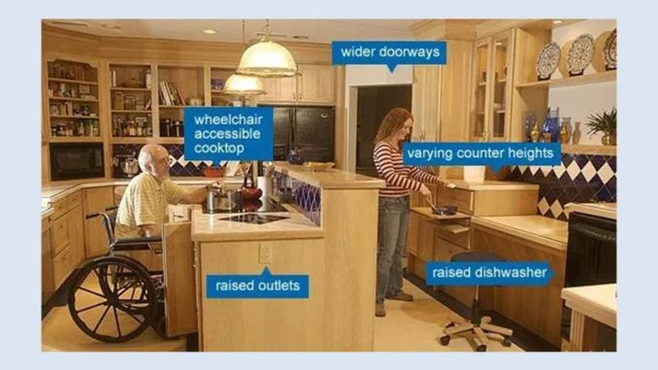
Universal Design

Slide 13
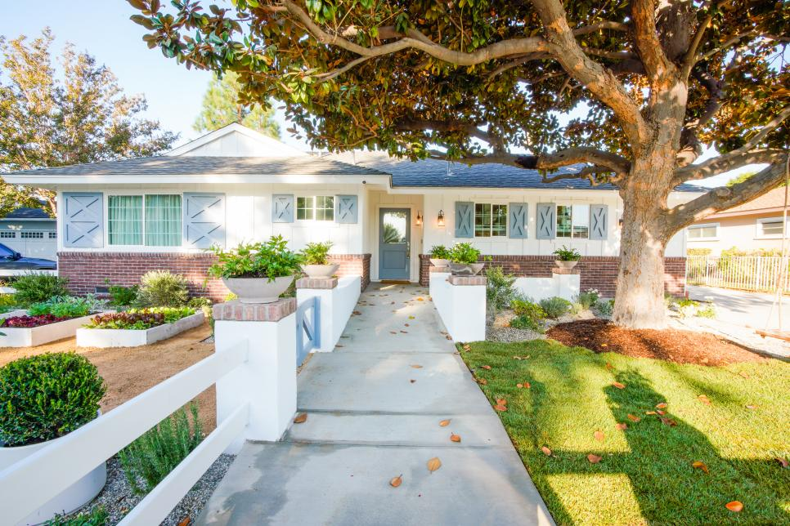
Wide Front Door
Zero [Step] Entry
(No steps to enter house)
Front pathway is
- Wide
- Flat,
- Non-slip concrete

Slide 14
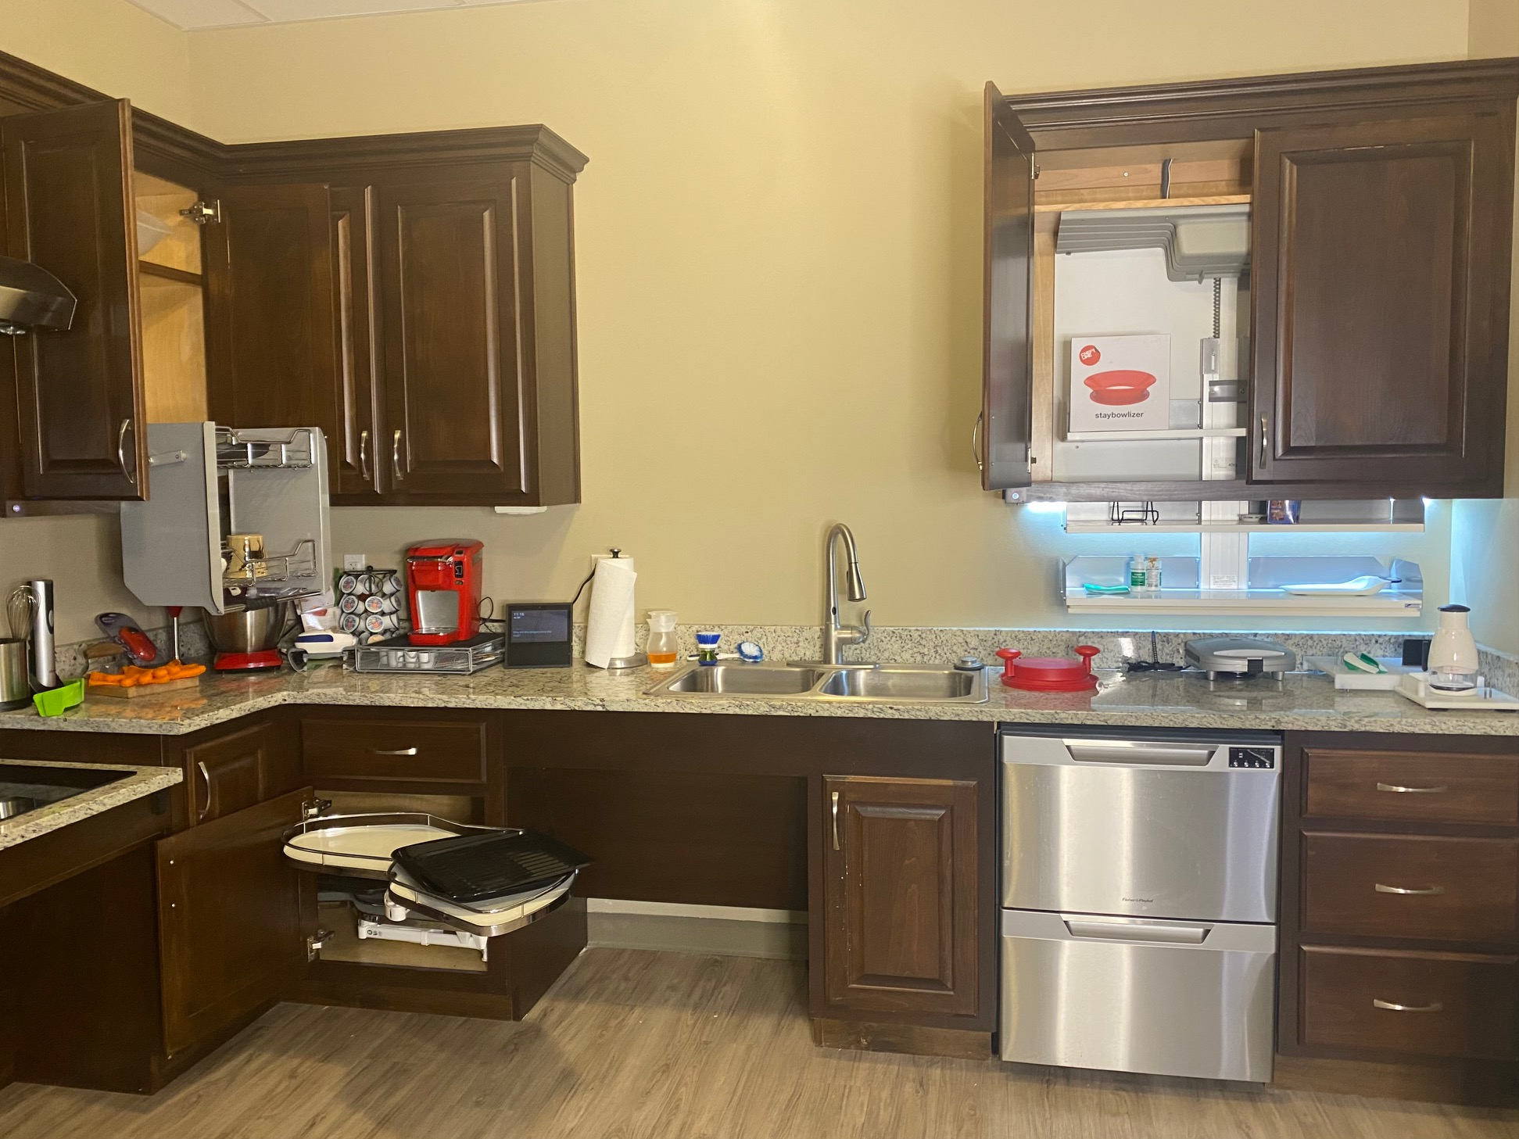

Slide 15
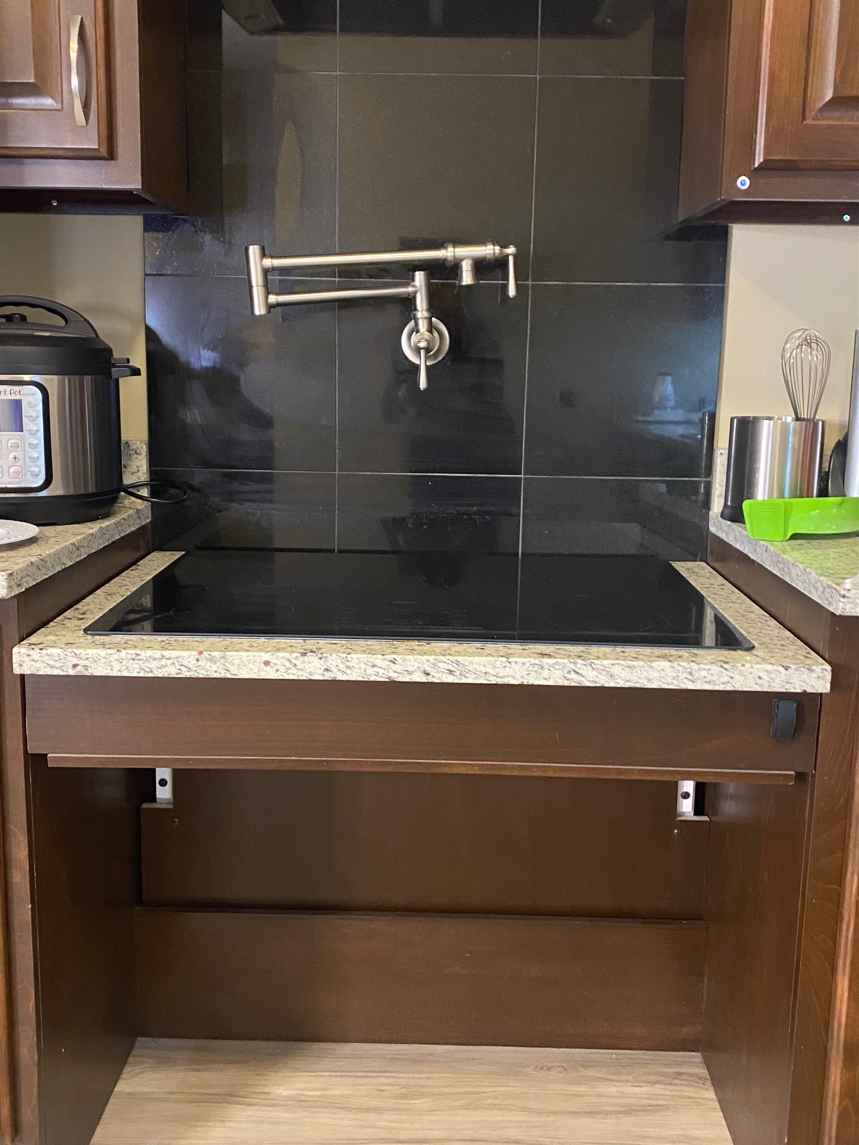
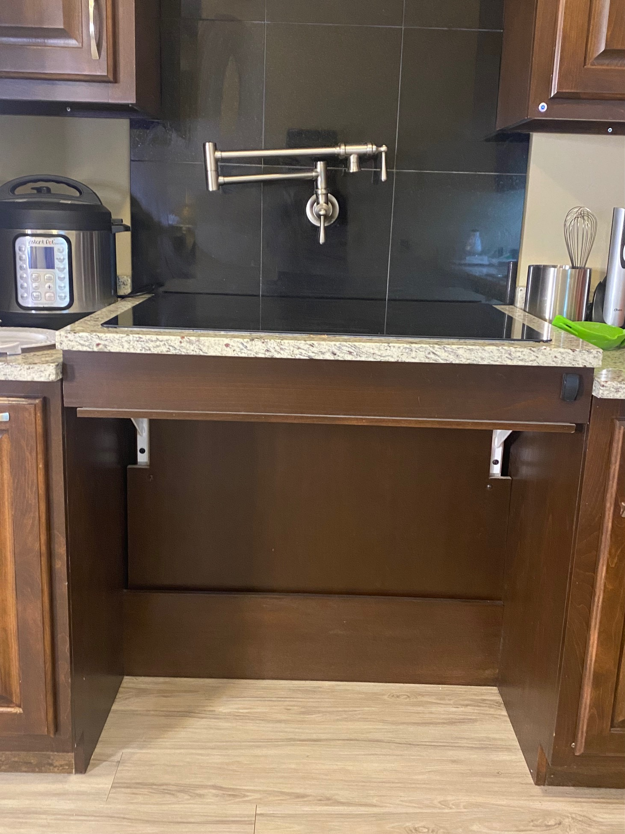

Slide 16
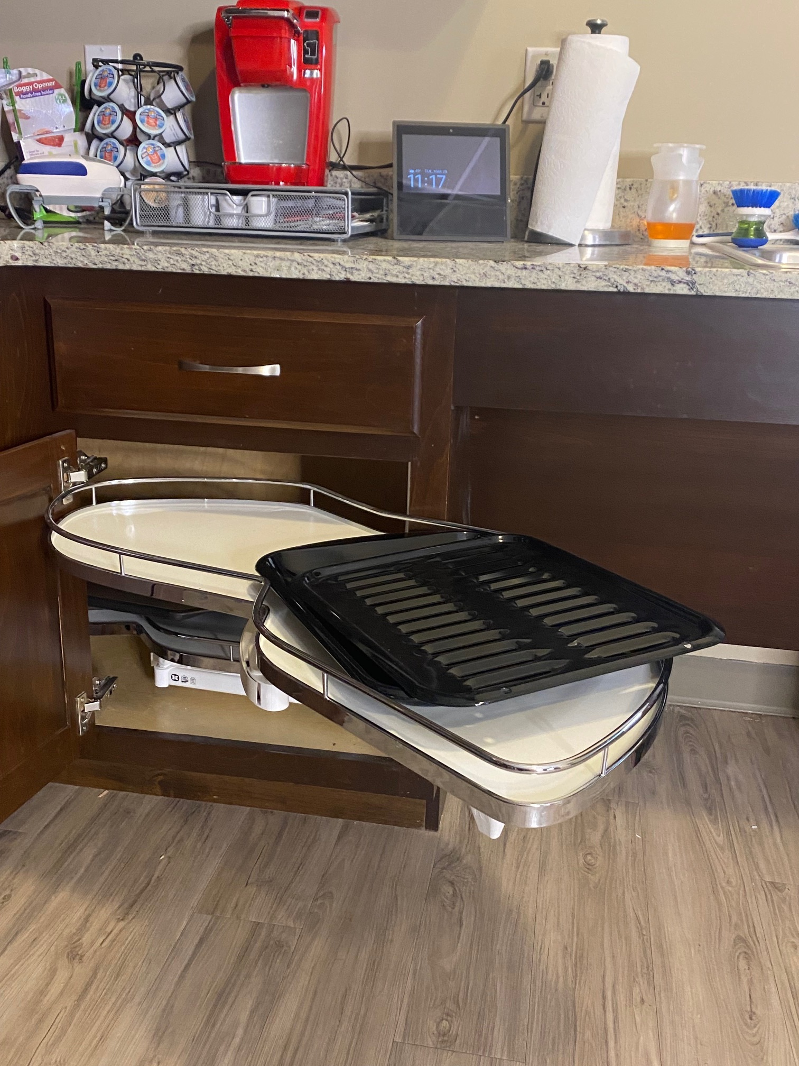
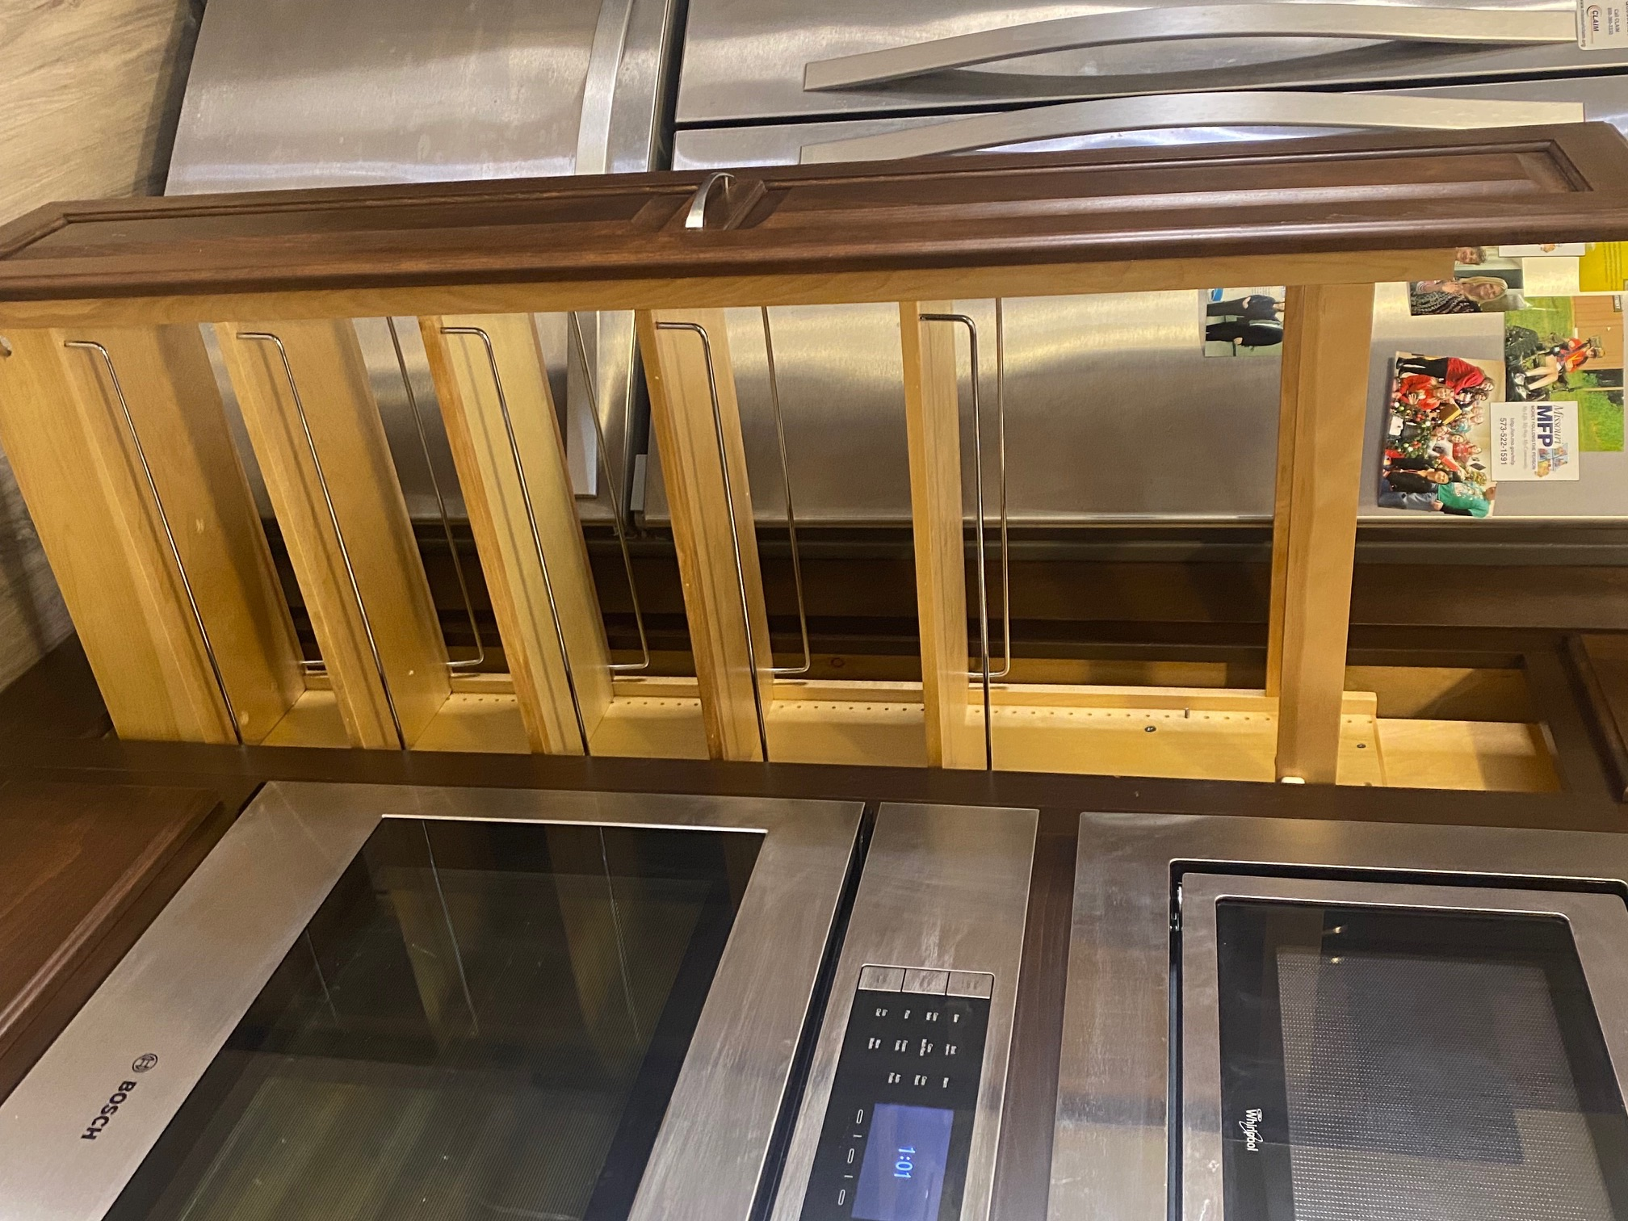

Slide 17
Mobility
Shower Chairs
Transfer Benches
Bedside Commodes
Universal Stand Assists
Patient Lifts
Hospital Beds
Bathtub lifts
Stair Chairs
Stair Rail Chairs

Slide 18
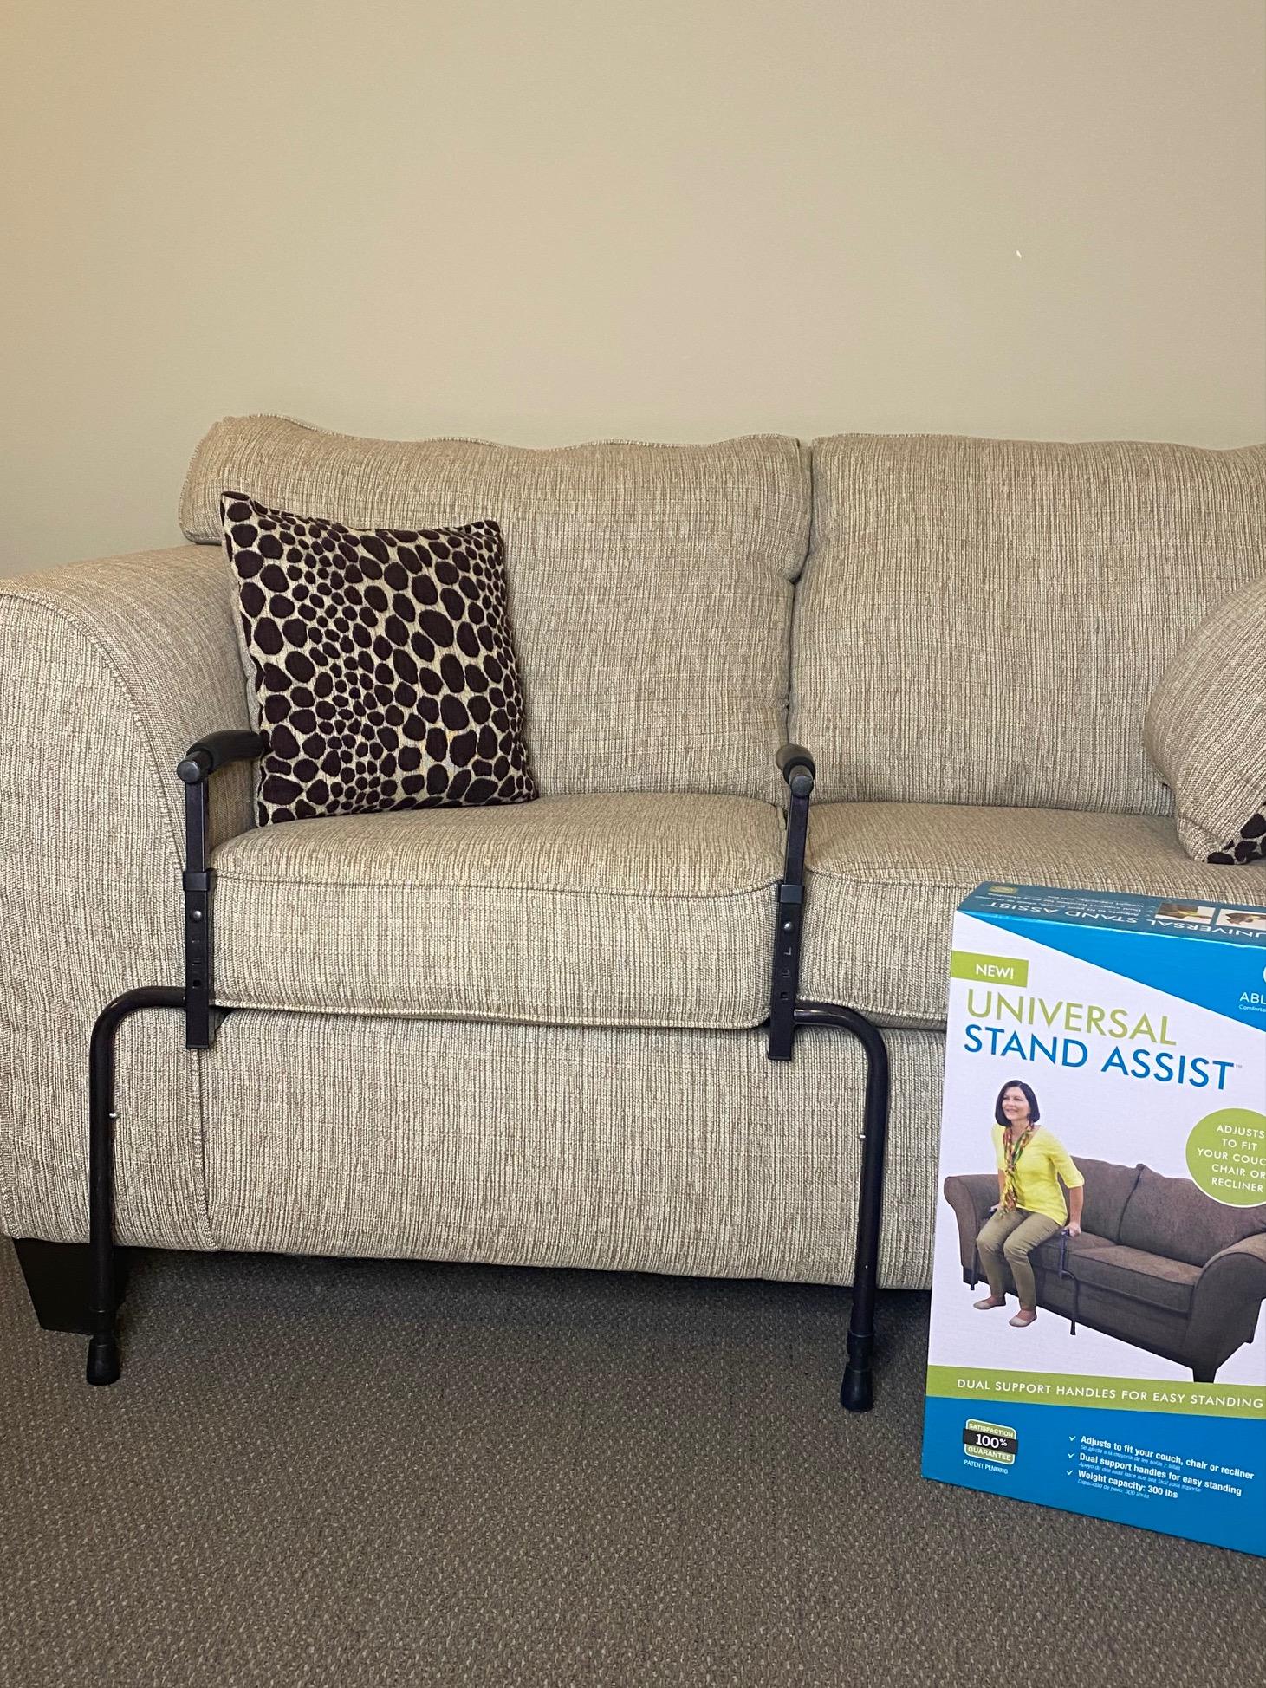
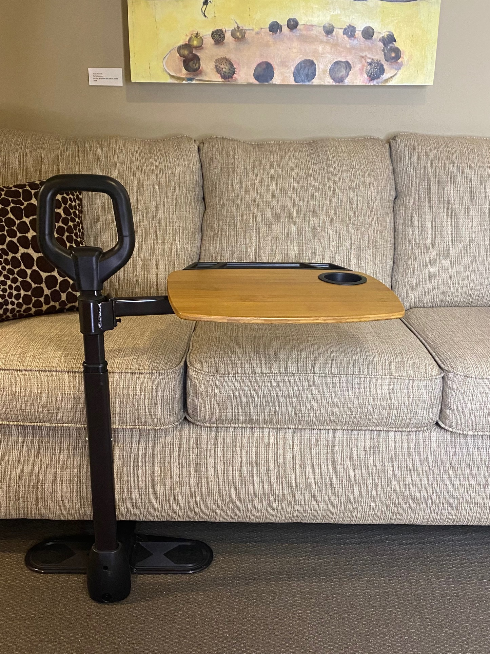

Slide 19
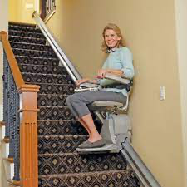
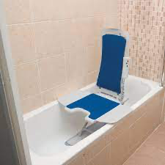
Notes:
$500 starting around $2500

Slide 20
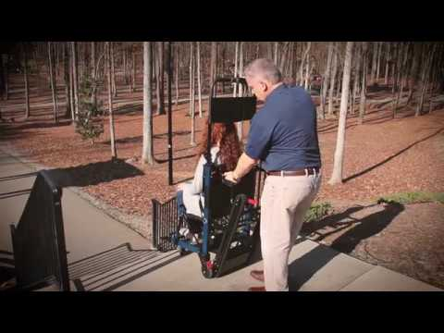
Notes:
$1500

Slide 21
Memory/Cognition
Automatic Stove Shut Off
Boil Alert
Alexa Oven
Medication dispensers
  Alarms
  Integrity Pharmacy
Talking frames
Picture based phones
Device trackers
  Air Tag
  Tile
  Chipolo
Tracking devices (GPS enabled for family to monitor)

Slide 22



Slide 23




Slide 24
Vision
Task Lighting
Lamps with magnifiers
CCTV
Zoomtext software
Bump dots and tactile markings
Boil alert
“Say When”
Talking pitchers
Talking devices
Smart homes
Smart thermostats

Slide 25


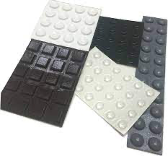

Slide 26
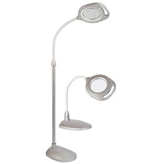
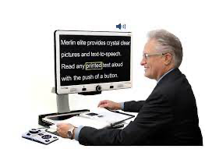

Slide 27
Hearing
Flashing Doorbells and Smoke Detectors
Captioned Phones
Lamp flashers
Visual signalers for phones
TV listeners
Personal amplifiers
Bed shakers
Weather alert with strobe

Slide 28



Slide 29
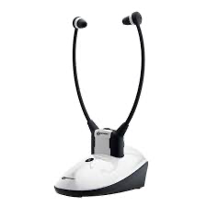
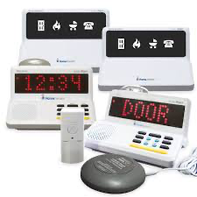

Slide 30
Safety
Video Doorbells
Door and Window Sensors
Medical Alert Systems
Cameras
Smart Lights & Outlets
Spam/Scam blocking apps for cell phones

Slide 31
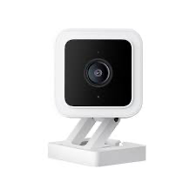
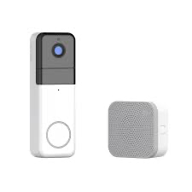

Notes:
stove shut off $384

Slide 32
Summary
Most seniors have a desire to stay in their own homes and age in place
To self-pay at an assisted or independent living facility is costly-financial planning is imperative
CDS and In-home services may help someone stay at home longer
It is best to build from the ground up, but retrofitting is possible
Universal Design is an ideal way to thing and build if you desire to age in place
There are a number of devices that can help seniors age in place

Slide 33
Contact Information
Amanda Whittington-West, Assistive Technology Coordinator
amandaw@empowerabilities.org
417-886-1188 x 233
Bethany Hornbeck, Assistive Technology Specialist
bethanyh@empowerabilities.org
417-886-1188 x 234
empower: abilities
1450 W. Cambridge St
Springfield, MO, 65807
https://empowerabilities.org/

