Slide 1


Valued Living AND ITS BARRIERS: A new vision to case management
Jessica venegoni and maggie adler

Slide 2




Introductions

Slide 3
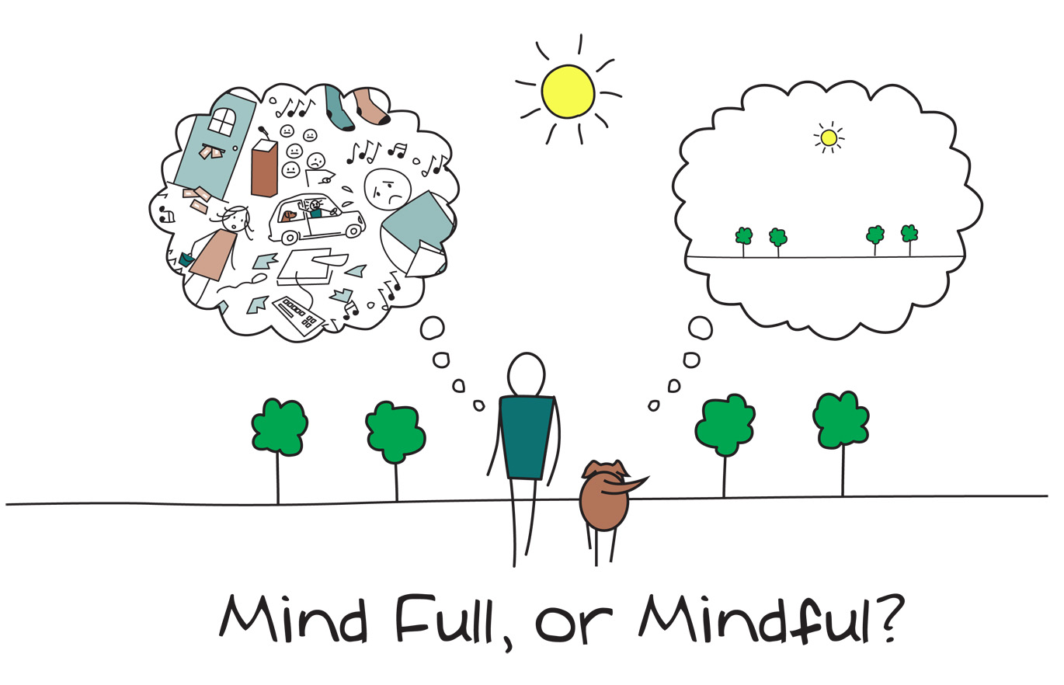
WHAT IS MINDFULNESS?
"Mindfulness is a set of psychological skills for effective living that involves paying attention with openness, curiosity, kindness, and flexibility" (Harris, 2019, p. 40)

Slide 4
Mindfulness and its benefits (PSYreg.org, 2022)
Gives you control over your emotions
Helps you regulate pain and fatigue
Improves brain functions and moods
Makes you more compassionate
Enhances quality of sleep
Manages anxiety, depression, and stress
Improves your overall well-being
Strengthens your character
Increases your productivity
Increases insight
Notes:
https://www.psychreg.org/why-mindfulness-important/

Slide 5



Mindfulness: Where and How?
Where?
How?
Walking mediation
Driving mindfully
Reading
Writing & Journaling
Drawing
"Breath bubble"
Gratitude List
Body scan
5-4-3-2-1
More!
YouTube
Spotify
Headspace.com
Mindful.org
"Get out of your mind, and into your life" -Steven Hayes
More...

Slide 6
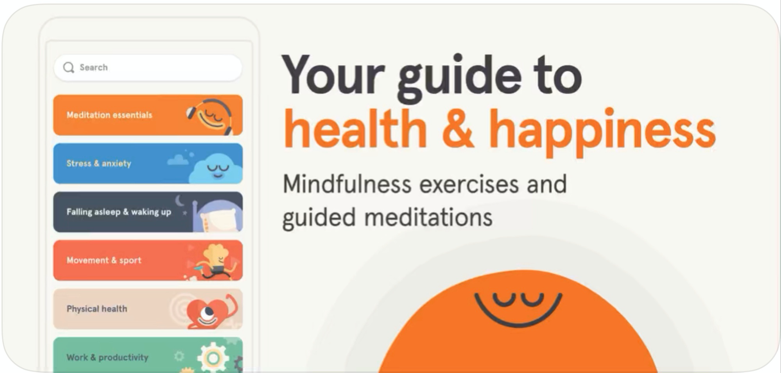
Mindfulness
Let's take 5 minutes to get in the right space.
https://www.headspace.com/meditation/5-minute-meditation
Something easy that can be practiced with clients before meetings.

Slide 7
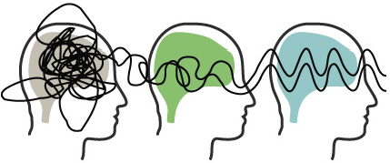
How to practice Mindfulness with clients
First, check in about the emotional and physical state they are currently in.
Start with shorter practices (1,5,10,15,20 minutes etc...)
  Try out different methods practices
    Guided
    Unguided (once you have practiced a few times!)
    Breathing exercises
    Mindful Movement
Trying different techniques to see which your client likes best.
As sessions continue, possibly lengthen mindful sessions
How to "get more" from sessions?
  Find values

Slide 8
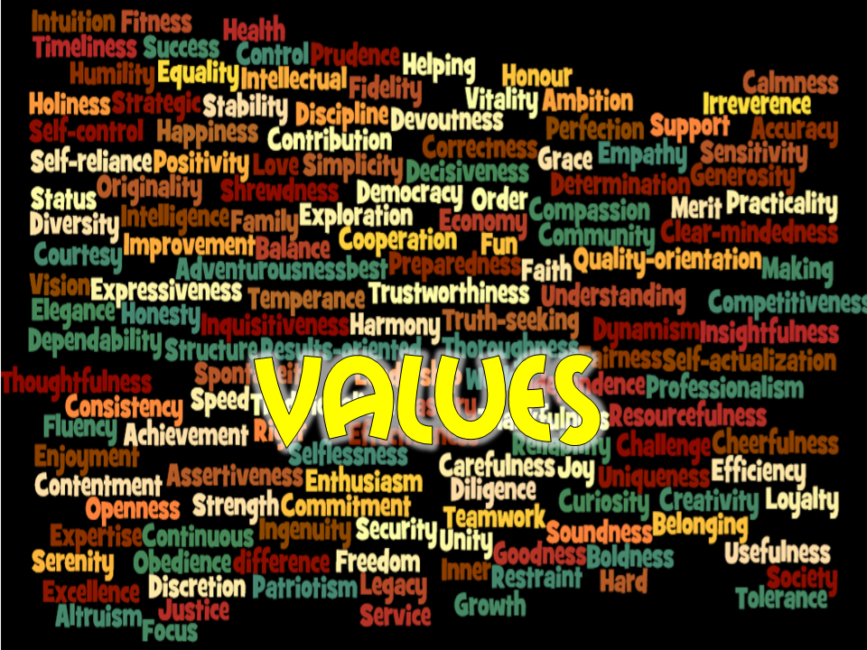
VALUES
Desired qualities of physical or psychological action (Harris, 2019, p. 7)
AKA: what's important to you and how do you want to act towards them?
Notes:
Not something you ever touch or reach, never will "check off" your list.

Slide 9
Our values are like the continents on a globe of the world. No matter how fast you spin that globe, you can never see all the continents at once; there are always some at the front, some at the back. From moment to moment, you get to choose: which values come to the front, and which move to the back?
- Russ Harris

Slide 10

goals
A goal is something your clients wants to do to work towards their value. (Harris, 2019, p. 66)
Something achievable.

Slide 11
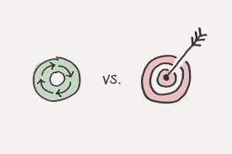
Values and goals example
What is a value?
  A person's principles or standards of behavior; one's judgment of what is important in life
Example: Communication of needs in relationships.
What's a goal?
  The object of a person's ambition or effort; an aim or desired result
Example: Calling your mom at least one time a week to discuss what you both have been up to and check in.

Slide 12

Barriers
"Something that what prevents the client from acting effectively in the face of life’s challenge" (Harris, 2019, p. 62)
Do you notice clients not reaching goals and values even though they really want to?
How does this affect them?
Example: I want a job to make money so then I can move out, but I don’t know how to fill out a job application.

Slide 13
Barriers to valued living inventory (BVLI)

Slide 14

BVLI
Using Barriers to Valued Living Inventory BVLI
Questions to ask.
  Identifies values and goals
  What supports do you have?
  What do you need?
  What might get in the way for you?
  What helps?
Finds barriers and identifies ways to overcome to reach goals.

Slide 15
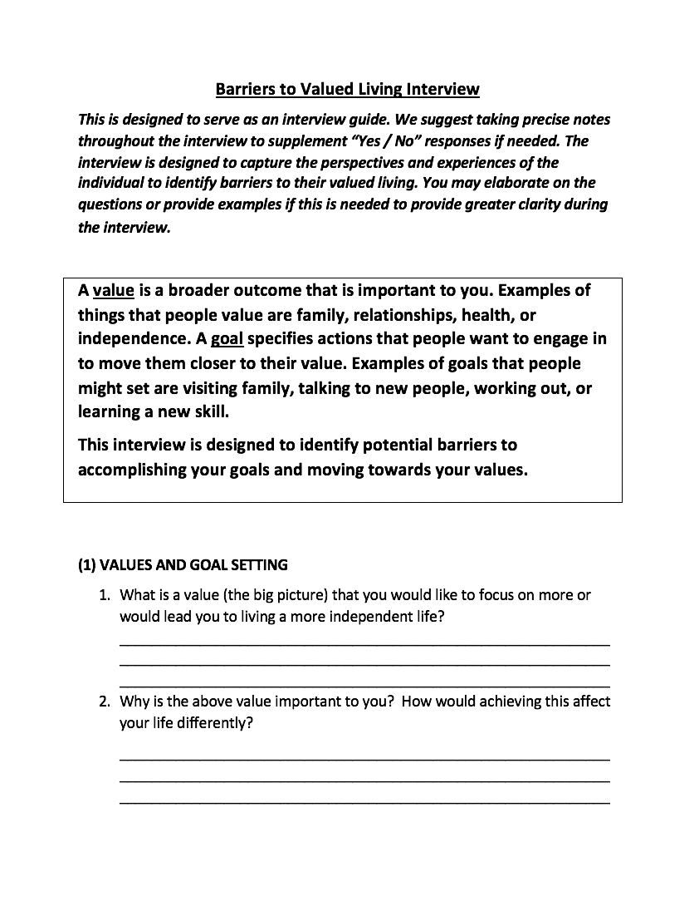
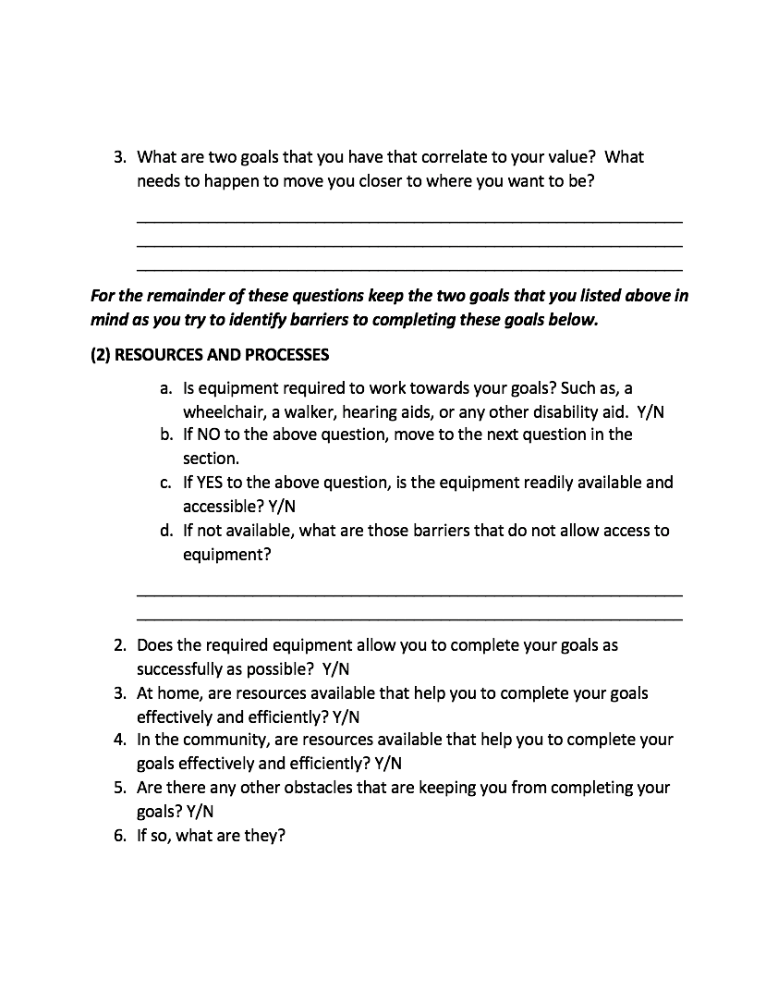

Slide 16
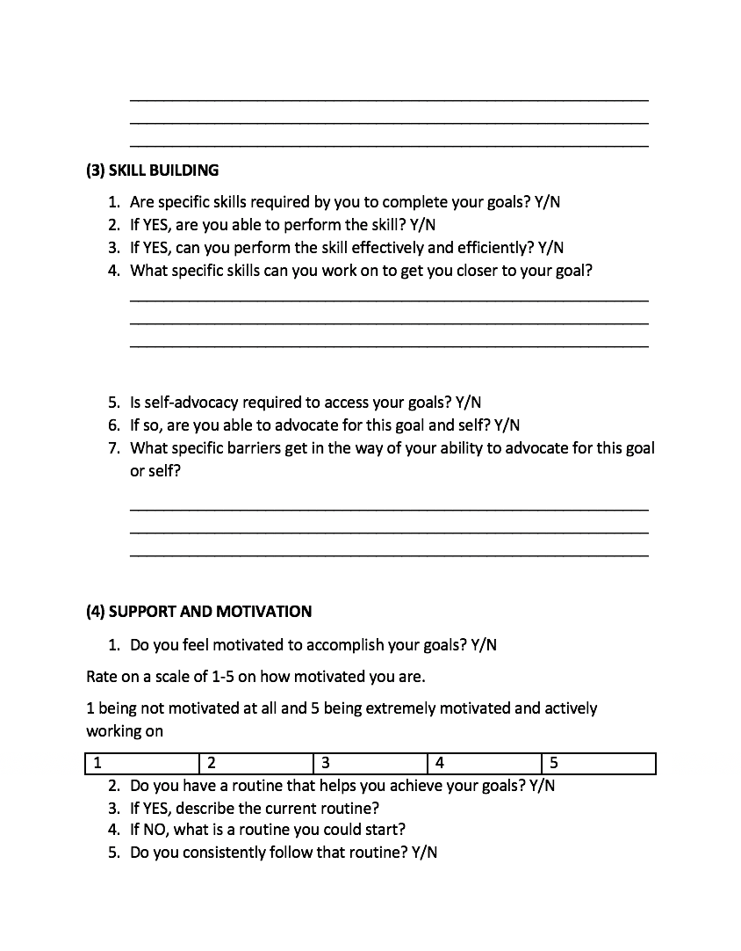
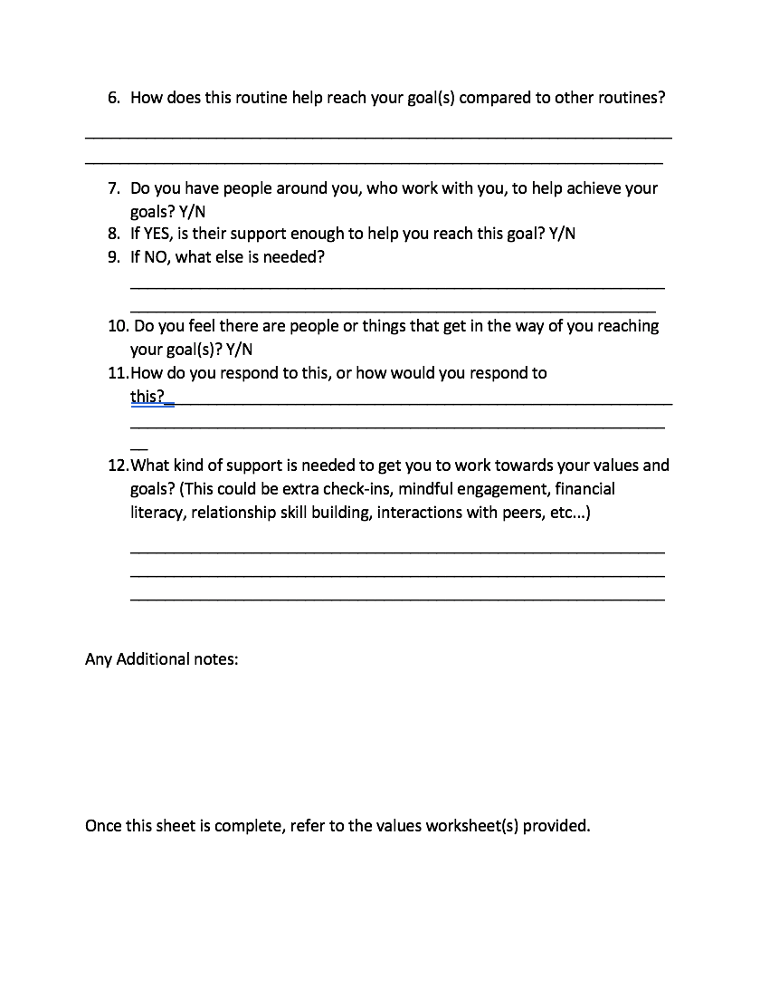

Slide 17
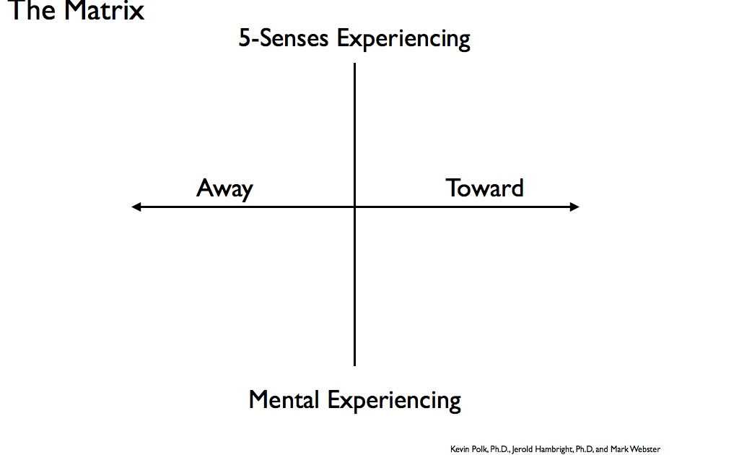
Matrix
What behaviors have you been doing to move away from stuff like fear, anger, or sadness?
What behaviors can you do to move toward what's important to you?
What internal stuff has gotten in the way of moving towards what's important to me?
Who and what are important to me?

Slide 18
How to create your own bvli
Step 1: Identify Values

Slide 19

Values
Values Section:
  Pinpoint what the value is (the BIG picture), then what goal(s) to get there?
  Why is this value important to the client?

Slide 20
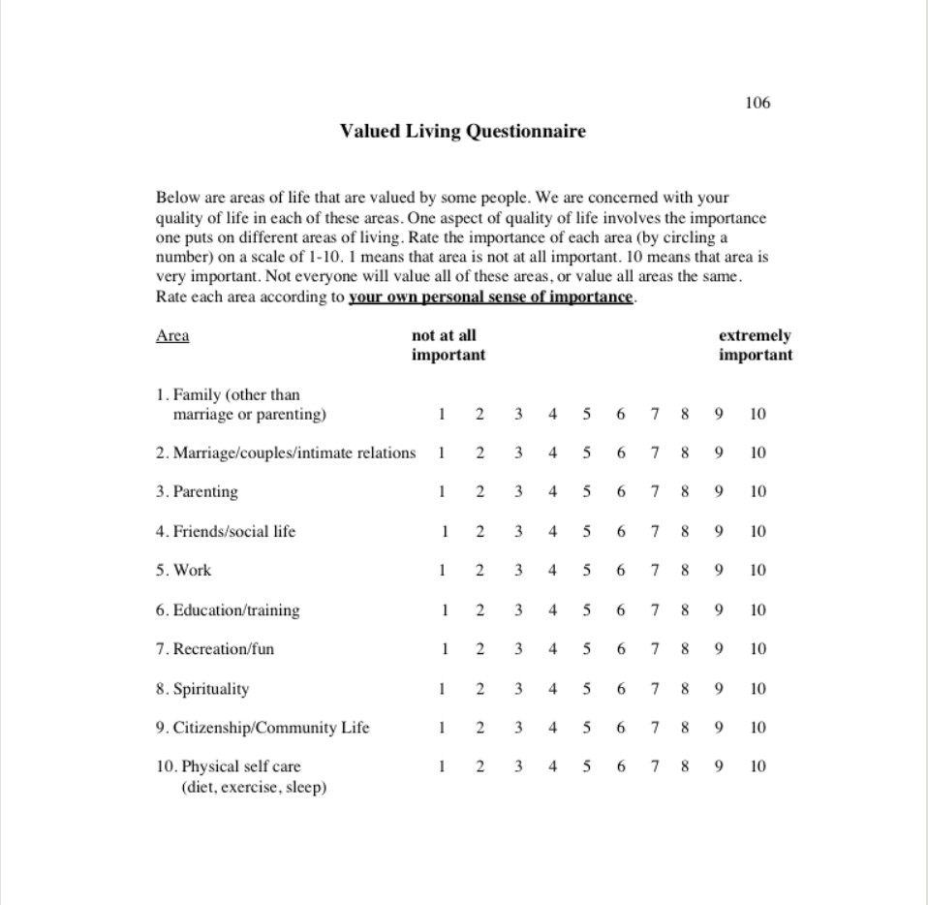
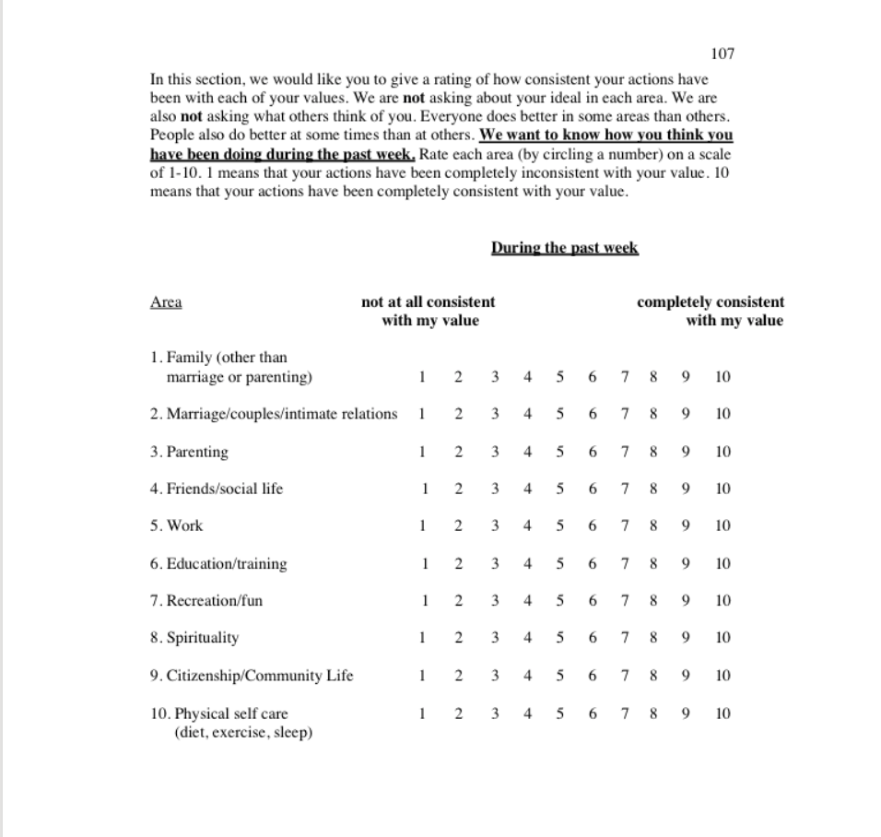
Valued living Questionnaire
Questionnaire helps identify client's values and how aligned they are living with their values

Slide 21
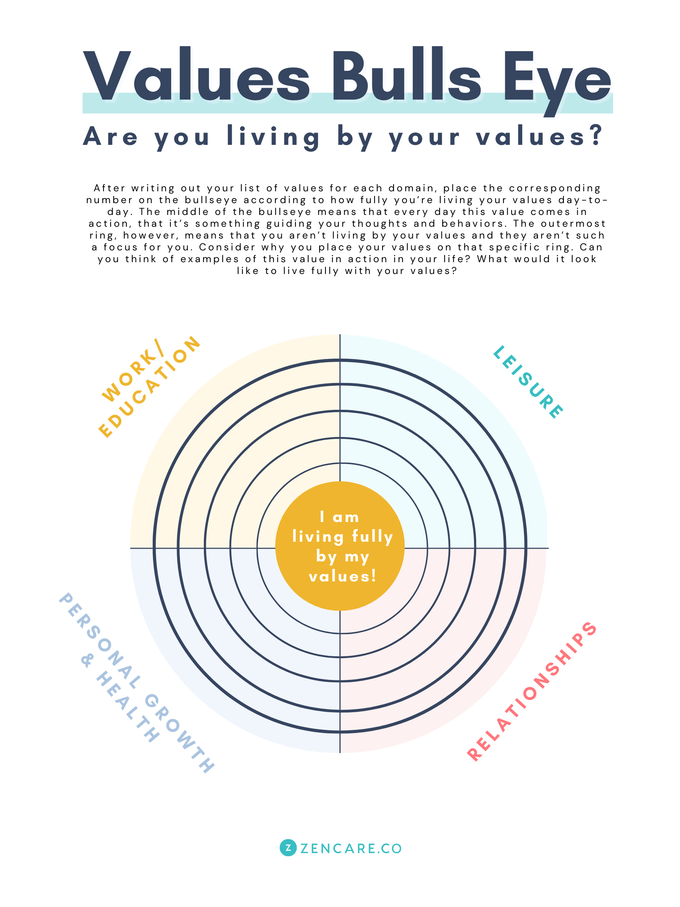
Bullseye

Slide 22
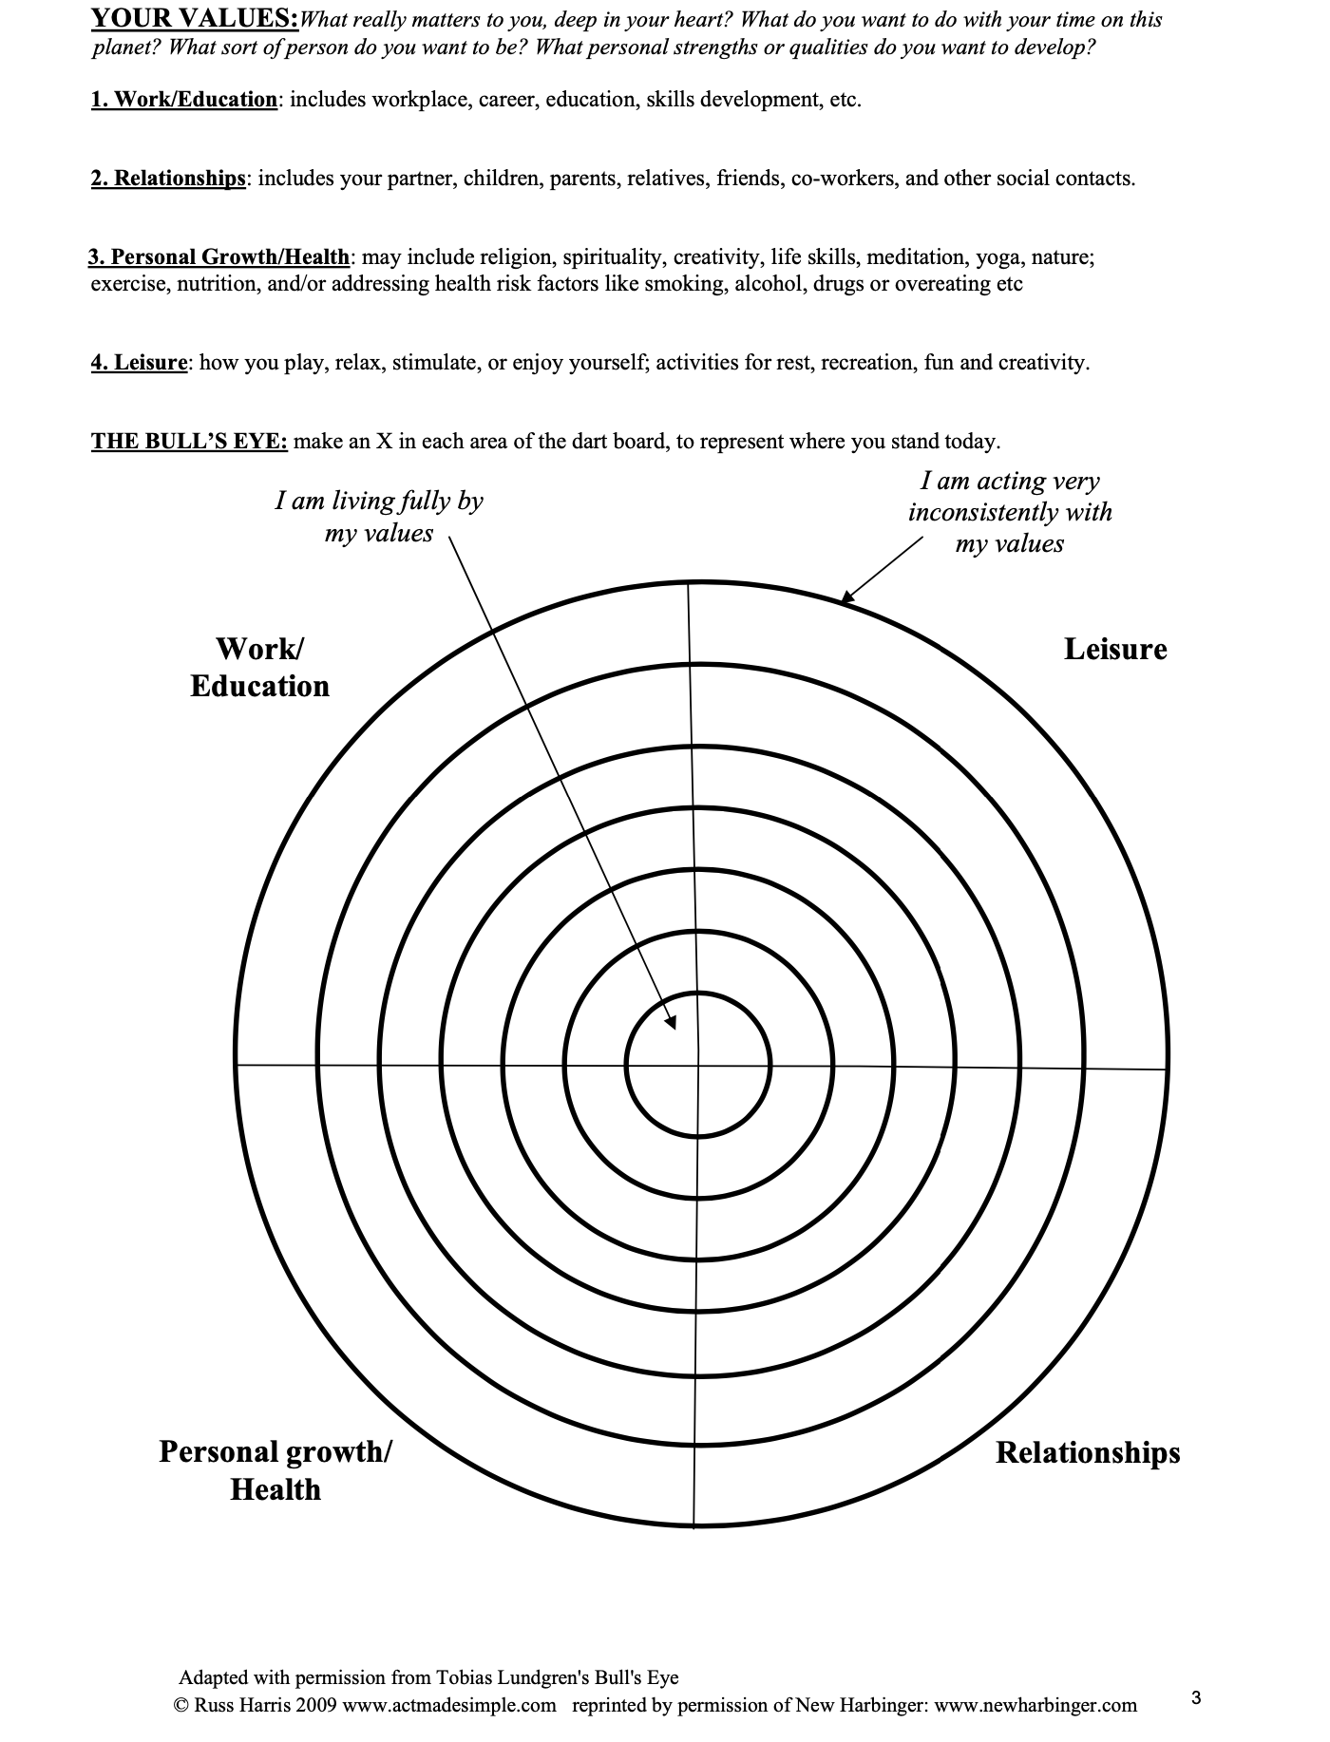
Notes:
Based off of this, what would this client be do really well in? Not so well in?

Slide 23
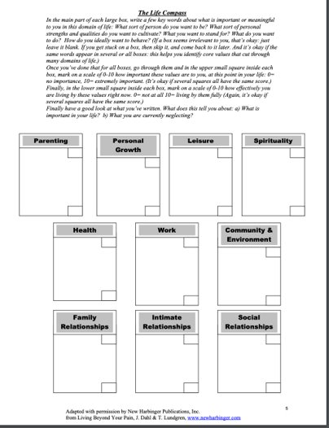
Values Compass

Slide 24
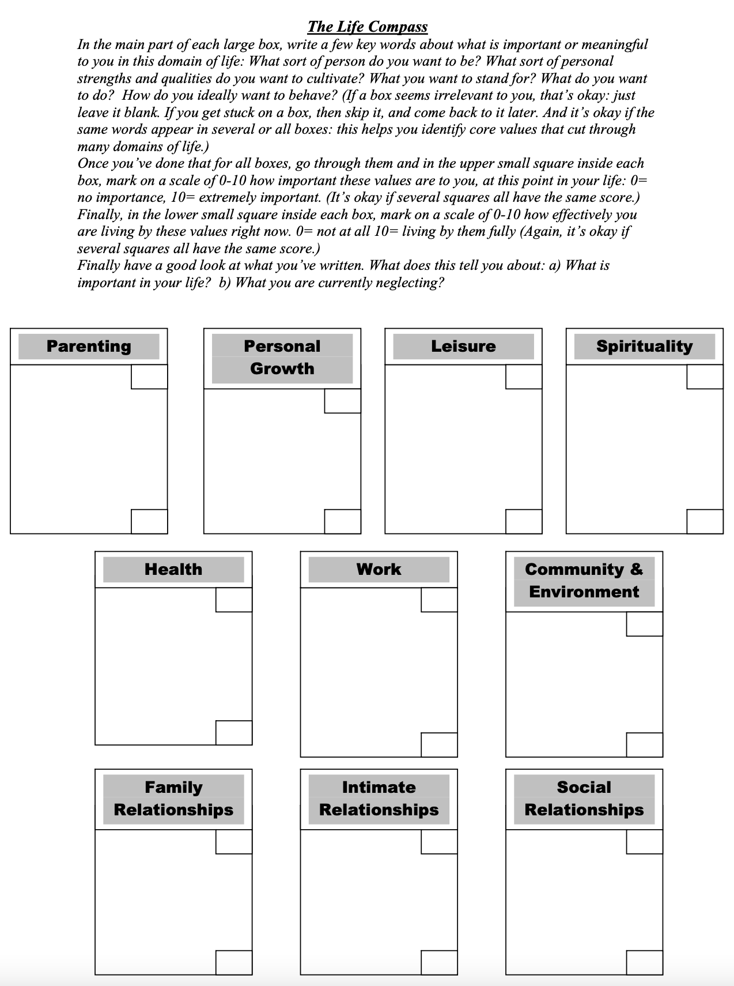
10
7
5
Positive influence
Attend sports games
Provide emotional support
7
Understand my emotions
Be gentle with myself
Understand why I react the way I do
Read more intentionally
Play with my cats more
Cook new meals
Walk a mile
Connect more with creative side
Get outside more
8
2
2
8
9
8
Collaborate with co-workers
Connected to work
9-5, then shut off work email
3
Eat more nutritiously
Better sleep hygiene
Volunteer at animal shelter
Recycle
5
9
8
10
10
Call my friends
Go out more often when asked
Communication
8
Communicate weekly
Understand my history
Forgive
Communicate needs
Show more compassion
Work as a team
6
5
8
Notes:
What seems to be important to this person?
What is this person neglecting? How do we know?

Slide 25
How to create your own bvli
Step 2: Set Goals

Slide 26

Goal Setting
Goal Setting
  Identify 1-2 goals your client can accomplish to work towards their value.
  Identify what must happen for your client to accomplish these goals.

Slide 27

1. Goal Setting
Think of one value.
What goals would allow you to achieve that value in a practical way?
VALUE: Autonomy
Long-Term Goals: Move out of my parent's house and into my own.
Short-Term Goals: Get a job.

Slide 28

Long term goals
Value: Autonomy
What do you hope to achieve later down the road?
Choose one of your long-term goals to work with.
Define specific actions you need to take to achieve that goal.
LONG-TERM GOAL: Move out of parent's house and into my own.
Specific Actions: Get a job, save up money, search for places to live, fill out housing applications.
What do you hope to accomplish in 6 months from this list? Have a job and save up 3 months-worth of rent.

Slide 29

Short term goals
Value: Autonomy
What can we do now?
Choose one of your short-term goals to work with.
Define specific actions you need to take to achieve that goal.
SHORT-TERM GOAL: Get a job.
Specific Actions: Research what jobs are hiring, identify what skills I have, find people who will be my references, identify transportation, apply to jobs, and brush up on interview skills.
What could you do today from this list? I will research jobs near me that are hiring.

Slide 30
S.M.A.R.T Goals
Specific- state exactly what you want to accomplish.
Measurable- can you track progress and measure the outcome?
Attainable- is the goal reasonable enough to accomplish?
Relevant- is the goal worthwhile and will it meet your needs?
Timely- goal should include a time limit.

Slide 31
How to create your own bvli
Step 3: Identify Barriers

Slide 32

identifying Barriers
Look at one specific action that you chose to work toward your short-term goal.
Choose one you have some "psychological resistance" towards doing.
What are some barriers that might come up?
SPECIFIC ACTION: Research jobs that are hiring near me.
BARRIERS: I want to apply to jobs, but I don’t think any will call me back. I don’t know what to search. I have a hard time using a computer.

Slide 33

Identifying Barriers – Questions to ask
  Is any equipment required for your client to accomplish these goals? Is the equipment accessible?
  Does your client need any skills to accomplish these goals? What are they?
  Does your client feel motivated to accomplish these goals? Do they have a routine to help them?
  Does your client have a good support system to help them achieve their goals?
Notes:
Equipment-
Does the equipment allow you to complete your goals as successfully as possible?
At home, are resources available that help you to complete your goals effectively and efficiently?
In the community, are resources available that help you to complete your goals effectively and efficiently?
Are there any other obstacles that are keeping you from completing your goals?
If so, what are they?
Skills-
If so, are you able to perform the skill?
If so, can you perform the skill effectively and efficiently?
What specific skills might you want to work on to get you closer to your goal? Is self-advocacy required to access your goals?
If so, are you able to advocate for this goal?
What specific barriers get in the way of your ability to advocate for this goal?
Motivation-
If so, do you consistently follow that routine?
What causes you to not follow your routine?
Support-
If so, is their support enough to help you reach this goal?
Do you have family or friends who support you to achieve this goal?
Who are they?
If so, is their support enough?
Is there anyone who does not support you to achieve this goal?
If yes, how do you respond to the people who don’t support you?
What kind of support is needed to get you towards your values?

Slide 34

Overcoming Barriers
Acceptance- opening and making room for unwanted private experiences: thoughts, feelings, emotions, memories, urges, images, impulses, and sensations. (Harris, 2019, p. 7)
  Learning to accept negative thoughts/events as part of the human experience to prevent them from discouraging you
Mindful Techniques

Slide 35
How to create your own bvli
Step 4: Self-Management

Slide 36

BVLI Self-Management Techniques
Antecedent Changes
  I.e., Remove any distractions from your environment that may prohibit you from accomplishing your goal
Consequence Changes
  I.e., Reward yourself for taking steps towards your goal
Social Supports
  I.e., Joining support groups at a disability advocacy center
Skills
  I.e., Taking a class on how to create a resume

Slide 37

Committed Actions
Effective actions you can take guided by your values. (Harris, 2019, p. 7)
  AKA: things you can do to bring you closer to your values TODAY
What's this look like?
  Example: Asking your friend to help you navigate a job-hunting site, or research what phrases to use when searching.

Slide 38
STRATEGIES WE HAVE COVERED IN SESSION
Mindfulness, Values, Goals, and Barriers

Slide 39

Questions?

Slide 40
References
5-minute meditation. Headspace. (n.d.). Retrieved April 26, 2022, from https://www.headspace.com/meditation/5-minute-meditation
Harris, R., & Hayes, S. C. (2019). ACT Made Simple (2nd ed.). New Harbinger Publications.
Oscar, P. (2022, January 5). Why Mindfulness Is Important. Psychreg. Retrieved April 28, 2022, from https://www.psychreg.org/why-mindfulness-important/
Worksheets to use with the happiness trap. (n.d.). Retrieved April 29, 2022, from https://thehappinesstrap.com/upimages/The_Complete_Happiness_Trap_Worksheets.pdf.pdf

