Slide 1
Advocating for Change:
From Grassroots to Grasstops
Carrie Scherr, Organizing and Advocacy Specialist
Briana Conley, Public Policy & Youth Services Manager

Slide 2
cy
Changing what is into what should be
Self-Advocacy: change for an individual
Systems Advocacy: large-scale change for a community or institution
Advocacy
Notes:
We’re going to focus on systems advocacy today

Slide 3
Grassroots Advocacy
You don’t win just by being right.
It takes power to make change.
Organizing is about GETTING power.

Slide 4
What is Grassroots Advocacy?
“Basic source of support from the ground up”
Includes organizing, mobilizing, and engaging the public to advocate for themselves
It is driven by the people – Centers for Independent Living are natural forces for grassroots advocacy work
Community Organizing is about winning collective power.

Slide 5

Educate Before You Legislate
You know everything about disability; does your neighbor?
Why is change needed?
The public won’t value something it does not know about
  If it’s not valued, it’s not protected (Medicaid)
Collect, analyze, and share data
Provide leadership and training resources to community members
Keep lawmakers and community leaders informed of policy and/or coalition advancements
Be mindful of education vs advocacy vs lobbying (more on this later)
Notes:
“Policy advocacy is the process of negotiating and mediating a dialogue through which influential networks, opinion leaders, and ultimately, decisionmakers take ownership of your ideas, evidence, and proposals, and subsequently act upon them.”

Slide 6
Organizing a Base
Look for coalition partners
Identify and engage people impacted by the issue
Show up at local events and meet community leaders
  Church events
  Farmer’s markets
  Townhalls
Develop leaders: train and support advocates
Get the word out
  Social media
  Posters & community bulletins
  Tabling at events
  Guest Columns, Letters to the Editor, and Op-Eds

Slide 7

Community Events
City Council meetings, townhalls, citizen forums, etc. all provide an opportunity to connect community members with local decision-makers
  Helps build and maintain a sense of unity and solidarity
    People with disabilities often feel so isolated
Attending meetings and events, especially in a group, raises awareness with both decision-makers and other community members

Slide 8
Personal Stories
Most lawmakers do not understand disability on a personal level
Stories put faces to the issues; they make them “real”
Gathering a story
  Conversation with a purpose
  NOT: an interview, therapy or casual conversation
Crafting a story
  State the issue
  How does the issue impact you/the advocate?
  What are the consequences?
  How would the proposed change improve or harm your/the advocates life?
Stories can be easily spread via letter and email, but large numbers are best
  Sharing in-person can be scary, ask how you can support self-advocates
Notes:
“What consequences have you/the advocate experienced because of the problem?”

Slide 9
Supporting Advocates
Uplift the voices of those most marginalized and impacted
    Offer meeting space and basic supplies
    Help advocates craft stories, publish letters, and recruit others
    Attend meetings and events to ensure your cause has a voice
    Seek out transportation, personal care attendants, and other supports advocates need for participation
    Connect advocates with other coalitions and people advancing their causes

Slide 10
Opinion Leaders
Find and develop champions for your cause through your education efforts
  Elected officials
  Nonprofit and business leaders
  School district leadership
  Union, trade association, and Chamber of Commerce leaders
  Civic and volunteer groups
  Media
Leaders should command respect and be able to speak about confidently about the issue

Slide 11
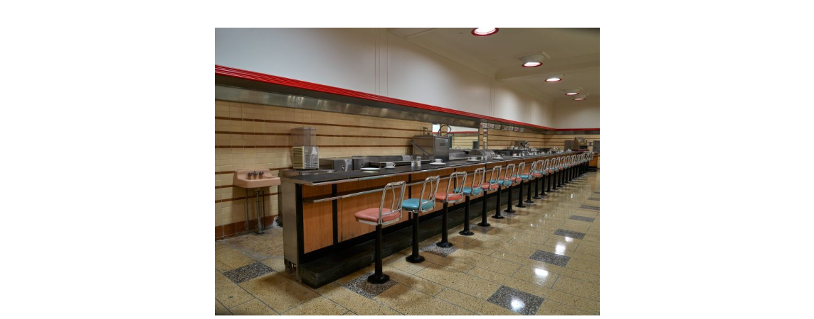
Mobilizing: Elevating the Voices of the Community
Nonviolent Direct Action
  Sit-ins (Stand-in, lay-in)
    504 Sit-In
  Strikes
  Boycotts
  Protests
  Rallies…
Notes:
“Nonviolent direct action seeks to create such a crisis and foster such a tension that a community which has constantly refused to negotiate is forced to confront the issue”
Woolworth's lunch counter in Greensboro, North Carolina (pictured today). The players were four black college students who decided to go into the store, sit at the counter and refuse to move until they were served. (Feb 1st, 1960) This moment at Woolworth's inspired a group of high schoolers in North Carolina to hold a sit-in of their own in a drugstore just a few weeks later.
They became known as the Chapel Hill Nine.
Ultimately the commitment by both protests led to the desegregation of the Woolworth lunch counter on July 25, 1960. Now the site of the International Civil Rights Center and Museum.
Disability history—”504 Sit-In” HEW protests in April 1977. San Fran lasted 21 days.
Mention cross-over between mobilization techniques.

Slide 12
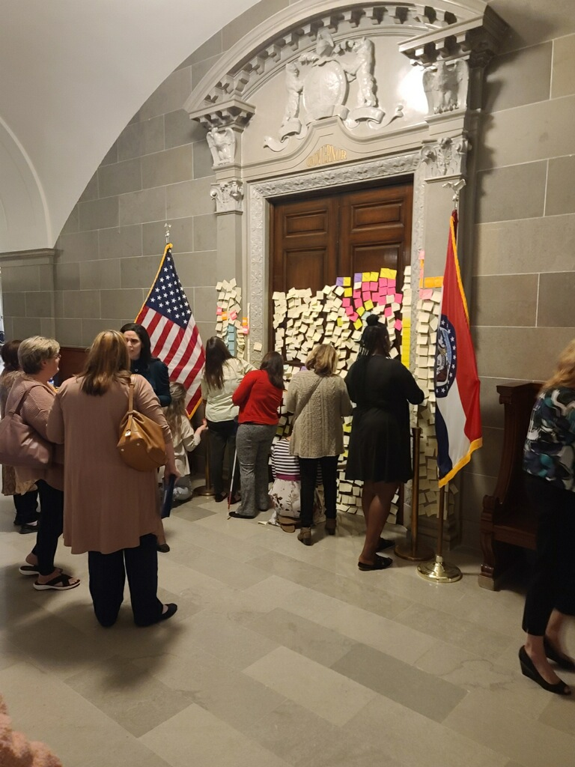
Mobilizing: Elevating the Voices of the Community
Rally
  In the community OR where decision-makers meet
    Disability Rights Legislative Day
    MOCIL Advocacy Day
Creates a disruption: physical, visual, etc.
    Refuse to be ignored
      Shut down streets
      Decorate a space
Notes:
Sometimes rallies are promoted as marches—can be similar to protests when in the community.
-Often feature speakers vs. chanting
The sticky notes with the governor (Pics?)

Slide 13
Mobilizing: Elevating the Voices of the Community
Coordinated social media and letter-writing campaigns (don’t forget a hashtag!)
  #metoo
  #BlackLivesMatter
  #standwithUkraine
  #stay@homewithCDS, #saveCDS
Facebook, Instagram, and Tiktok
  Twitter is especially powerful target lawmakers (@GovParsonMO)
    Tracking movements – Arab Spring
Often work along side direct action
Notes:
#MeToo
It was activist Tarana Burke who used this hashtag for the first time in 2006 to promote ‘empowerment through empathy.’ However, #MeToo went viral in 2017 when actress Alyssa Milano took to Twitter encouraging other women to share their narrative of sexual harassment and assault. It spread like wildfire.
#BlackLivesMatter
This one originated on Facebook through a heartfelt post after the shooting of 17-year-old Trayvon Martin in 2012. The hashtag led to a civil rights movement in the United States and was used 30 million times on Twitter – an average of 17,003 times per day. The movement campaigns against violence towards black people.
Here we’ll talk about the virtual advocacy day in 2021.

Slide 14
Get Out the Vote
Barriers faced by PWD and consequences
  Lack of curbside voting at polling sites
  Inaccessible voting machines
  Inaccessible polling places
  Laws that restrict early and absentee voting
  Laws that restrict voting assistance
Voting is the most basic, fundamental way to pursue change
  Votes are the leverage communities have over their elected officials—How to ensure they work for you.
How to overcome barriers:
  Missouri Protection and Advocacy—connect with local representative
Cannot tell people HOW to vote, except ballot initiatives

Slide 15
Grasstops Advocacy

Slide 16
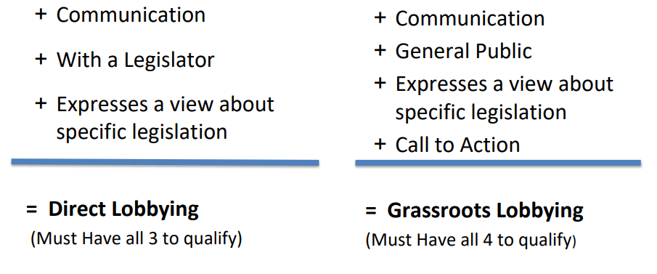
But What About Lobbying?
501(c)3s may lobby freely within generous federal limits; consult provided resources for specific guidelines
May not support or oppose any candidate for public office
Notes:
Lobbying is the practice of influencing decisions made by the government and it is divided into 2 categories…
DIRECT LOBBYING When you state your position on specific legislation to legislators or others who participate in the formulation of legislation
GRASSROOTS LOBBYING When you state your position to the general public and ask the general public to contact legislators or other decision makers who participate in the formulation of legislation
Both definitions include Communication. What is that? Is it a letter, phone call, visit, or a chance meeting in a grocery store? It is Anything used to convey a message

Slide 17
Who is a Legislator?
Legislators are not…
Legislators include…
Members of local, state, federal and international legislative bodies (e.g. City Council members, County Commissioners, State and Federal Senators and Representatives)
Legislative staffers
Judges
Executive branch officials (including agency and department officials) unless they participate in the formulation of legislation and your principal purpose in communicating with them is to influence legislation
Notes:
The federal tax code defines a legislator as any member or employee of a legislative body or any government official or employee who may participate in the formulation of legislation.

Slide 18
Who is a Legislator? (cont.)
Legislators are not…
Legislators include…
Other government employees (e.g. executive branch or administrative officials or staff) who participate in the formulation of legislation, but only when the principal purpose of your communication with them is to influence legislation
Members of the general public when voting on a ballot measure
School Board Members
Housing Authority Commissioners
Zoning Board Members
Members of other similar local special purpose bodies
Members of the public, other than when they vote on ballot measures
Notes:
The federal tax code defines a legislator as any member or employee of a legislative body or any government official or employee who may participate in the formulation of legislation.

Slide 19
What is a Call to Action?
Urging the public to contact a legislator
Providing an address or means to contact a legislator
Identifying key legislators on a particular issue

Slide 20

How Does a Bill Become a Law?
Notes:
So now that we know what lobbying is and that we can do it, lets jump into the legislative process or rather…how a bill becomes a law.

Slide 21
Legislative Process – Introducing a Bill
Find a Sponsor
  Politics: party, seniority, district represented, appointments
  Who is well-versed in the subject?
  Voting record?
Introducing the Bill
  Written by legislator, a member of the Committee on Legislative Research at a lawmaker’s request, or YOU
  Prefiling begins December 1st; filing deadline is the 60th legislative day of session
  After a bill is introduced, it’s assigned a number (SB or HB) and read by title by the S or H reading clerk (1st Reading)
  It is placed on the calendar for 2nd Reading and committee assignment

Slide 22
Legislative Process –
Off to Committee
Public Hearing
  Bill is presented to the assigned committee by the sponsor
  Proponents and opponents are heard in the same hearing – may testify for informational purposes
  After the hearing, a bill may be voted on in ‘executive session’
    Do pass/Do not pass
    Pass with amendments attached to the bill
    Return the bill without recommendation
    Substitute bill language
    No report

Slide 23
Perfection
After a bill is passed out of committee with or without amendments or subs, it’s placed on the perfection calendar
Committee amendments and substitutes are debated and voted on first, then the general assembly can propose changes
Once all amendments are considered, it is declared perfected and reprinted

Slide 24
Passing a Bill
After perfection, it’s placed on the calendar for third reading and final passage
Any member may make a case for or against the bill, but no amendments can be offered
At the end of the debate, a recorded vote is taken. To pass, 18 votes in the Senate or 82 in the House

Slide 25
Passing a Bill
(cont.)
Reading, committee assignment, hearing, reported, 3rd Read and approved.
Conference Committee: comprised of House and Senate members charged with drafting a compromise for approval by both chambers
Truly agreed to and finally passed – the bill is on its way to the governor’s desk

Slide 26
Governor’s Signature
Governor has 15 days to act during session, 45 days if the legislature is adjourned for 30 or more days
If he signs it, it’s sent to the Office of the Secretary of State
If he vetoes, it’s returned to the house of origin; 2/3 vote of both chambers required to override a veto
If the governor does not act on a bill within the time limits, it will become law as though he signed it
Law goes into effect 90 days after signing, the date the bill specifies, or in the case of an emergency clause, immediately

Slide 27
Budget Process
Governor releases his recommended budget within 30 days of the start of legislative session
Budget bills are referred to the House Budget Committee; subcommittees work on specific department budgets and present them to the full committee
Once the full committee approves, the budget is presented to the entire House for passage

Slide 28
Budget Process
Bills move to Senate Appropriations Committee for amendments; after Committee passage, the bills are presented to entire Senate
Conference committees are formed to address differences between H and S budget and present the reconciliation for approval by the general assembly
Governor has until July 1st to veto, sign, line-item veto, or allow them to become law
Veto session in September to consider overrides

Slide 29
What Can I Do?
Seek out bill sponsorship
Ask the H Speaker or S pro tem for a committee assignment (and if you have a preference, which committee!)
Ask the committee chair for a hearing
Testify in the hearing
Contact committee members individually to educate them on the measure

Slide 30
What Can I Do? (Cont.)
Ask the committee chair to ‘exec’ or vote on a bill
Ask the H Speaker or S pro tem to place a bill on the perfection calendar
Contact members of the general assembly for support/opposition
Contact the governor for signature or veto
Repeat in the other house
Invite and engage fellow advocates at every step!

Slide 31
Communicating With Lawmakers
They work for you
Phone calls, usually speak with staff
Emails, works best from a group of people
Legislative meetings – In-person meetings are the most impactful
  Make an appointment, be on time, and be prepared
  Explain the issue and how it impacts you
  Ask for lawmaker’s perspective
  Offer to be a resource
  Have professional, concise leave-behinds
  Say thank you and follow up

Slide 32
Messaging
Representation
  Are you a constituent or do you have a significant business interest in the district?
  If not, can you demonstrate your issue significantly impacts people in that district?
Legislative record
  Bill sponsorship
  Voting
Personal connection to the issue
Committee assignment
Party politics

Slide 33
Thank You!

