Slide 1
CARF
Can CARF Benefit Your CIL?

Slide 2
Possible Funding Opportunities
VR CRP Contracts
DMH Contracts
Independent Funders & Grant Proposals

Slide 3
Aspire to Excellence
Aspire to Excellence section is required for all organizations seeking accreditation.

Slide 4
Aspire to Excellence
Leadership
Key Areas Addressed
■ Leadership structure and responsibilities ■ Person-centered philosophy ■ Organizational guidance ■ Leadership accessibility ■ Cultural competency and diversity ■ Corporate responsibility ■ Organizational fundraising, if applicable

Slide 5
Aspire to Excellence
Governance (optional)
Key Areas Addressed
■ Written Policies for the Board of Directors ■ Documentation of self assessments ■ Records of conflict of interests & ethics ■ Samples of meeting material
■ Documentation of leadership reviews
■ Board meeting agendas and minutes

Slide 6
Aspire to Excellence
Strategic Planning
Key Areas Addressed
■ Environmental considerations ■ Strategic plan development, implementation, and periodic review

Slide 7
Aspire to Excellence
Input from Persons Served and Other Stakeholders
Key Areas Addressed
■ Collection of input ■ Integration of input into business practices and planning

Slide 8
Aspire to Excellence
Legal Requirements
Key Areas Addressed
■ Compliance with obligations ■ Response to legal action ■ Confidentiality and security of records

Slide 9
Aspire to Excellence
Financial Planning and Management
Key Areas Addressed
■ Budgets ■ Review of financial results and relevant factors ■ Fiscal policies and procedures ■ Reviews of bills for services and fee structures, if applicable ■ Safeguarding funds of persons served, if applicable ■ Review/audit of financial statements

Slide 10
Aspire to Excellence
Risk Management
Key Areas Addressed
■ Risk management plan implementation and periodic review ■ Adequate insurance coverage ■ Media relations and social media procedures ■ Reviews of contract services

Slide 11
Aspire to Excellence
Health and Safety
Key Areas Addressed
■ Competency-based training on safety procedures and practices ■ Emergency procedures ■ Access to first aid and emergency information ■ Critical incidents ■ Infection control ■ Health and safety inspections

Slide 12
Aspire to Excellence
Workforce Development and Management
Key Areas Addressed
■ Composition of workforce ■ Ongoing workforce planning ■ Verification of background/credentials/fitness for duty ■ Workforce engagement and development ■ Performance appraisals ■ Succession planning

Slide 13
Aspire to Excellence
Technology
Key Areas Addressed
■ Ongoing assessment of technology and data use ■ Technology and system plan implementation and periodic review ■ Technology policies and procedures ■ Written procedures for the use of information and communication technologies (ICT) in service delivery, if applicable ■ ICT instruction and training, if applicable ■ Access to ICT information and assistance, if applicable ■ Maintenance of ICT equipment, if applicable ■ Emergency procedures that address unique aspects of service delivery via ICT, if applicable

Slide 14
Aspire to Excellence
Rights of Persons Served
Key Areas Addressed
■ Policies that promote rights of persons served ■ Communication of rights to persons served ■ Formal complaints by persons served

Slide 15
Aspire to Excellence
Accessibility
Key Areas Addressed
■ Assessment of accessibility needs and identification of barriers ■ Accessibility plan implementation and periodic review ■ Requests for reasonable accommodations

Slide 16
Aspire to Excellence
Performance Measurement and Management
Key Areas Addressed
■ Leadership accountability for performance measurement and management ■ Identification of gaps and opportunities related to performance measurement and management ■ Input from stakeholders ■ Performance measurement and management plan ■ Identification of objectives and performance indicators for service delivery ■ Identification of objectives and performance indicators for priority business functions ■ Personnel training on performance measurement and management

Slide 17
Aspire to Excellence
Performance Improvement
Key Areas Addressed
■ Analysis of service delivery performance ■ Analysis of business function performance ■ Identification of areas needing performance improvement ■ Implementation of action plans ■ Use of performance information to improve program/service quality and make decisions ■ Communication of performance information

Slide 18
Quality Individualized Services & Supports
Quality Individualized Services & Supports section is required for all organizations seeking accreditation.
Some areas may not apply to an organization, depending on programs and services.

Slide 19
Quality Individualized Services & Supports
Program/Service Structure
Key Areas Addressed
■ Services are person centered and individualized ■ Persons are given information about the organization’s purposes and ability to address desired outcomes ■ Documented scope of services shared with stakeholders ■ Service delivery based on accepted field practices ■ Communication for effective service delivery ■ Entrance/exit/transition criteria

Slide 20
Quality Individualized Services & Supports
Individual-Centered Service Planning, Design, and Delivery
Key Areas Addressed
■ Services are person centered and individualized ■ Persons are given information about the organization’s purposes and ability to address desired outcomes

Slide 21
Quality Individualized Services & Supports
Medication Monitoring and Management
Key Areas Addressed
■ Current, complete records of medications used by persons served ■ Written procedures for storage and safe handling of medications ■ Educational resources and advocacy for persons served in decision making ■ Physician review of medication use ■ Training and education for persons served regarding medications

Slide 22
Quality Individualized Services & Supports
Employment Services Principle Standards
Key Areas Addressed
■ Goals of the persons served ■ Community resources available ■ Personnel needs of local employers ■ Economic trends in the local employment sector

Slide 23
Quality Individualized Services & Supports
Community Services Principle Standards
Key Areas Addressed
■ Access to community resources and services ■ Enhanced quality of life ■ Community inclusion ■ Community participation

Slide 24
Quality Individualized Services & Supports
Service Delivery Using Information & Communication Technology
Key Areas Addressed
■ Written Policies for the use of information & communication technologies ■ Documentation of Training ■ Records of Maintenance of equipment ■ Emergency Procedures for service delivery
■ Individualized service plans

Slide 25
Employment and Community Services Standards Manual

Slide 26
Employment and Community Services Standards Manual

Slide 27
Required Written Documentation

Slide 28
Required Written Documentation

Slide 29
Required Written Documentation

Slide 30
Required Written Documentation

Slide 31
Required Written Documentation

Slide 32
Required Written Documentation

Slide 33
Required Written Documentation

Slide 34
Required Written Documentation

Slide 35
Required Written Documentation

Slide 36
Required Written Documentation

Slide 37
Required Written Documentation

Slide 38
Required Written Documentation

Slide 39
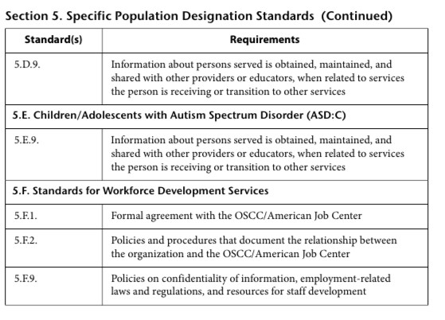
Required Written Documentation

Slide 40
Required Trainings

Slide 41
Required Trainings

Slide 42
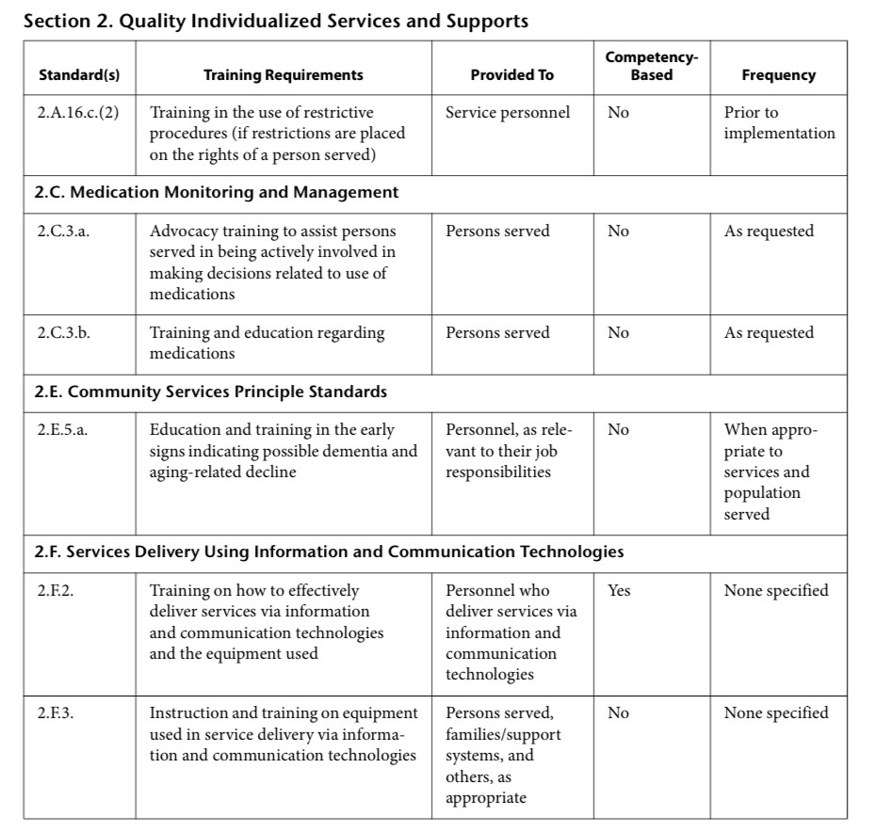
Required Trainings

Slide 43
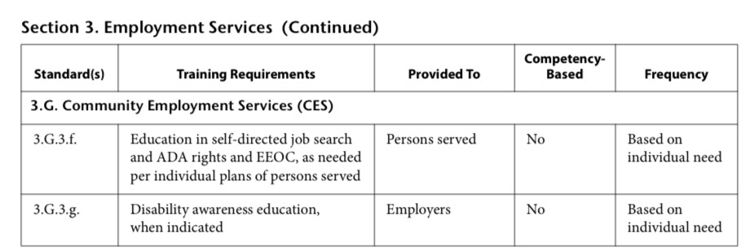
Required Trainings

Slide 44
Required Trainings

Slide 45
Required Trainings

Slide 46
Required Trainings

Slide 47
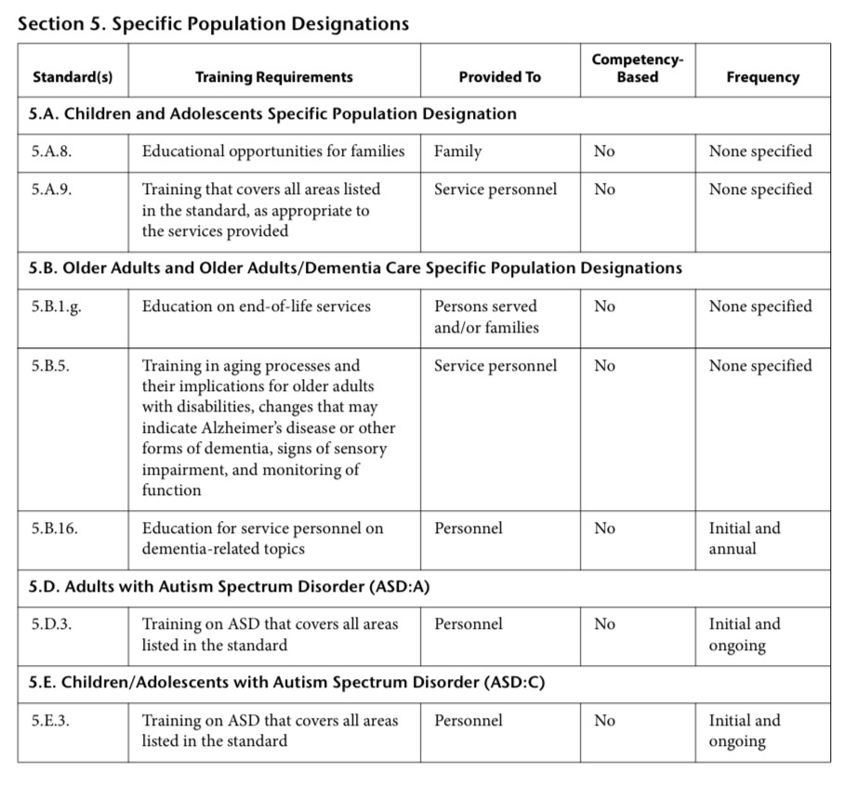
Required Trainings

Slide 48
Next Steps
Carf.org
Connect with your Resource Specialist
Determine what Standards Manual(s)
Get the Standards Manual
Enroll in CARF 101 &/or 202 classes
Prepare for Survey
Apply for Accreditation

Slide 49
Questions?

